Slide 1

Seminar 6: Church Planning
Developing a Purpose Driven Model for Youth Ministry in the Local Church

Slide 2
SEMINAR OBJECTIVES
Assist the leader to plan a yearly model for the youth of the church.
How to implement the key AYM objectives of the local church within the four dynamic areas that grew the early New Testament church (growth, worship, community, and service)
Stress the fact that AYM primarily focuses on Jesus, the Master Youth Leader.
How to annually the major youth objectives of their conference, union, and division.
assist the leader to implement the current re-visioning of the GC AYM department to save our youth through the initiatives of “Reach In, Reach Out, Reach Up”.

Slide 3
FOLLOWING JESUS’ PURPOSE
The youth leader needs to understand that it all begins with a focus on Jesus as the Master Leader who has given us a basic model to follow that transcends time. Christ’s life on earth gives the true model to save lost youth and usher them into the kingdom of God, modeling them into disciples of Christ, while living in this sinful world.

Slide 4
Christ’s Method- The Best
Christ’s method of fulfilling His mission on earth was very purposeful and practical. Likewise, there is a need for youth leaders to become purposeful in the way we lead our youth. Becoming purposeful involves a sense of urgency in the way we live and work. What made Jesus successful was His connection with heaven to carry out His mission. The promise Jesus gave to His disciples before His accession to heaven is exactly the same promise youth leaders can accept today as His last day disciples hastening His soon coming.
“But you will receive power when the Holy Spirit comes on you; and you
be my witnesses in Jerusalem, and in all Judea and Samaria, and to
the ends of the earth.” (Acts 1:8)

Slide 5
FOUR DYNAMIC BIBLICAL FORCES
Luke 6: 12-17 A Day in the Life of Jesus
Verse 12: “He went out on the mountainside to pray.” He spent the first hours of His day in communion with the Father. We will identify that as PERSONAL SPIRITUALITY/DISCIPLESHIP
Verse 13: “When the morning came he called his disciples to him and chose twelve of them.” Strengthened by His communion with the Father, He next sought the company of His twelve disciples. The Christian was never meant to live in isolation; God is community. Jesus showed us the way to COMMUNITY
Verse 17: “...he went down with them . . . and a great number of people . . . had come to hear him and be healed.” Together, Jesus and His disciples spent the rest of the day in service, in the proclamation and demonstration of the Kingdom of God. This is true SERVICE AND MISSION.
Acts 2:42-47 A Day in the Lives of the Early Christians

Slide 6
ACTS 2:42-47
FOUR DYNAMIC BIBLICAL FORCES

Slide 7
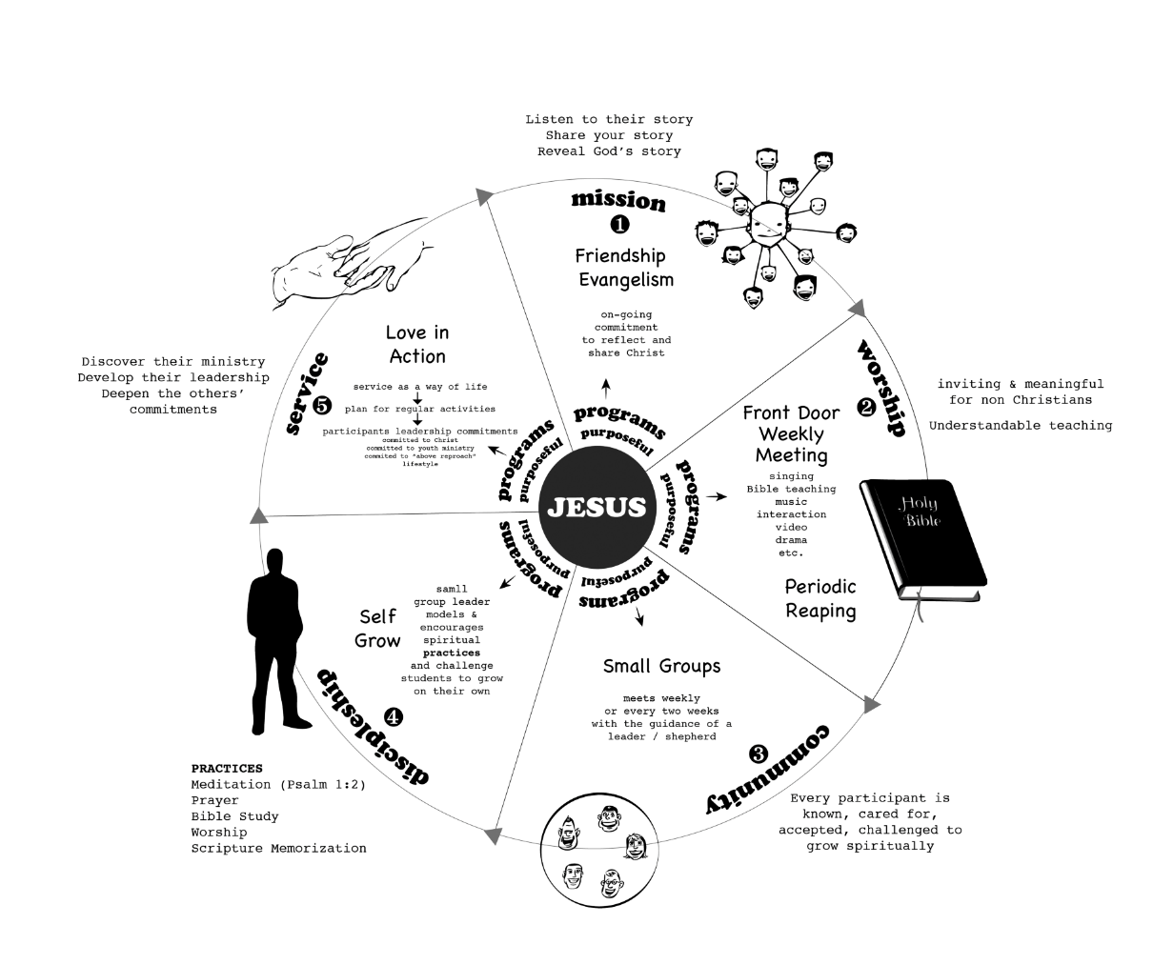
Youth Ministry Programming Cycle Model for the Local church

Slide 8
How the AYM Model is Applied
The Meeting Model: Plan for your weekly meeting to be your Front Door for Evangelism
Consider your regular AY meeting, youth group, or small group meeting as an event that will have multiple targets:
  Minister to non-Adventist youth
  Minister to Adventist youth who are nominal
  Minister to Adventist youth who have made a commitment to Jesus
While your Message and Method are clearly defined and our three Foundations are firmly in place, these targets will define and determine the nature of your programming.

Slide 9
Elements of the AYM meetings:
Relevant themes; develop a sense of belonging; make it attractive; engage the participants; use a variety of methods throughout the year.
We live in the age of technology and wherever possible use technology in the context of your meetings.
However, always remember the foundations of your ministry and always be purposeful in your programming.
Core elements that are generally present in whatever type of meeting you choose to run:
  Creative and not repetitive
  Relationally based and warm
  Grounded in practical Bible teaching relevant to the theme of the day
  Based on involvement and interaction
  Anointed in prayer

Slide 10
Meetings are generally constructed around a THEME and contain a number of elements that include welcome, prayer, songs, ice breakers, quiz, interaction, role, etc.; however, there is a main segment that can be presented in a number of different ways, such as:
Formal presentation by someone who has some insights on the theme
Debate on the theme
Theme presented to be discussed in a small group followed by reporting and summing up

Slide 11
4. A musical meeting based on a theme (different songs to be presented and discussed
5. A theme to be role-played by different groups followed by discussions
6. A presentation of a drama

Slide 12
Developing community:
An essential foundation of your youth ministry
Growing into Deeper Spirituality:
Discipleship
Youth Ministry begins and ends with Service and Mission

Slide 13
TOTAL YOUTH INVOLVEMENT –Pass it On
Reach Up/Reach In/Reach Across
Reach Up (“For the love of Christ compels us.” 2 Cor. 5:14) Spiritual Renewal through:
Worship
Prayer
Meditation (Ps. 1:2)
Spirit of Prophecy
Bible study (1 Tim. 3:16)
Other Bible Practices

Slide 14
Reach In
Reach In (“By this everyone shall know that you are my disciples if we love one another” Jn. 13:35). Church Community through:
Small Groups
Adventurers
Pathfinders
Ambassadors
Teen Ministries
Supportive Groups
Public Campus Ministries
Young Adults
(Involving Relational/Incarnational/Intergenerational)

Slide 15
Reach Out
Reach Out (The Gospel to all the World in my Generation… tell the World). Mission Service through:
Public Evangelism
Small Groups
Personal Evangelism (My Story/His Story/Our Story)
Reclaim
Adventist Volunteer Services
Service Projects
Church Planting
Web Evangelism

Slide 16
Jesus - The Center of Love and Forgiveness
Jesus is our Center of Empowerment: “As the father has sent me, I am sending you … Receive the Holy Spirit.” (Jn. 17:20-22)
His Purpose – “To Proclaim the Good News of the Kingdom of God.” Luke. 4:43 (NIV)
His Message – “The Kingdom of God has come near.”
(Mk. 1:14-15)
His Method – “But you will receive power when the Holy Spirit comes upon you.”(Acts 1:8)
His Prayer – “That all of them may be one.”
(John. 17:20-21)

Slide 17
See the three principles clearly in His own earthly life:
Luke 6: 12-19 (NIV)
Reach Up – vs. 12 “One of those days Jesus went out to a mountainside to pray and SPENT THE NIGHT PRAYING TO GOD.”
Reach In – vs. 13 When morning came, he called HIS DISCIPLES TO HIM AND CHOSE TWELVE of them, whom he also designated apostles: 14 Simon (whom he named Peter), his brother Andrew, James, John, Philip, Bartholomew, 15 Matthew, Thomas, James son of Alphaeus, Simon who was called the Zealot, 16 Judas son of James, and Judas Iscariot, who became a traitor.
Reach Out – vs. 17 HE WENT DOWN WITH THEM and stood on a level place. A large crowd of his disciples was there and a great number of people from all over Judea, from Jerusalem, and from the coastal region around Tyre and Sidon, 18 who had come TO HEAR HIM AND TO BE HEALED OF THEIR DISEASES. Those troubled by impure spirits were cured, 19 and the people all tried to touch him, because power was coming from him and healing them all.

Slide 18

The AYM Model

Slide 19
AYM
Our Mission: To lead young people in a saving relationship with Jesus and help them embrace his call to discipleship.
Our Motto: The love of Christ compels us.
Our Aim: The Advent Message to all the world in my generation.
Our Theme (2016-2020): Pass It On

Slide 20
Be strong and very courageous. Be careful to obey all the law my servant Moses gave you; do not turn from it to the right or to the left, that you may be successful wherever you go. Keep this Book of the Law always on your lips; meditate on it day and night, so that you may be careful to do everything written in it. Then you will be prosperous and successful. Have I not commanded you? Be strong and courageous. Do not be afraid; do not be discouraged, for the Lord your God will be with you wherever you go.
—Joshua 1:7-9

