Slide 1

Seminar 1: Introduction to Youth Ministry
Understanding the History, Philosophy, Vision, Objectives
and Structure of Adventist Youth Ministry

Slide 2
Seminar 1: Introduction to Youth Ministry
Organizational Structure of Adventist Church
History of Adventist Youth Ministries (AYM)
History of the JMV Classes - AY/AJY classwork
Name Changes of Department
Philosophy and Mission of AYM
Vision/Mission
Objectives of AYM
AYM Age Grouping
Organizational Chart
Ideals of the AYM

Slide 3
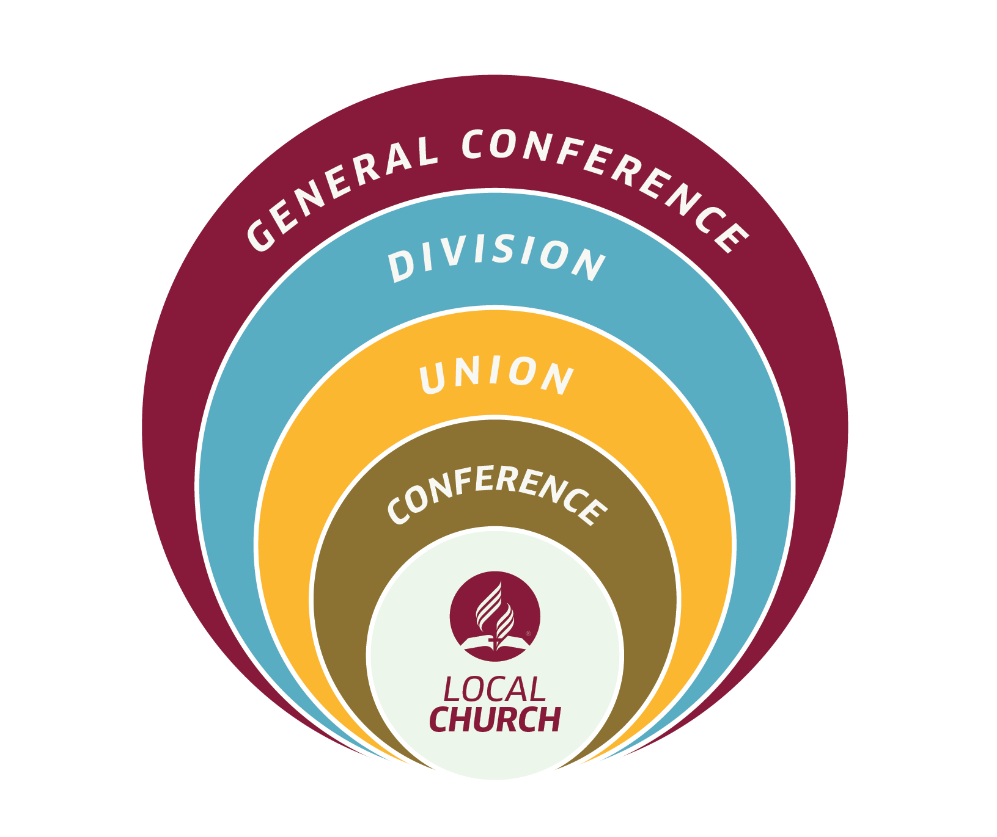
ORGANISATIONAL STRUCTURE

Slide 4
HISTORY OF ADVENTIST YOUTH MINISTRIES
The first youth organization in the local Seventh-day Adventist church began in 1879 when two young boys, Harry Fenner, (16 years) and Luther Warren, (14 years)
1901 the General Conference officially voted into existence the young people’s organization, under the Sabbath school department.
1907 General Conference Council approved the formation of a Youth Department within the General Conference where elder M. E. Kern was elected the first GC Youth Director.
1907- name finally agreed upon was “Seventh-day Adventist Young People’s Department of Missionary Volunteers.”

Slide 5
History of the JMV Classes - AY/AJY classwork
1947 1st North American Division youth congress- San Francisco, E. W. Dunbar as world youth director,
1969 the first World Youth Congress was held in Zurich, Switzerland,
Theodore Lucas as world youth director.
The Character Classics Reading Plan (later changed to Encounter) was adopted in 1946.
1946- John Hancock organized the first conference-sponsored Pathfinder Club in Southeastern California Conference at Riverside, California.

Slide 6
History of the JMV Classes - AY/AJY classwork
1950 General Conference adopted the Pathfinder Club organization.
1922 -General Conference session- introduced the work of the Junior Missionary Volunteer Society - “progressive classwork.”
1927 - General Conference Autumn Council, enlarged the Progressive Classwork to include three classes, Friend, Companion and Comrade, for junior youth and one class for senior youth and adults
1928 - MV Honors and the Master Comrade Class—developed for senior youth and adults “who desired to prepare for junior leadership.” The first Master Comrade (later called Master Guide) was invested in 1931.

Slide 7
NAME CHANGES FOR THE DEPARTMENT OF ADVENTIST YOUTH MINISTRIES
1907 as “Seventh-day Adventist Young People’s Department” (known as MV – Missionary Volunteers), changed to “Youth Department of Missionary Volunteers” in 1972.
1978 the department name changed to “Adventist Youth” commonly known as AY department
2005 General Conference Session voted the name, “Youth Ministries Department” which encompassed all the three age levels of youth ministry (e. g. Adventure Club, Pathfinder Club, and Senior (Young Adult) Youth Society.
2015 General Conference session further adopted a name change to “Adventist Youth Ministries” (AYM).

Slide 8
PHILOSOPHY AND MISSION OF ADVENTIST YOUTH MINISTRIES (AYM)
The basic philosophy of AYM is securely grounded in the Biblical revelation of who Jesus Christ
Not only did Jesus show the Father’s immense love for humanity through “servant leadership” (Jn. 13:1-17), but He also showed them how to receive power to overcome sin in this world through the power of the Holy Spirit. Jesus showed His disciples how to live a life in the Spirit and become disciples of the Kingdom of God in a sinful world.
It is Jesus who is our model of “incarnational ministry” (e. g. allowing the character of Jesus and the power of Holy Spirit to be revealed in the life of our young people, thus becoming true disciples of His in this generation

Slide 9
The youth are the objects of Satan’s special attacks; but kindness, courtesy, and the sympathy which flows from a heart filled with love to Jesus, will gain their confidence, and save them from many a snare of the enemy . . . There must be more study given to the problem of how to deal with the youth, more earnest prayer for the wisdom that is needed in dealing with minds . . . We should seek to enter into the feelings of the youth, sympathizing with them in their joys and sorrows, their conflicts and victories . . . We must meet them where they are if we would keep them . . . let us remember the claim of God upon us to make the path to heaven bright and attractive.
(Ellen White, Gospel Workers (Washington, D. C.: Review & Herald, 1948), 207-212, emphasis added.)

Slide 10
MISSION AND VISION
"To lead young people into a saving relationship with Jesus Christ and help them embrace His call to discipleship"

Slide 11
MISSION/VISION
“Youth ministry built on this model (life and ministry of Jesus) seeks to meet young people where they are, and to offer them pastoral care not only as spiritual guides, but also as counselors and friends, fellow pilgrims on a similar spiritual journey. With Jesus as our model we are called to ministry, a personal and relational ministry, that will involve a good deal of one to one time.” (Gane: 54-55) (Building Youth Ministries-A Foundational Guide).

Slide 12
MISSION/VISION
The mission of Adventist Youth Ministries is basically one of: salvation, discipleship, and service, which is grounded deep in the biblical model of the early church’s mission in the book of Acts 2:42-47. There are four dynamic forces that undergirded the growth of the early church: grace, worship, community, service. These four dynamic forces are strongly interwoven into the work and mission of the youth department. It is a biblical ministry where the AYM Pledge is carried out, by the youth, to the youth, for the youth, with the youth.

Slide 13
Objectives of the AYM
Understanding of the objectives of the AYM is of utmost importance. Ellen G. White said ;- Signs of the Times, May 29, 1893. Here she set forth the objectives for the department:
  To train the youth to work for other youth,
  To recruit the youth to help their church and “those who profess to be Sabbath-keepers”;
  To work “for those who are not of our faith”
In seeking to reach these objectives, the youth are called upon:
to pray together and study the Word together
to fellowship together in Christian social interaction
to act together in small groups to carry out well-laid plans for witnessing
to develop tact and skill and talent in service to Jesus
to encourage one another in spiritual growth

Slide 14
In 1907, at the General Conference Council at Gland, Switzerland, M. E. Kern, the first elected youth director for the department, set out the following objectives
  To raise the level of the devotional life of the young person
  To lift up the standard of attainment of the youth
  To educate and train youth for service
  To provide opportunities for outreach and service
  To teach the principles of stewardship
  To lead youth to discover their individual worth and develop and discover their spiritual gifts (GC Pastor’s and Elder’s Handbook for Youth Ministry, 2002:13)

Slide 15
Structure of Adventist Youth Ministries (AYM)
Junior Youth Ministries (JYM): Ages: 04-15 includes:
Adventurer Ministry (ages 04-09)
Strengthens parent-child relationships by providing weekly activities tuned into the psychological needs of this age group and also giving parents opportunities for learning parenting skills and enjoying special activities with their children.
Pathfinder Ministry (PF) (ages 10-15)
Assists in the critical years of identity formation and adolescent transformation for boys and girls. Offering intentional activities of service and mission, Pathfinders guides the energy of young people to focus on their community.

Slide 16
Structure of Adventist Youth Ministries (AYM)
Senior Youth Ministries (SYM): Ages: 16-30+ includes:
Ambassador Ministry (ages 16-21)
Designed to strengthen the current senior youth ministry of the church. It
challenges them to experience and share a personal relationship with Jesus;
helps them develop a lifestyle that is consistent with their belief system;
provides training in diverse vocational interests; and provides them with a
safe environment for the wholesome development of lifelong friendships.
Young Adult Ministry (ages 22-30+)
Engages the vitality of a generation sharing their living relationship with Jesus
in work and life, recognizing the diverse demographic from those in education
or work, married or single, and possibly parents. This critical ministry embraces empowering young adults for leadership, mentoring, evangelism, and healthy lives.

Slide 18

Our colors represent our mission. We’re bold, bright, and confident.
Blue represents Heaven. Blue is the color of the sky and a reminder of the heavenly realm
Scarlet in the Bible represents blood and redemption. The life of man is in the blood (Leviticus 17:11) and Christ’s blood atonement is necessary for the redemption of man.
Green represents growing and blooming where one is planted. It is representative of a Christian life that produces good fruit and finds rest in Christ.
White represents righteousness because of its purity of color and light. It points to the Righteous One and the righteousness He imputes to all who come to Him in faith

Slide 19

Red reminds us of Christ and His sacrifice. "For God so loved the world, that he gave his only begotten Son, that whosoever believeth in him should not perish, but have everlasting life” (John 3:16). "Present your bodies a living sacrifice, holy, acceptable unto God" (Rom. 12: 1).
Three sides represent completeness of the Trinity -- Father, Son, Holy Spirit. •Tripod of education: Mental Crafts and Honors, Physical Campouts, work bee, health focus Spiritual Outreach and personal spiritual development.
Gold represents excellence "I counsel thee to buy of me gold tried in the fire, that thou mayest be rich" (Rev. 3:18). The Pathfinder Club has high standards to help build strong character for the kingdom of heaven.

Slide 20
Shield represents protection. In the Scripture God is often called the shield of His people. (Protection) "Fear not... I am thy shield" (Gen. 15:1) "Above all, taking the shield of faith, wherewith ye shall be able to quench all the fiery darts of the wicked." (Eph. 6:16)
White represents purity. "He that overcometh, the same shall be clothed in white raiment" (Rev. 3:5). We desire to have the purity and righteousness of Christ's life in our lives.
Blue represents loyalty. It is the purpose of the Pathfinder Club to help teach us to be loyal to: Our God in heaven. Our parents. Our church. Loyalty is defined as a reflection of the character of our True Master Guide.
Sword represents the Bible. The sword is used in warfare. A battle is always won by offense. We are in a battle against sin, and our weapon is the Word of God. The sword of the Spirit is the Word of God. (see Eph. 6:17)
Inverted Triangle represents the order of importance Jesus taught which is contrary to that taught by the world. Sacrificing of one's self by placing the needs of others ahead of our own.

Slide 21

The cross in the logo points to the fact that Jesus’ sacrifice is the center of a relationship with Him.
The cross on the earth is symbolic of His sacrifice, giving us hope of a new and better life both here on earth through the concept of servant leadership and through an earth made new at His return.
The open book is the Word of God, the foundation for our faith, knowledge, and lifestyle. It is open because it’s a message for us to internalize as our constant guide and companion. It is also for sharing with all who will freely receive it.
The graded colors of yellow to orange represent the dawn of eternal life that follows the darkness of our temporal experience on this sinful earth.

Slide 22

The gospel of Jesus represented by the cross is at the center of Young Adult Ministry. Colossians 1:17.
The three angels message of Revelation 14:6-12, represents an urgent plea to the world. A message to be carried by the Young adults to all the world in their generation.
The half globe represents the world field that should receive the three angels message. The message is for every tongue, nation, kindred. NO discrimination.
Blue represents loyalty. It is the purpose of the Young Adult Ministry to teach loyalty to God, the mission and the church. Loyalty is defined as a reflection of the character of Jesus.
Yellow is the color of sunshine. It’s associated with joy,
happiness, intellect, courage and energy.

Slide 23
The Ideals of the Adventist Youth Ministry
Aim
“The Advent message to all the world in my generation.”
Mission
“To lead young people in a saving relationship with Jesus and help them embrace his call to discipleship.”
Motto
“The love of Christ compels me.”
Pledge
“Loving the Lord Jesus, I promise to take an active part in the work of the Adventist Youth Ministries, doing what I can to help others and to finish the work of the gospel in all the world

