Slide 1


Adventist Youth Ministries

Slide 2

Module 7 –
Community Outreach Development
Zlatko Musija
Youth Director
TRANS-EUROPEAN DIVISION
Adventist Youth Ministries

Slide 3
Ten Objectives
Ambassadors Ministry
1
Make the number-one priority of your Ambassador programming to be the personal salvation of each and every teen who is a member.
6
Inspire the teens to give personal expression of their love for God
by teaching them how to be involved in various outreach activities.
2
Encourage teens to discover their God-given talents and to
use their gifts and abilities to fulfil God’s expectations of them.
7
Teach the teens specific vocational skills and hobbies that will
provide them with purpose and employment opportunities.
Teach the teens to internalize God’s love and His principles so that they
will take responsibility for their walk with God and use His principles and
the guidance of the Holy Spirit to make wise decisions in their lives.
Encourage the young people to develop and maintain physical
fitness through an active, energetic, drug-free lifestyle.
3
8
Help teens to realize that God and His church love them and appreciate the implementation of their talents for the fulfilling of the gospel commission as established in Matt. 28:18–20 and Acts 1:8. Help them find fulfillment in their life with God as they share their beliefs with those who God brings to them.
Provide them with opportunities to develop and demonstrate their leadership abilities. They will strengthen their resolve to learn and maintain appropriate internal discipline and apply their skills of resourcefulness and understanding of the processes of group dynamics.
4
9
Teach an understanding and love for God’s creation through programs of adventure and discovery. The young people will find their fellowship with God to be more meaningful as they are given the opportunity to experience
that sense of wonder and worship as nature unfolds its deepest spiritual secrets, as described in Romans 1:19, 20.
Provide ample opportunities for teens to interact in carefully
supervised activities that will lead to and strengthen life-long committed relationships.
5
10

Slide 4








Seven Foundations/ Modules
Ambassadors Ministry
A Christ-centered
Discipleship
Leadership
Development
Mission Lifestyle
Character &
Personality
Outdoor Adventure
Lifestyle &
Vocational Training
Nurturing
Godly Relationships
Community outreach development

Slide 5
Four Essential Elements
Ambassadors Ministry
Individual
Discipleship
Plan (IDP)
Spiritual
Companion
Social
Activities
Projects
01
02
03
04

Slide 6
Outcome and Evidence of Learning
Ambassadors Ministry
 | Outcomes
Head Participants will...
Hands Participants will be able to...
Heart Participants will be able to...

Slide 7
The Importance of Module 7
Ambassadors Ministry
The best way to represent Jesus is by living/ loving like Him – serving people in need.
Young people often leave the Church disappointed because it is not serving the community.
Young people want to see the church take a stand against injustice.
Involvement in community project can help youth find their vocation/ spiritual gifts/ leadership skills.
Resiliance – active involvement in service develops their own resiliance against at-risk behaviours.

Slide 8
SESSION 1: OVERVIEW
Ambassadors Ministry
This lesson provides an overview for the first 7 lessons in Module #7 on community development outreach using strategies for reaching out to our neighbors and communities from a ministry philosophy known as Christian Community Development (CCD).
This lesson will provide a quick introduction to the key components of this philosophy and encourage participants to consider how these principles can be applied in their communities through their own churches.
This lesson uses an example from the lives of John and Vera Mae Perkins, who were very active in the civil rights struggle in America. Their story can be used to draw parallels to the current situations and realities of the Ambassadors in your group in any country or setting.

Slide 9
SESSION 1: OVERVIEW
Ambassadors Ministry
BIBLICAL FOUNDATION FOR COMMUNITY DEVELOPMENT:
Luke 4:18-19 (Jesus ministry to eradicate all evil and injustice)
Jeremiah 29:4-7 (seeking the „peace and prosperity” of the place where you live)
Matthew 22:36-40 (loving God and people as the greatest way to live as a Christian)
John 10:10 (Jesus ministry – to bring an abundant life)
Isaiah 65:17-24 (the vision of the new heaven and earth is prosperity, justice and joy)
How can we be a part of helping our communities experience this heavenly experience on earth?

Slide 10
SESSION 1: OVERVIEW
Ambassadors Ministry
SHARE THE STORY
Share that the Christian Community Development movement in America began with a demand for justice by John M. Perkins and his wife, Vera Mae Perkins (also known as "Grandma Perkins"). Despite being a third-grade dropout, Perkins has been recognized for his work with 16 honorary doctorate. He has served on the Boards of Directors of World Vision and Prison Fellowship. Perkins has advised and/or served on the Presidential Task Forces of five U.S. Presidents and is the author of 17 books, including the best-selling One Blood: Parting Words to the Church on Race.
Share some other good stories (e.g. „Mama Maggie” Gobran in Egypt etc.)

Slide 11
SESSION 1: OVERVIEW
Ambassadors Ministry
The key components of the ministry philosophy are:
Relocation: living in the community in which one is ministering
Reconciliation: having been reconciled with God, we now work on reconciliation with one another
Redistribution: creating equal access and opportunity for all humanity to the needed resources (economic, social, educational and relational)
Church-Based: the Church is the foundation from which other programmes emanate
Listening to the Community: the needs of the community are to be identified and addressed
Wholistic: community development is to be comprehensive
Leadership Development: developing the future leadership from among those indigenous to the community
Empowerment: developing and strengthening capacity enabling others to do for themselves and use their gifts to serve others.

Slide 12
SESSION 2: CHURCH-BASED
Ambassadors Ministry
This lesson helps the participants understand the central role of the church in any community development outreach effort and to see the value of church in community.
As participants understand the biblical understanding of church, they will also see applications of how the church can help every community to look more like the kingdom of God.
This lesson will pick up where the previous lesson ended in talking about God’s kingdom being on earth as it is in heaven.

Slide 13
SESSION 2: CHURCH-BASED
Ambassadors Ministry
BIBLICAL FOUNDATION
Mat 5:13-15 (church as salt and light)
God’s relationships to those in need (Deut 10:17-18; Ps 35:10; Proverbs 29:7; Pro 31:8-9; Jer 22:3; James 1:17 etc.)
Isaiah 58 – Sabbath and social justice

Slide 14
SESSION 2: CHURCH-BASED
Ambassadors Ministry
PROBLEM:
The problem with the Church is that it is often self-focused and self-serving; not involved in developing its communities.
Churches are guilty of being open only once or twice a week and being almost irrelevant to the needs of the people in the communities they serve.
Many para-church or secular organizations have started to do the work of loving their neighbor that the Church has neglected.
It is practically impossible to do effective wholistic ministry apart from the local church. The goal of this lesson is to encourage youth to do their community involvement through the Church.

Slide 15
SESSION 2: CHURCH-BASED
Ambassadors Ministry
The church in relationship with the community:
Doing ministry IN a community,
Doing ministry TO/FOR a community,
Doing ministry WITH a community.
Look at your church/organization and relationship to the community.
Which of these descriptions fits your situation?
Why?

Slide 16
SESSION 2: CHURCH-BASED
Ambassadors Ministry
Examples of church-based ministry to the needy:
PRIA ministries (India)
Example from history (Fernando Stahl in Peru)
Find some local examples

Slide 17
SESSION 3: RELOCATION
Ambassadors Ministry
This lesson will explain the principle of Relocation, first looking at the example of Jesus and other examples (like Moses).
To understand that there are different types of “relocators”.
It is also important to note that relocators do not “bring God” to the community. God is already there! They come to participate in God’s work.

Slide 18
SESSION 3: RELOCATION
Ambassadors Ministry
BIBLICAL FOUNDATION
Jesus incarnation - He became one of us. He didn’t commute back and forth to heaven.
Moses “relocation”– what did he learn by leaving the Pharaoh’s house?
Relocation is physically living amongst those in need in under-resourced communities.
“With-ness” – the gift of presence, being there to walk through life together, sharing the suffering and pain of others.

Slide 19
SESSION 3: RELOCATION
Ambassadors Ministry
Relocation can happen in any of three ways.
As a relocator, a person who moves into a community from the outside who has never lived in the community before.
As a “returner,” someone born and raised in the community but left for a time, and chose to return.
As a “remainer,” someone born and raised in the community and intentionally stayed to be a part of the solution to the problems surrounding them.

Slide 20
SESSION 3: RELOCATION
Ambassadors Ministry
Relocation is hard – whatever is your type of relocation, the essence is to sacrifice your commodity in order to be close to the people.
Relocation is the best way to serve:
You will understand most clearly the real problems facing the poor
You will develop relationships with people you are serving
They will perceive you as „one of them”, not somebody „above them”
By getting to know them, you will respect and involve the people from community

Slide 21
SESSION 4: LISTENING TO THE COMMUNITY
Ambassadors Ministry
This lesson will explain the principle of Listening to the Community which is key to the ministry philosophy.
In this lesson the participants will have a chance to participate in a number of exercises to help them understand the value of taking the time to listen to the community as well as practice some of the skills/ techniques that help one listen well.
This lesson includes a “homework” assignment that will provide practice in discovering the assets within their own community

Slide 22
SESSION 4: LISTENING TO THE COMMUNITY
Ambassadors Ministry
PROBLEM:
Too often communities are developed by outsiders that bring in resources without taking into account the community itself.
Often we work on what we think they need.
Also, we focus on the weaknesses and needs of a community.

Slide 23
SESSION 4: LISTENING TO THE COMMUNITY
Ambassadors Ministry
Felt needs (you listen in order to find out what they really need). The community „decides” what needs to be changed.
Focus on their assets not on their weakenesses. Their strengths are used to bring change.
This approach affirms the dignity of individuals and encourages the engagement of the community to use their own resources and assets to bring about sustainable change.
If we listen and focus on their assets, that will give them a sense of ownership. It is important to recognize everyone has something to say and everyone has something to contribute

Slide 24
SESSION 4: LISTENING TO THE COMMUNITY
Ambassadors Ministry
EXCERCISES/ ACTIVITIES:
Head, Hands, Heart Treasure Hunt (bring your gifts, not your weaknesses)
Label exercise (everyone has been labeled at some point)
Listening/ Learning conversation exercise (questions, in groups...)
Homework – prayer walk (walk around your community in places you usually go during a typical week and pray while you are walking. Pray with your eyes and heart open. As you walk and pray, pay attention to what you are seeing. See your community through God’s eyes)

Slide 25
SESSION 5: REDISTRIBUTION
Ambassadors Ministry
BIBLICAL FOUNDATION
Redistribution is the redistributing of economic, social, educational, and relational resources in order to create equal access and opportunity for all humanity
OT economic system was created to keep gap between rich and poor as small as possible (e.g. Lev 19:5-15)
Caring for people in need (Deut 15; Deut 22; Prov 14:31; 2 Cor 8:13-15; Luke 3:10-11; Acts 2:42-47; 1 Tim 6:17-19; James 5:1-6)
Two different worldviews: Viewing yourself as an owner with rights vs. Viewing yourself as a steward with responsibility

Slide 26

SESSION 5: REDISTRIBUTION
Ambassadors Ministry

Slide 27

SESSION 5: REDISTRIBUTION
Ambassadors Ministry

Slide 28
SESSION 6: EMPOWERMENT
Ambassadors Ministry
BIBLICAL FOUNDATION
The Bible teaches empowerment, not dependency.
In Deuteronomy 24 and Leviticus 19, God instituted the gleaning system:
As an opportunitiy for people to get their needs met.
The person who had a need must be willing to work for it. When these principles are working, a person’s dignity is affirmed.

Slide 29
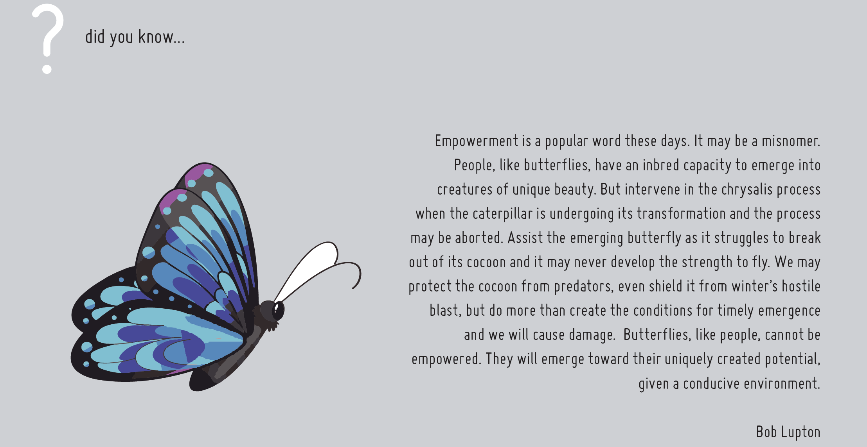
SESSION 6: EMPOWERMENT
Ambassadors Ministry

Slide 30
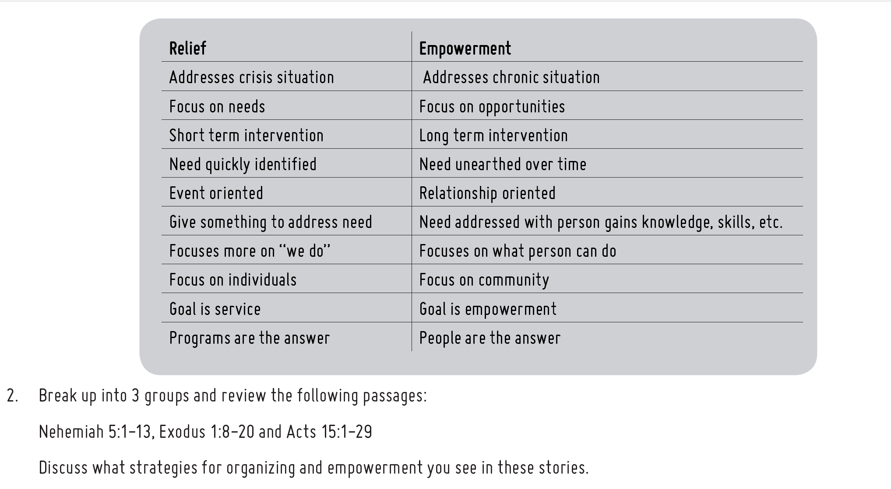
SESSION 6: EMPOWERMENT
Ambassadors Ministry
RELIEF
BETTERMENT
EMPOWERMENT
SYSTEM CHANGE

Slide 31
SESSION 7: WHOLISTIC
Ambassadors Ministry
This lesson provides an overview of the component of ‘Wholistic’ from the Christian Community Development philosophy of ministry. It will help tie all the previous lessons in this module together.
Feel free to bring back in anything from the previous lessons that you find helpful.
Leave time to answer questions here that may have come up before, or those you may not have had time for in previous lessons.

Slide 32
SESSION 7: WHOLISTIC
Ambassadors Ministry
There is never a simplistic answer to the problems in poor communities (spiritual, social, economic, political, cultural, emotional, physical, moral, judicial, educational and familial issues of each person).
The wholistic approach is difficult because there are so many aspects to a person’s life. That is why there is no better way of helping a person than having him or her committed to a local church.
The church must be involved in every aspect of a person’s life. It is also important to network with other organizations in the community.

Slide 33

SESSION 7: WHOLISTIC
Ambassadors Ministry
Share with the whole group about the work of ADRA, which includes disaster/relief work, but also wholistic community development. For example, ADRA Australia has projects that include the efforts in the following areas where shalom/wholeness is needed:
youth development
clean water
remote medical services
HIV/AIDS prevention and services
small enterprise development
employment services and education

Slide 34
Emergency Preparedness
Ambassadors Ministry
What to do before, during, and after an emergency while fostering critical 21st-century skills such as problem solving, teamwork, creativity, leadership, and communication.
We do not have a standardized Emergency Preparation Training because each country operates differently.
The leader should contact their Conference/Union/ADRA office to see if there are any organized training, if not, then they can contact their local Red Cross/Civil Defense and arrange for them to give the seminar (Do this a few months ahead of time).
To help defray any cost involved in running the seminar/training and to maximize the seminar benefit/effectiveness, it might be best organized through the local conference to involve multiple churches/groups.

Slide 35
Module 7 –
Community Outreach Development
Zlatko Musija
Youth Director
TRANS-EUROPEAN DIVISION
Adventist Youth Ministries

