Slide 1
Adventist Youth Ministries

Slide 2
Module 4:
PERSONALITY, CHARACTER, AND OUTDOOR ADVENTURE
Magulilo Mwakalonge
Youth Director
East-Central Africa Division

Slide 3
Seven Foundations
Ambassadors Ministry
A Christ-centered
Discipleship Plan
Leadership
Development
A Personal, Public,
& Small Group Based
Mission Lifestyle
Character &
Personality Development,
including Outdoor,
High Adventure Programming
Lifestyle &
Vocational Training
Nurturing
Godly Relationships
Community outreach development through service projects and emergency preparedness training

Slide 4
Module 4 Objectives
Ambassadors Ministry
Help Ambassadors discover that they are “the Sent” of God. Jesus says to them: As the father has sent me, so I am sending you Ambassadors.
Aim at making every 16-21 years old live the commitment that: “I am an ambassador for another world”
Remind Ambassadors that they are a new generation of spiritual leaders.
Help them discover their personality.
Through the outdoor adventure programs, let them develop their character and their love of God. (Romans 1:19, 20).

Slide 5
Four Essential Elements
Ambassadors Ministry
Individual
Discipleship
Plan (IDP)
Spiritual
Companion
Social
Activities
Projects
01
02
03
04

Slide 6
Outcome and Evidence of Learning
Ambassadors Ministry
 | Outcomes | Evidence of learning
Head Participants will...
Hands Participants will be able to...
Heart Participants will be able to...
Notes:
Stay focused

Slide 7
Major Sections: 14 Chapters
Ambassadors Ministry
Session 1 - Human Personality | Session 8 - Fire Building Techniques
Session 2 - Godly Character | Session 9 - Food and Water Procurement
Session 3 - God’s Plan – Character Growth | Session 10 - Survival Shelter Building
Session 4 - God’s Plan – Character Tested | Session 11 - Navigation Techniques
Outdoor Adventure: Session 5 - Wilderness Survival – prioritize the seven basic needs for survival | Session 12 - Solo Supervised Overnight Camping Trip
Session 6 - The Will to Survive | Session 13 - Simple Faith and Trust-Building Activities
Session 7 - Effective Signaling Techniques | Session 14 - Advanced Faith and Trust-Building Activities

Slide 8
Major Sections
Ambassadors Ministry
Lessons 1-4 of this module cover: the basics of human personality and the most important traits of good character.
Help the participants to learn about their own personalities using a simple test. Be able to compare their results with others.
Help the participants to learn how to define the human being as created by God to have particular characteristics and variations.
Lessons 5-14 are about the relationship between character growth and challenging outdoor activities.
The main activity in this module is a three-day camping trip.

Slide 9
Human Personality
Ambassadors Ministry

Slide 10
Human Personality
Ambassadors Ministry
Personality is the combination of characteristics or qualities that form an individual's distinctive character.
HUMAN PERSONALITY
GODLY CHARACTER
OUTDOOR ACTIVITIES

Slide 11
Human Personality
Ambassadors Ministry
Lead the Participants to do the personality test. After they have identified their personality type, remind them of two things:
God can use them regardless of their unpleasant personalities. He used Peter despite his harsh personality.
Be yourself and allow God to use you. “Stand in your God-given personality. Be no other person’s shadow. Expect that the Lord will work in and by and through you.” (Ellen G. White, The Ministry of Healing, 498)

Slide 12
Character
Ambassadors Ministry
Godly Character:

Slide 13
Character...
Ambassadors Ministry
Godly Character:
Character has to do with moral and ethical choices and habits.
The Galatians character traits, better known as the fruits of the Spirit — (Galatians 5:22, 23) includes Love, Joy, Peace, Patience, Goodness, Faithfulness, Gentleness, Self-control, and Longsuffering. These are better than worldly wisdom.
Jesus called the exercise of good character traits “bearing fruit” (Matthew 7:16–18 and Luke 6:43–45).
Proverbs 1:1–5 sets the stage for an exploration of the value of good character.

Slide 14
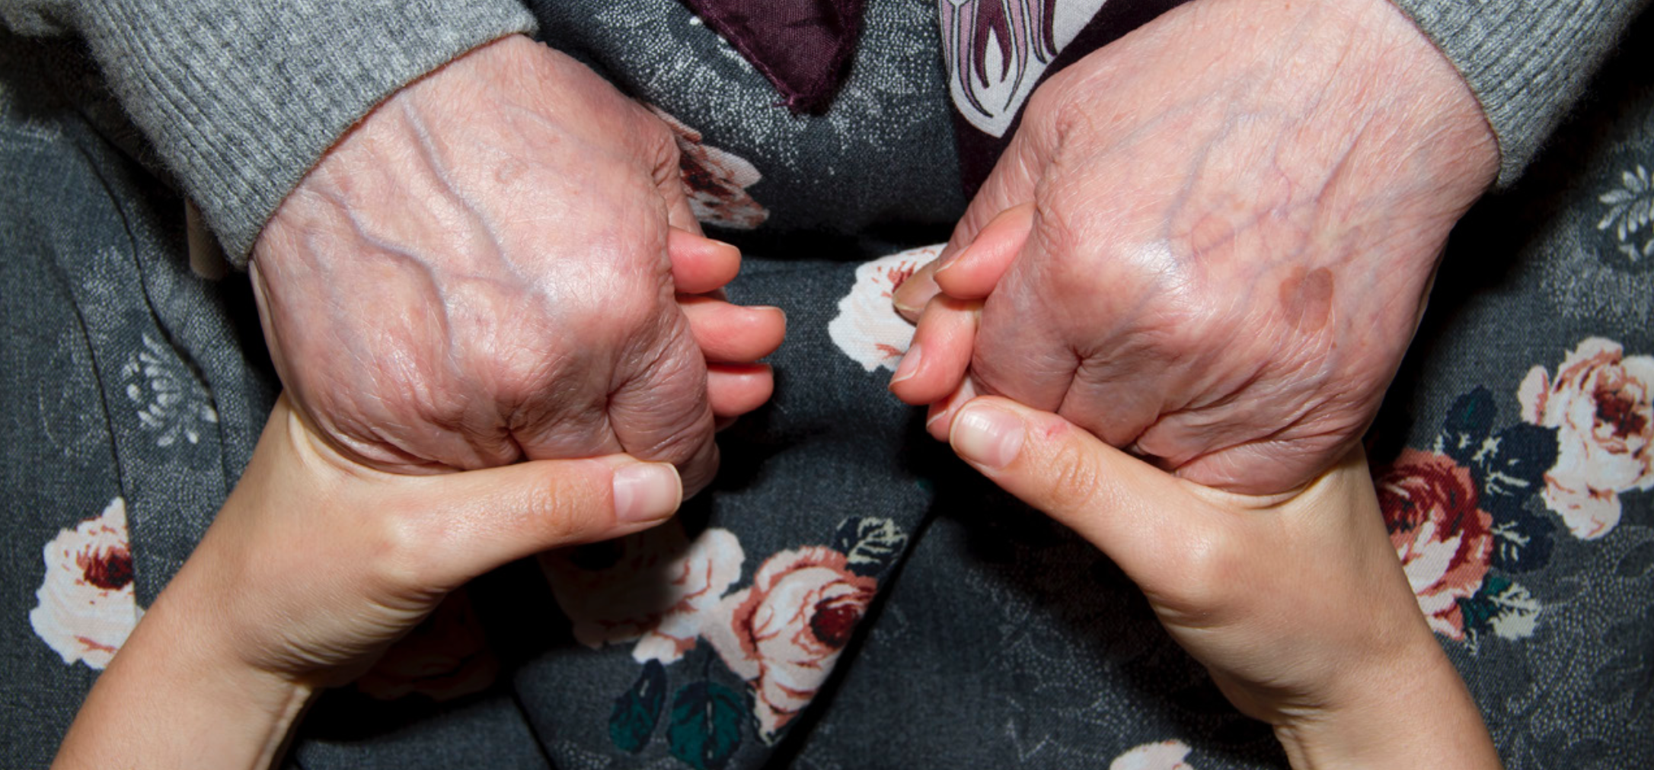
Character…
Ambassadors Ministry
God’s Plan- Character Growth

Slide 15
Character…
Ambassadors Ministry
God’s Plan- Character Growth
Assure the participants that God is in the business of transforming characters. Appeal to them to cooperate with him. (Hebrews 2:18).
Encourage each Ambassador to come up with a character-growth plan of his/her own that takes into account the following needs:
Knowing what needs to be improved in his/her character; Knowing the blueprint for the godly character traits revealed to us in the Bible; Knowing how long the process of character growth takes; Knowing the steps it takes to get going in character development.

Slide 16
Character…
Ambassadors Ministry
God’s Plan- Character Tested

Slide 17
Character…
Ambassadors Ministry
God’s Plan- Character Tested
Prepare the participants to learn lessons from survival skills and how they have effects on various traits in your character.
God puts our characters in a test. He never “tempts” to make one stumble, but “tests” to strengthen.
The story of Gideon in Judges 7:1-24 illustrates one of those tests. The army of 32,000 men was reduced to 10,000 and ultimately to 300.
Remind Ambassadors that God tests characters to strengthen them. When you are tested, do not be surprised but rejoice! (1Peter 4:12-19).

Slide 18
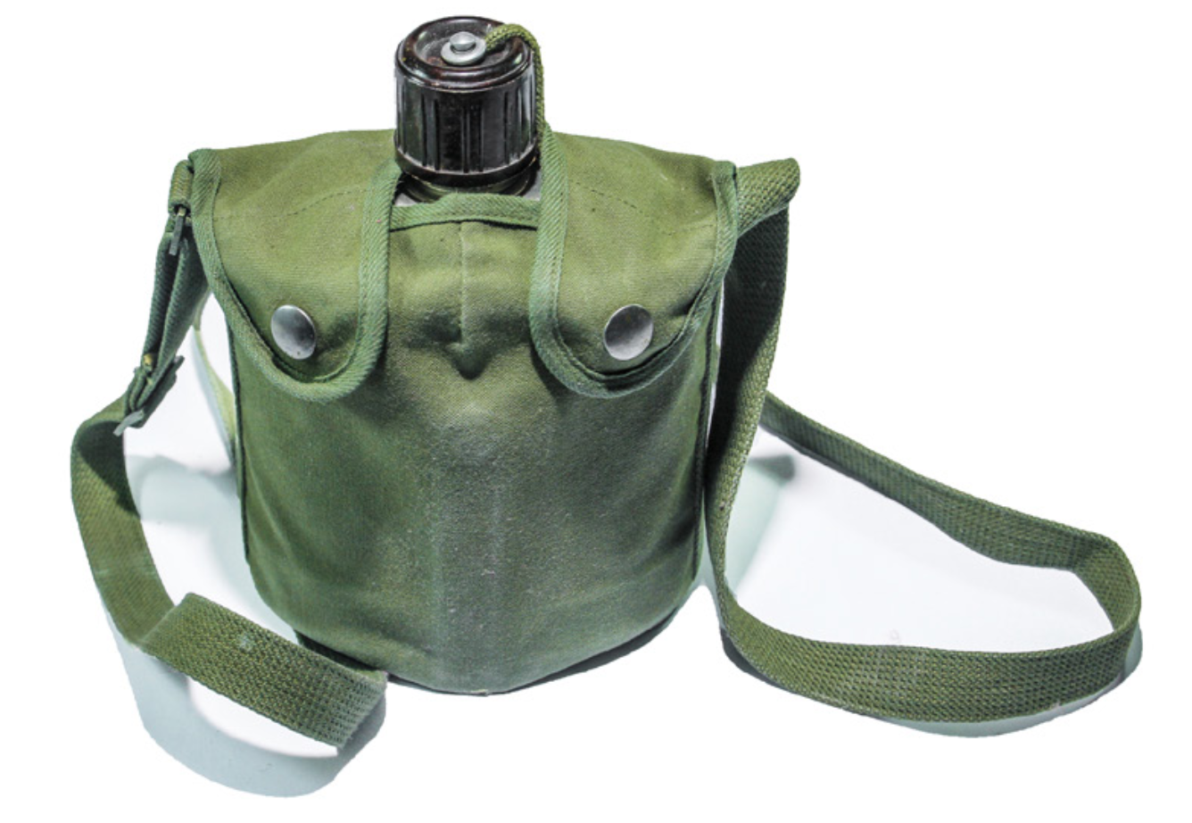
Outdoor Adventure
Ambassadors Ministry

Slide 19
Outdoor Adventure…
Ambassadors Ministry
Camping trips, like life situations that test in specific ways, show the strength of one’s character.
Survival skills learned in the “out of door” activities can teach us the lessons that will help in passing the tests.
In this section, expose the participants to learn some lessons from outdoor activities. Here are few examples of Lessons:

Slide 20
Outdoor Adventure…
Ambassadors Ministry
Wilderness Survival: Highlights Jesus words, “I will come again, and receive you unto myself” (John 14:3). Surviving life is the ultimate survival and the return of Jesus is the ultimate rescue.

Slide 21
Outdoor Adventure…
Ambassadors Ministry
The Will to Survive: Engage the participants to review how they relate to God in times of crisis in their lives. Expose them to the survival stories such as that of Hagar and Ishmael in the desert.

Slide 22
Outdoor Adventure…
Ambassadors Ministry
Effective Signaling Techniques:
God has sent many kinds of signals to His people throughout
human history. Explore with the participants the signs such as
the Rainbow of Noah, the Passover Blood, the Sabbath,
the Scarlet Cord, etc.

Slide 23
Outdoor Adventure…
Ambassadors Ministry
Fire-Building Techniques: Concerning the meaning of fire in the Bible.

Slide 24
Outdoor Adventure…
Ambassadors Ministry
Food and Water Procurement: On the significance of water in the scripture.

Slide 25
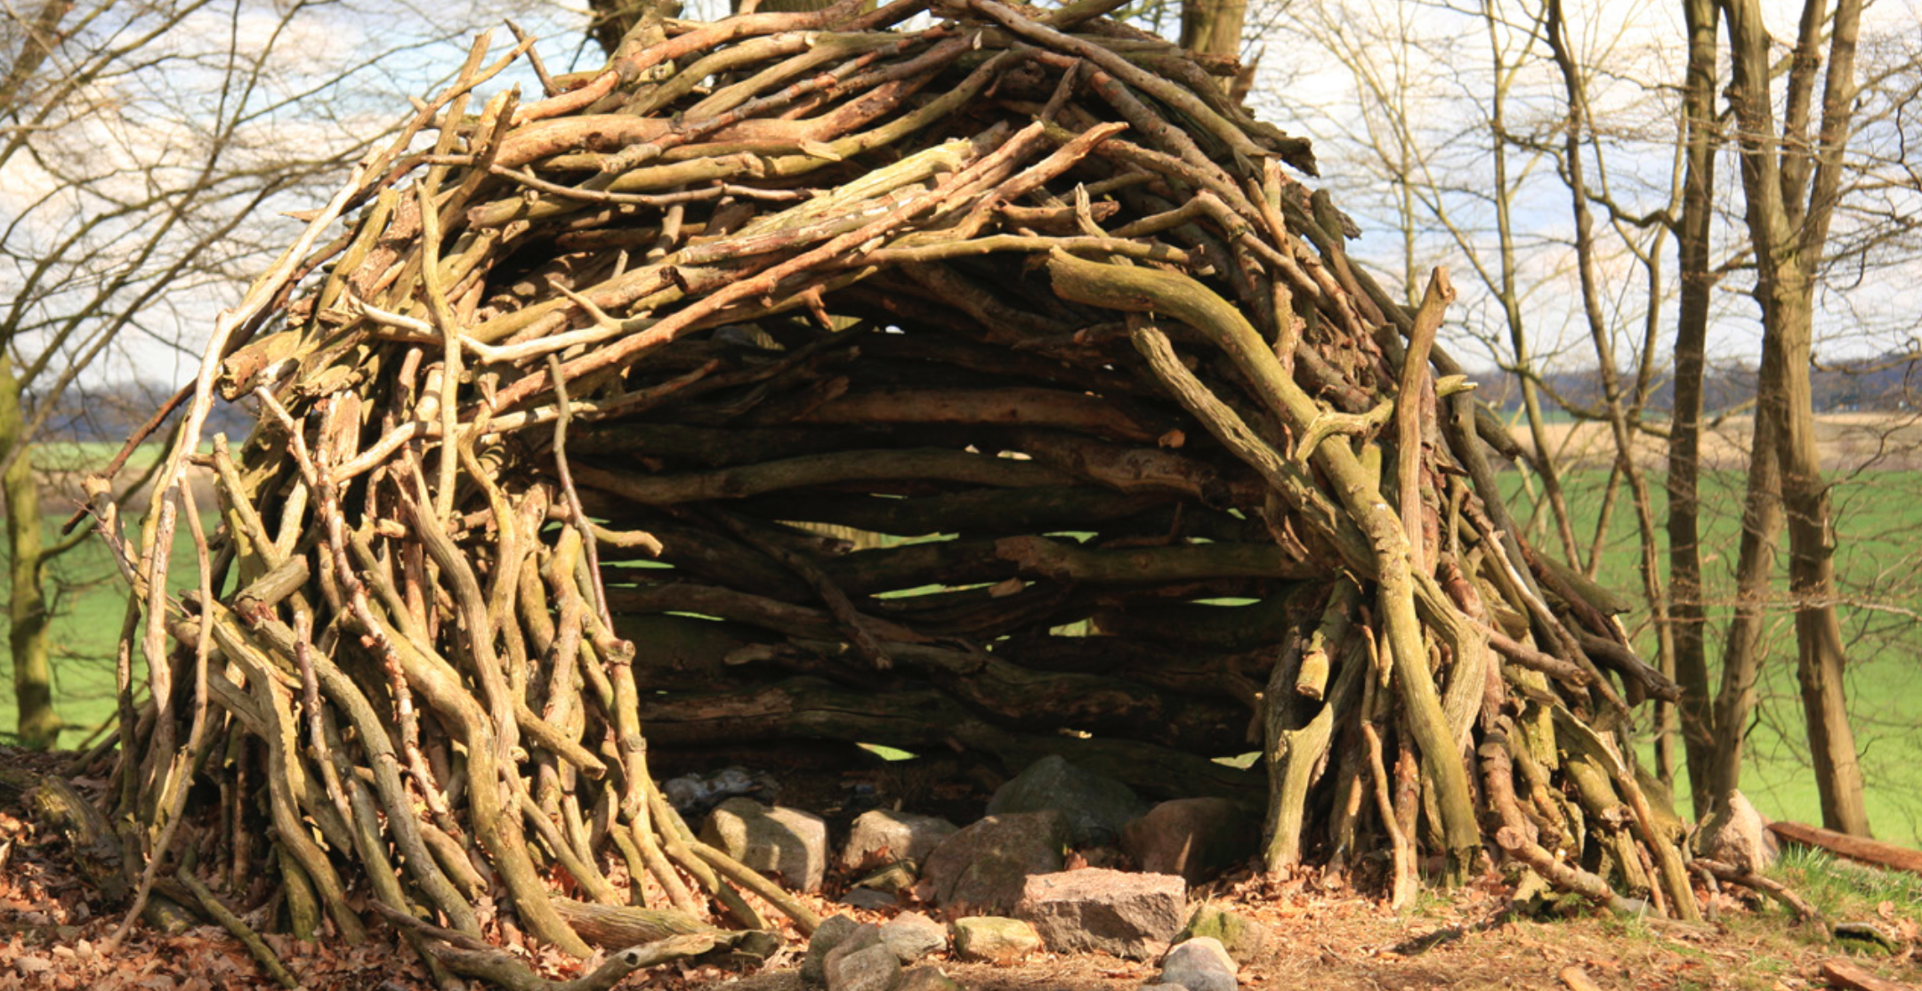
Outdoor Adventure…
Ambassadors Ministry
The Survival Shelter Building: Regarding the need for shelter expressed in various threats in the Bible.

Slide 26
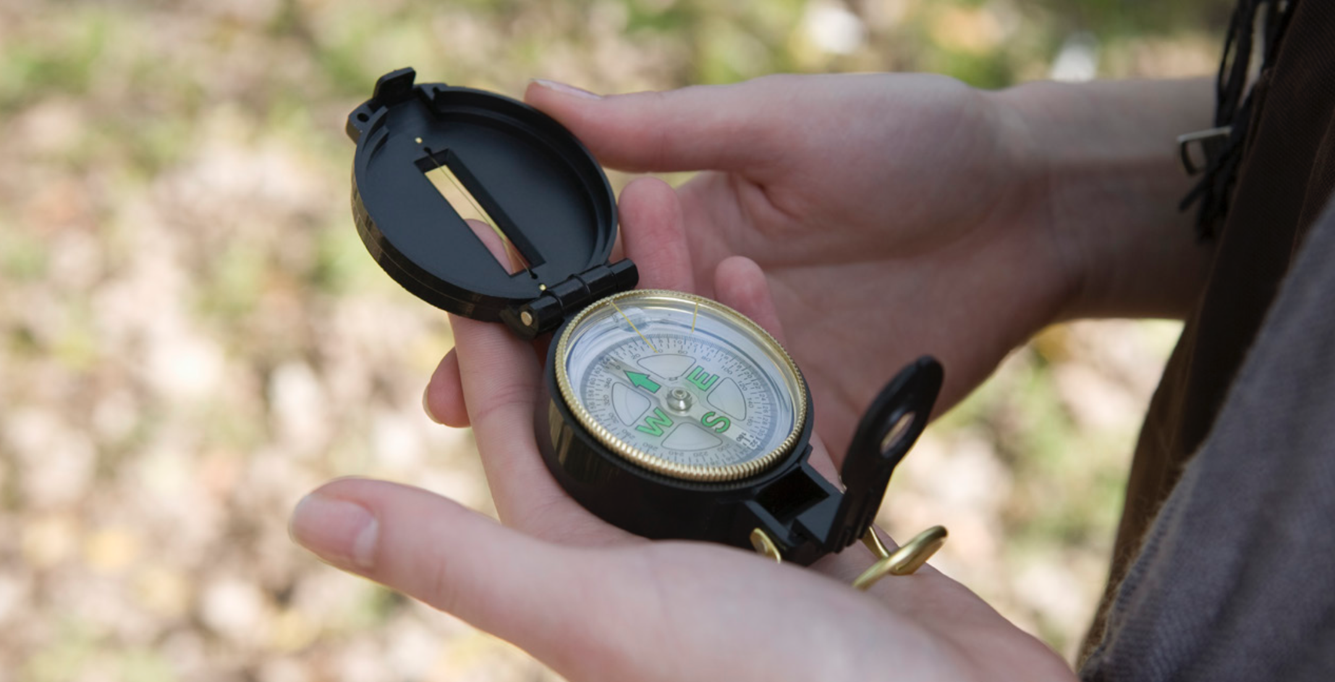
Outdoor Adventure…
Ambassadors Ministry
Navigation Techniques: With reference to God’s Word as a system of navigation, a set of directions for the lost.

Slide 27
Outdoor Adventure…
Ambassadors Ministry
Solo Supervised Overnight Camping Trip: Like that of Jacob when he was running from Esau, and the assurance he got of God’s protection.

Slide 28
Outdoor Adventure…
Ambassadors Ministry
Faith and Trust-Building Activities: In reference to the way Nehemiah trusted God.

Slide 29
Outcome and Evidence of Learning
Note: In all these lessons, engage the participants to get head knowledge, to do projects with their hands and develop their hearty IDPs.
 | Outcomes | Evidence of learning
Head Participants will...
Hands Participants will be able to...
Heart Participants will be able to...
Ambassadors Ministry
Notes:
Stay focused

Slide 30
Adventist Youth Ministries

