Slide 1
Slides for Day 8 of the
2016 Youth and Young Adults Week of Prayer Sermons
Copyright © 2015-2016 General Conference of
Seventh-day Adventist® Youth Ministries Department.
A PDF of the complete sermon can be downloaded here
Sermon written by: Pastor Ty Gibson http://www.lightbearers.org/profile/ty-gibson/
Email: Ty@lightbearers.org
For additional use of any of the images in this presentation please contact GoodSalt Inc.
Phone: 800-805-8001 ● Website: http://www.goodsalt.com

Slide 2

Jesus – the Essence of Our Faith

Slide 3
2016 youth and young adults
Week of Prayer
Theme:
Jesus—The Center of It All
Copyright ©2015 General Conference of SDA Youth Ministries Department
www.gcyouthministries.org

Slide 4
In this
Week of Prayer series
we will be exploring
eight key
Bible doctrines
of the
Seventh-day Adventist Church.

Slide 5
Welcome to day 8
of our re-examination of our core beliefs.

Slide 6
The doctrinal truths of Scripture
can be thought of as a series of perceptual windows through which God's character may be viewed from various different angles.

Slide 7
For our purposes, let’s imagine
the structure of truth as an
octagon-shaped building.
On each of the eight sides of the structure, there is a window.
Each window represents one of
our doctrinal beliefs:

Slide 8
DAY 1: The Trinity
DAY 2: The Great Controversy
DAY 3: The Law of God
DAY 4: The Sabbath
DAY 5: The Sanctuary
DAY 6: Death and Hell
DAY 7: The End Time
DAY 8: The Second Coming

Slide 9
Remember our guiding metaphor?
The doctrinal truths of Scripture are like windows that look in upon the God’s attractive character as revealed in Christ.
No doctrine is an end in itself.

Slide 10

THE SECOND COMING

Slide 11
As Seventh-day Adventists, the biblical truth of the second coming
of Jesus is built into our name,
which is pretty cool, as we are
about to discover.

Slide 12
The word “advent” simply means “arrival”.
When we say we are Adventists,
we are identifying ourselves as a people who cherish the brightest
hope imaginable.

Slide 13
Our name declares that the same Jesus who came to our world 2,000 years ago—born of Mary in
Bethlehem, crucified on a Roman cross, resurrected on the third day, and ascended to heaven—is coming
again to end all evil and pain and usher in a whole new world of
perfect relational harmony.

Slide 14
However—if we’re not careful,
we are liable to miss the why of His coming as we become preoccupied
with proving how He will come.
Traditionally, we have devoted most
of our evangelistic focus to the
manner of His coming against the secret rapture doctrine.

Slide 15
Yes, we need to clearly proclaim the
true manner of our Lord’s return, but
not to the neglect of why He’s coming.
The goal in preaching the second coming should not be to merely prove what it’s not, but rather to paint a beautiful, inviting picture of what it is.

Slide 16
We shortchange ourselves and
the world when we reduce our preaching on the second coming
to merely proving the secret
rapture false.

Slide 17
In our second coming doctrine we have some really, really, really good news to proclaim.
Like all biblical truths, the second coming serves as a window into God’s love. So let’s take a look through the window.

Slide 18
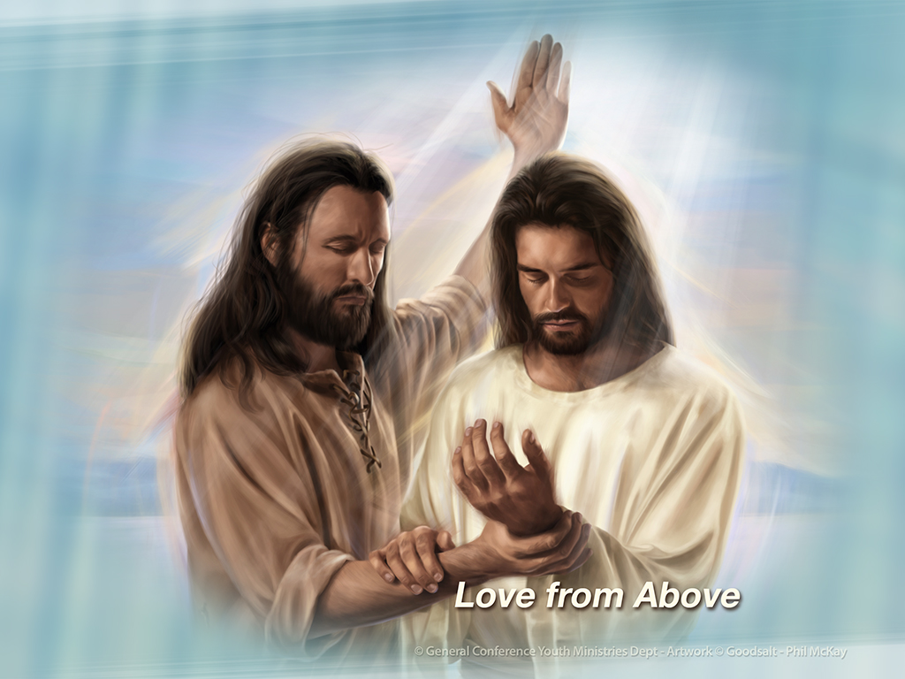

Slide 19
When Jesus came the first time,
He was specifically identified by
John the Baptist as the heavenly
lover seeking His earthly
beloved.
When John’s followers were manifesting jealously over people turning their focus from him to
Jesus, John had this to say:

Slide 20
“He who has the bride is the bridegroom; but the friend of the bridegroom, who stands and hears Him, rejoices greatly because of the bridegroom’s voice.
Therefore this joy of mine is fulfilled. He must increase, but I must decrease” (John 3:29, 30).
Did you catch that?

Slide 21
John called Jesus “the bridegroom,”
and he identified himself as “the
friend of the bridegroom,” or what we call “the best man”.
We are super familiar with the idea that Jesus came to our world as our Savior from sin and guilt, and we praise God for that, but here we are given an additional insight.

Slide 22
Not only did He come to save us
from sin, He also came to draw us
into His love.

Slide 23
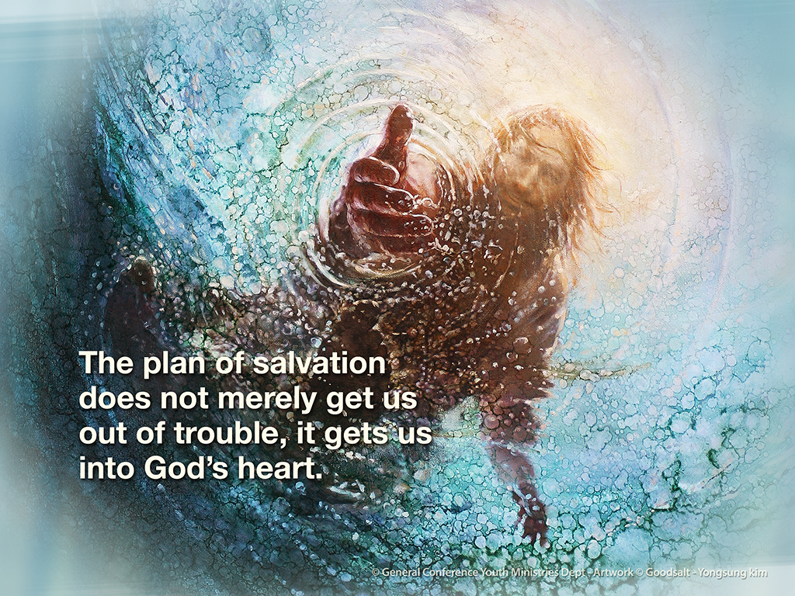

Slide 24
Our redemption has an aim,
a goal, and a purpose.
We are delivered out of a really bad situation into a really good one.
Out of sin into love! Not only does God pity us, He wants us with the passion of a pursuing lover.
That’s the bigger picture.

Slide 25
In Ezekiel 16 God tells us a very
emotional story. Notice verses 4-8:
“As for your nativity, on the day
you were born your navel cord
was not cut, nor were you washed in water to cleanse you; you were not rubbed with salt nor wrapped in swaddling cloths.

Slide 26
No eye pitied you, to do any of
these things for you, to have compassion on you; but you were thrown out into the open field,
when you yourself were loathed
on the day you were born.

Slide 27
And when I passed by you and
saw you struggling in your own
blood, I said to you in your blood,
Live!’ Yes, I said to you in your blood, ‘Live!’ I made you thrive like a plant
in the field; and you grew, matured,
and became very beautiful.
Your breasts were formed, your hair grew, but you were naked and bare.

Slide 28
When I passed by you again and
looked upon you, indeed your time
was the time of love; so I spread My wing over you and covered your nakedness. Yes, I swore an oath to
you and entered into a covenant
with you, and you became Mine,’
says the Lord God.”

Slide 29
It is just amazing that the Almighty Creator of the Universe is the kind of God that would tell a story like this!.

Slide 30
He obviously wants us to
understand something and to feel something. Let’s take in the picture.
So God finds a baby abandoned in
an open field—naked, bloody, and unwashed. The umbilical cord is
hanging from its body, as if the child
was ripped from the womb without
any sympathy.

Slide 31
“No eye pitied you,” God says.
Another version says, “No one loved
you.” What a graphic and revealing depiction of our terrible predicament
as human beings.

Slide 32
We realize here that it is a lack
of love that defines our fallen condition.
We… Need… Love!
That’s what God sees in us.
What He sees in our lostness.
And He knows that His love alone
can save us.

Slide 33
So He says, “And when I passed by
you and saw you struggling in your
own blood, I said to you in your
blood, ‘Live!’ Yes, I said to you in
your blood, ‘Live!’” We were dying
in our sins, but God came along and
took us up into His arms—the abandoned the baby that nobody
loved—and He spoke the word of life over us. He says to us: “Live! Live!”

Slide 34
Then, under the influence of His nurturing care, the baby thrives and grows up into a beautiful woman. “Indeed your time was the time of
love,” God says. Another version
says, “I saw that the time had come
for you to fall in love.” (Today’s English Version)
Wow!

Slide 35
Don’t miss the heart of God here.
As He looks upon us, He’s looking
for something specific and special.
He longs for us to grow up spiritually
to the point where we fall in love with Him in response to His love for us.
Ellen White got this. According to her,
falling in love with Jesus is what we’re supposed to get out of the Bible.

Slide 36
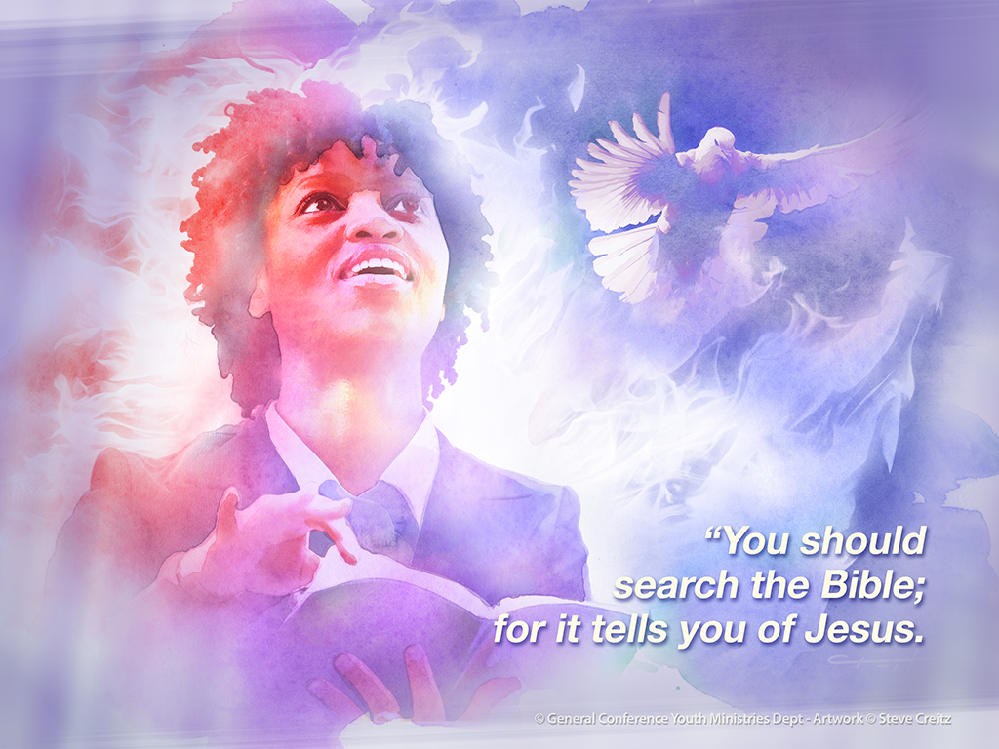

Slide 37
As you read the Bible, you will see
the matchless charms of Jesus.
You will fall in love with the Man of
Calvary, and at every step you can
say to the world, ‘His ways are ways
of pleasantness, and all His paths
are peace.’ You are to represent Christ
to the world. You may show to the
world that you have a hope big with immortality. (Life Sketches, p. 293)

Slide 38
Now come back to the story in
Ezekiel 16. When God sees that we
are ready for love, He says,
“I spread My wing over you and
covered your nakedness.
Yes, I swore an oath to you and
entered into a covenant with you,
and you became Mine.”
Amazing!

Slide 39
Here we see God essentially saying,
“I love you so much I want you to be
My wife.” God gives us life—or
salvation—by loving us into a
condition of thriving.

Slide 40
Then He swears a marriage oath to
us with the hope that we will say
“Yes” and love Him back.
That’s the real goal of the plan
of salvation. The prophet Hosea
opens our understanding further
on this point.

Slide 41
He describes the fallen human
condition as sexual promiscuity
in 2:13:
“‘She decked herself with her
earrings and jewelry, and went
after her lovers; but Me she forgot,’
says the Lord.”

Slide 42
All sin is spiritual adultery, because
all sin basically boils down to a lack
of love. Every sinner is a whore,
pursuing illicit love affairs with things that displace God from the center
of our affections and passions.

Slide 43
So what is God going to do?
How is He going to save us?
By forcing us?
By manipulating us?
No.
Force and manipulation are contrary
to the ways of love and therefore contrary to the character of God
since “God is love.” (1 John 4:8)

Slide 44
So He has a different plan.
Through the prophet Hosea, God described His course of action.
Look at Hosea 2:14:
“Therefore, behold, I will allure her,
will bring her into the wilderness, and speak comfort to her.”
God the allurer!

Slide 45
Not the picture most people
envision when they think of God!
And yet here it is, plain as day.
God intends to save us by alluring
us. This is a prophecy of the
coming Messiah, Jesus Christ, the
one John the Baptist called the bridegroom who had come to Earth searching for His bride.

Slide 46
We should not be surprised,
then, when Jesus speaks of His
death on the cross in the language
of attraction. Notice John 12:32:
“And I, if I am lifted up from the
earth, will draw all peoples to Myself.”
Upon the cross, giving His life in total
self-sacrifice, Jesus gave the ultimate revelation of His love for us.

Slide 47
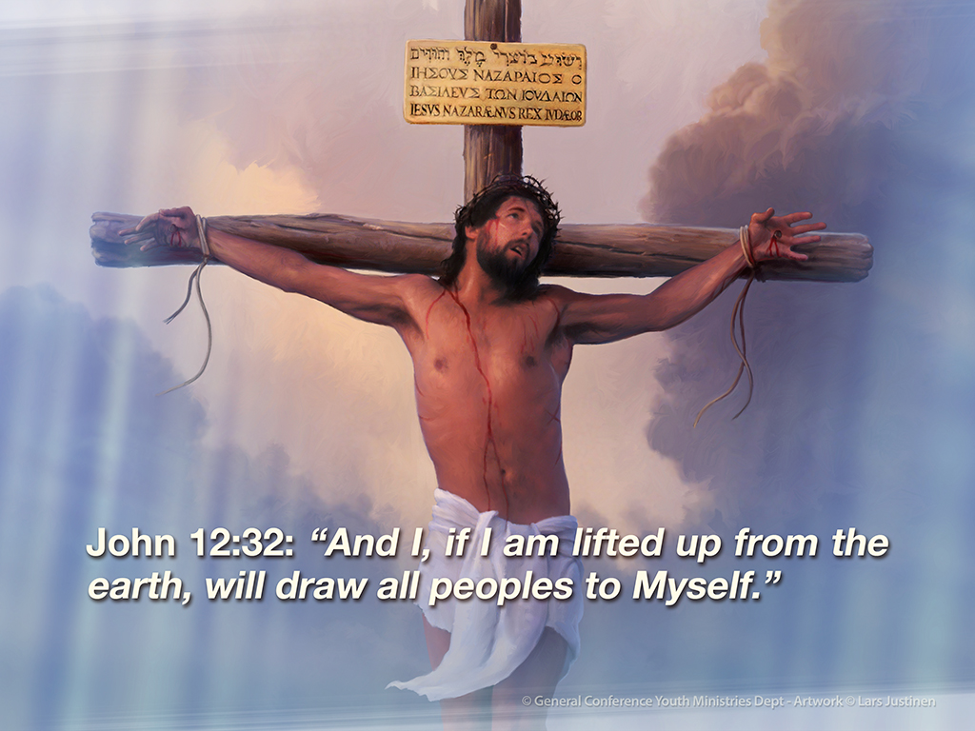

Slide 48
And that love, if we look upon it,
will exert a drawing power upon us.
It will generate attraction in our hearts toward Him and allure us to His heart.
Now come back to Hosea 2:16: “And it shall be, in that day, says the Lord, that you will call Me ‘My Husband,’ and no longer call Me ‘My Master.” What an incredible God!

Slide 49
This is the most powerful being
in the universe and yet He refuses
to overpower us.
He does not want a master-servant relationship with us, but rather a husband-wife relationship. In other words, He wants voluntary love to be
the motivating power that defines our relationship with Him.

Slide 50
In verses 19 and 20 God pledges
Himself to be our faithful spiritual husband: “I will betroth you to Me
forever; yes, I will betroth you to
Me in righteousness and justice,
in loving-kindness and mercy;
I will betroth you to Me in faithfulness,
and you shall know the Lord.”
Jesus came to our world to fulfill this prophecy.

Slide 51
Standing before us with the
promise of unwavering faithfulness,
He offers Himself to us for an
eternal union that will never be
broken, which just happens to be
what His second coming is all about.

Slide 52
To Be With Us
Let’s return now to John 14:1-3,
this time noticing this the famous
second coming passage:
“Let not your heart be troubled;
you believe in God, believe also
in Me. In My Father’s house are many mansions; if it were not so, I would
have told you.

Slide 53
I go to prepare a place for you.
And if I go and prepare a place
for you, I will come again and
receive you to Myself; that where
I am, there you may be also.”

Slide 54
Now that we’ve seen the matrimonial
context in the Gospel of John, and
in the whole of Scripture, what Jesus
said here about His second coming
makes perfect sense.
What we’re seeing here is that Jesus
foretold His second coming by
employing language that invoked the
marriage customs of His time.

Slide 55
First, there was the wooing phase.
If a man loved a woman, he would
interact with her in such a way as
to draw her to himself.

Slide 56
Once drawn to him, the couple
would enter into the courtship
phase, getting to know one another
and growing in their love.
Then the man would propose.

Slide 57
If her answer was yes, the man
would then depart from his
bride-to-be with a promise to return
for her. The reason of his departure
was practical. He would go away so
that he could prepare a place for
her in his father’s house.

Slide 58
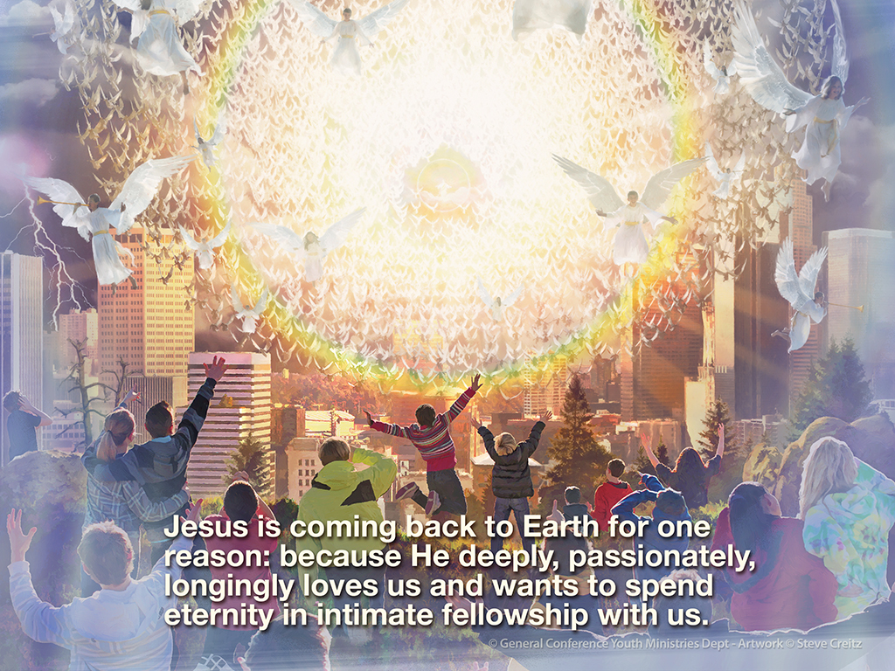

Slide 59
In other words, Jesus did not merely
promise to return, He promised to
return for His bride.
He is coming back to Earth for one
reason: because He deeply,
passionately, longingly loves us and
wants to spend eternity in intimate
fellowship with us.

Slide 60
Don’t miss the fact that He says,
“I will come again and receive you
to Myself; that where I am, there
you may be also.”
Later, just before He was to die on
the cross, Jesus again expressed
His heart in John 17:24: “Father, I
desire that they also whom You
gave Me may be with Me where I am.”

Slide 61
“With Me”
That’s what He wants.
Jesus desires that you and I would
simply be “with” Him.
Think of someone you like to be with, someone whose presence you desire
and enjoy—your spouse, your mom
or dad, your best friend.

Slide 62
The point is simple and beautiful:
we like to be with those we love.
That’s who we are to Jesus.

Slide 63
He longs for our presence, for our friendship, for the enjoyment of
our love.
When the apostle Paul talks about marriage, he uses it as a symbolic springboard to describe the love of Christ for His church. Let’s read Ephesians 5:25-33:

Slide 64
“Husbands, love your wives,
just as Christ also loved the church
and gave Himself for her,
that He might sanctify and
cleanse her with the washing of
water by the word,
that He might present her to Himself
a glorious church,

Slide 65
not having spot or wrinkle or
any such thing, but that she
should be holy and without
blemish.
So husbands ought to love their
own wives as their own bodies;
he who loves his wife loves himself.

Slide 66
For no one ever hated his own
flesh, but nourishes and cherishes
it, just as the Lord does the church.

Slide 67
For we are members of His body,
of His flesh and of His bones.
“For this reason a man shall leave
his father and mother and be
joined to his wife, and the two
shall become one flesh.”
This is a great mystery, but I speak concerning Christ and the church.”

Slide 68
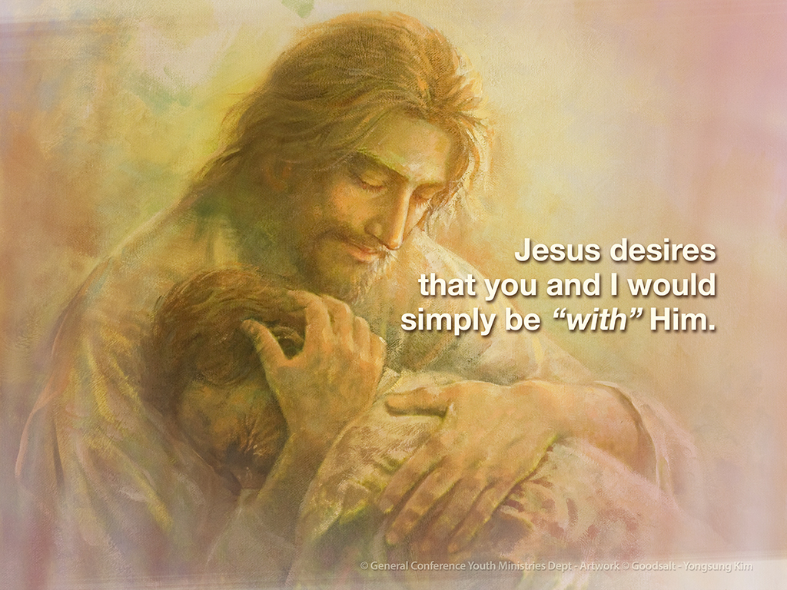

Slide 69
That last sentence is key:
“This is a great mystery,
but I speak concerning Christ
and the church.”
Paul is saying that the marriage relationship holds before us a deep, secret truth regarding our
relationship with Jesus as His
eternal bride.

Slide 70
God has something in mind for
us beyond our wildest dreams.
Some things must be experienced
in order to be understood.

Slide 71
Such is the case with our marriage
to Christ.
It defies mere intellectual comprehension.
So Paul calls it a “mystery”, a deep, secret truth.

Slide 72
Even so, the more fully we experience the love of Jesus, the more we will come to grasp the glorious wonder
of who we really are in God’s plan,
who we really are to God’s heart.

Slide 73
Presently, we are in the courtship
phase of the relationship.
He is wooing and winning us,
revealing to our minds the beauty
of His character so that we can
mature in our love for Him.

Slide 74
The total reality of our identity
as the bride of Christ will not dawn
upon us until the wedding itself.
A point will come in salvation
history when the church is
spiritually “ready” to enter the
marriage with her Lord.

Slide 75
The whole on-looking universe will witness our readiness and make the wedding announcement.
Look at Revelation 19:6-8:

Slide 76
“And I heard, as it were, the voice
of a great multitude, as the sound
of many waters and as the sound
of mighty thunderings, saying,
Alleluia! For the Lord God
Omnipotent reigns!

Slide 77
Let us be glad and rejoice and
give Him glory, for the marriage
of the Lamb has come, and His
wife has made herself ready.’
And to her it was granted to be
arrayed in fine linen, clean and
bright, for the fine linen is the
righteous acts of the saints.”

Slide 78
The entire biblical story rushes
forward to a single point of climactic beauty: Jesus returning to earth
to receive the church as His
eternal bride.

Slide 79
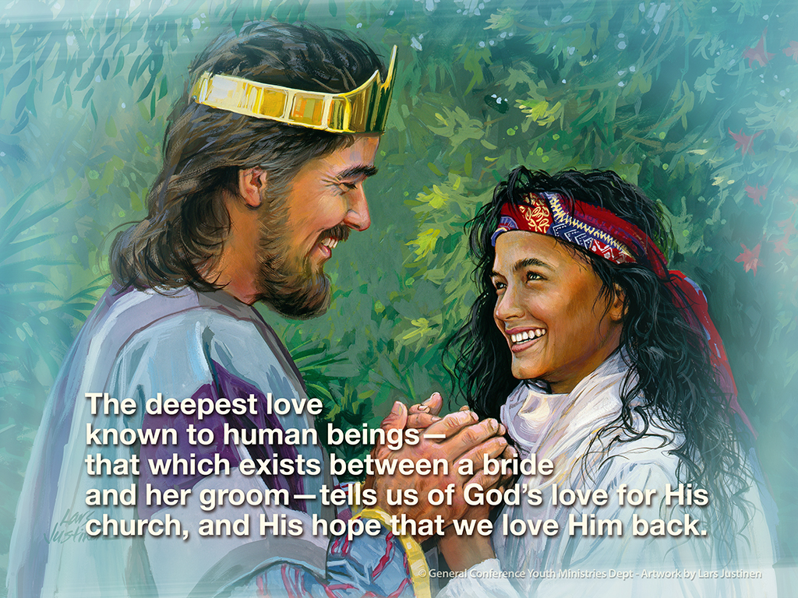

Slide 80
Eternal Shalom
The Song of Solomon is a
prophetic love song that offers
a unique window into the love
of Christ for His church.
In this most epic of all love songs,
we get a penetrating glimpse into
God’s matrimonial love for His people
and where it ultimately leads.

Slide 81
Chapter by chapter, verse by verse, expressions of devotion are
exchanged between the man
and the woman.

Slide 82
They describe one another’s
virtues with lyrical dexterity.
They compliment one another
with exuberance.
They ache with passion to be with
one another.

Slide 83
And just as we’re thinking that
this is just another one of our
world’s silly love songs,
wondering why it’s in the Bible,
the climactic point of the song
has the woman saying something
very profound to her man:

Slide 84
“Set me as a seal upon your heart,
as a seal upon your arm, for love
is strong as death, jealousy is
fierce as the grave.
Its flashes are flashes of fire,
the very flame of the Lord.
Many waters cannot quench love, neither can floods drown it.

Slide 85
Suddenly, we are led to realize
that the deepest love known to
human beings—that which exists between a bride and her groom—
tells us of God’s love for His church, and His hope that we love Him back.

Slide 86
Dying on the cross, Jesus did,
indeed, reveal to us a quality
of love that is stronger than death,
a love that no force in the world
can quench.
Still, there is something more
to notice.

Slide 87
There is a poetic pattern to the
song. Under the influence of the
Holy Spirit, King Solomon paints
a picture of two lovers with—
get this—the same name.

Slide 88
His name is Solomon, which is
the masculine form of the Hebrew word shalom.
She is identified as Shulamite,
which is the feminine version of shalom.

Slide 89
And watch this.
The love between Solomon and Shulamite reaches its climactic
point when she has this amazing realization in 8:10:
“Then I became in his eyes as one
who found shalom” (Song of Songs 8:10).

Slide 90
With poetic beauty and high
spiritual significance, the song
reveals Solomon courting the
heart of Shulamite until shalom
defines their union.
We most commonly translate
shalom as “peace”.

Slide 91
In Hebrew the word carries the
idea of complete fulfillment,
wholeness, a sense of total
well-being from which nothing is missing. In the song Shulamite
finds a sense of complete
wholeness in Solomon’s love.

Slide 92
He is what she desires and
exactly what she needs.
Within his love she is totally
fulfilled. Solomon and Shulamite
are a perfect match.
Shalom, the woman finds shalom
the experience in Shalom, the man.

Slide 93
She is at home in him, for he is the perfect companion to her deepest heart’s desire.

Slide 94
The Bible on a whole is the story
of the perfect match between the human heart and the divine heart, between the One who is the
source of all true love and those
who desperately need His love for
their eternal wholeness and
wellbeing.

Slide 95
Solomon is a messianic type of Jesus.
Shulamite is a type of the church.

Slide 96
Salvation is the plan by which
Jesus allures our hearts back to
Him and establishes eternal shalom between Himself and us. And the second coming of Jesus is when the lover of our souls comes back to
get us so we can be with Him forever.
Now that’s good news!

Slide 97
We are Seventh-day Adventists
and that means we eagerly long
for the return of Jesus in the light
of the fact that He looks upon us
with longing love.
He wants to be with us. That’s why
He’s coming back.

Slide 98
The question is… do we want to be
with Him?

Slide 99
Small group
Discussion Time

Slide 100
Question 1
#1 Discuss: Did John the Baptist really
decrease by giving his ministry and fame
over to Jesus?
Do we increase or decrease when we submit
fully to God? Be specific.
#2 Share: Those who are willing, share some stories of ways in which Jesus “found you in
your blood”, like the story in Ezekiel 16: raised
you up, nurtured you, and bound you to Himself.

Slide 101
#3 Share: What is it like, being “engaged” to
Jesus and waiting for Him to prepare your home
and come back for you? How do you maintain
and grow your relationship in the meantime?
Read Song of Solomon 8:6, 7 in several versions
of the Bible and discuss the imagery.
Do you feel you are bound on God’s arm
like a seal?
Do you recognize His love and jealousy for
you that are stronger than death?
How can you encourage each other to grow
in this awareness?

Slide 102
2016 Youth and Young Adults Week of Prayer Sermons
Copyright © 2015-2016
General Conference of Seventh-day Adventist®
Youth Ministries Department
Sermon written by: Pastor Ty Gibson http://www.lightbearers.org/profile/ty-gibson/
Email: Ty@lightbearers.org
For additional use of any of the images in this presentation please contact GoodSalt Inc.
Phone: 800-805-8001 ● Website: http://www.goodsalt.com

