Slide 1
Slides for Day 7 of the
2016 Youth and Young Adults Week of Prayer Sermons
Copyright © 2015-2016 General Conference of
Seventh-day Adventist® Youth Ministries Department.
A PDF of the complete sermon can be downloaded here
Sermon written by: Pastor Ty Gibson http://www.lightbearers.org/profile/ty-gibson/
Email: Ty@lightbearers.org
For additional use of any of the images in this presentation please contact GoodSalt Inc.
Phone: 800-805-8001 ● Website: http://www.goodsalt.com

Slide 2

Jesus – the Essence of Our Faith

Slide 3
2016 youth and young adults
Week of Prayer
Theme:
Jesus—The Center of It All
Copyright ©2015 General Conference of SDA Youth Ministries Department
www.gcyouthministries.org

Slide 4
In this
Week of Prayer series
we will be exploring
eight key
Bible doctrines
of the
Seventh-day Adventist Church.

Slide 5
Welcome to day 7
of our re-examination of our core beliefs.

Slide 6
The doctrinal truths of Scripture can be thought of as a series of perceptual windows through which God's character may be viewed from various different angles.

Slide 7
For our purposes, let’s imagine the structure of truth as an octagon-shaped building. On each of the eight sides of the structure, there is a window. Each window represents one of our doctrinal beliefs:

Slide 8
DAY 1: The Trinity
DAY 2: The Great Controversy
DAY 3: The Law of God
DAY 4: The Sabbath
DAY 5: The Sanctuary
DAY 6: Death and Hell
DAY 7: The End Time
DAY 8: The Second Coming

Slide 9
Remember our guiding metaphor?
The doctrinal truths of Scripture are like windows that look in upon the God’s attractive character as revealed in Christ.
No doctrine is an end in itself.

Slide 10

NON-COERCIVE LOVE

Slide 11
As Seventh-day Adventists, we are a people of end-time Bible prophecy, or what theologians call “eschatology”.
First, we believe that the movement we’re part of was foretold in Bible prophecy. Second, we believe we’re living in the final phase of human history.

Slide 12
These are big claims that have the potential to either illuminate or darken people’s minds, depending on how we communicate them.

Slide 13
Ellen White discerned that there is a potential danger we need to deliberately avoid in our preaching of last day events:
“The shortness of time is frequently urged as an incentive for seeking righteousness and making Christ our friend.

Slide 14
This should not be the great motive
with us; for it savors of selfishness.
Is it necessary that the terrors of the
day of God should be held before us, that we may be compelled to right action through fear?
It ought not to be so. Jesus is attractive. He is full of love, mercy, and compassion. He proposes to be our friend.” (Signs of the Times, March 17, 1887)

Slide 15
What an insightful and necessary
caution for a people called to
proclaim end-time prophecy!.

Slide 16
Preachers should not present Bible prophecy in a manner that arouses fear.
God’s purpose in revealing end-time events is not to scare us, but to prepare us; not to freak us out, but to pull us in; not to impose anxiety upon us, but to generate hope and peace within us.

Slide 17
If I try to get right with God because
time is short, I don’t actually know
or love God.
I am merely on a self-preservation trip.

Slide 18
While I may look like I’m serving God,
I’m really serving myself.
There is only one legitimate motive for serving the Lord. In Ellen White’s words:
“Jesus is attractive.” His love is the actuating motive we need to keep in
focus as we preach end-time prophecy.”

Slide 19
The Attractive loveliness of His
character, when we see it,
moves us from the inside out!

Slide 20
Listen to King David on this matter:
“One thing I have desired of the Lord,
that will I seek: that I may dwell in the house of the Lord all the days of my life, to behold the beauty of the Lord, and to inquire in His temple.
For in the time of trouble He shall hide
me in His pavilion; in the secret place
of His tabernacle He shall hide me;
He shall set me high upon a rock.”
(Psalm 27:4, 5)

Slide 21
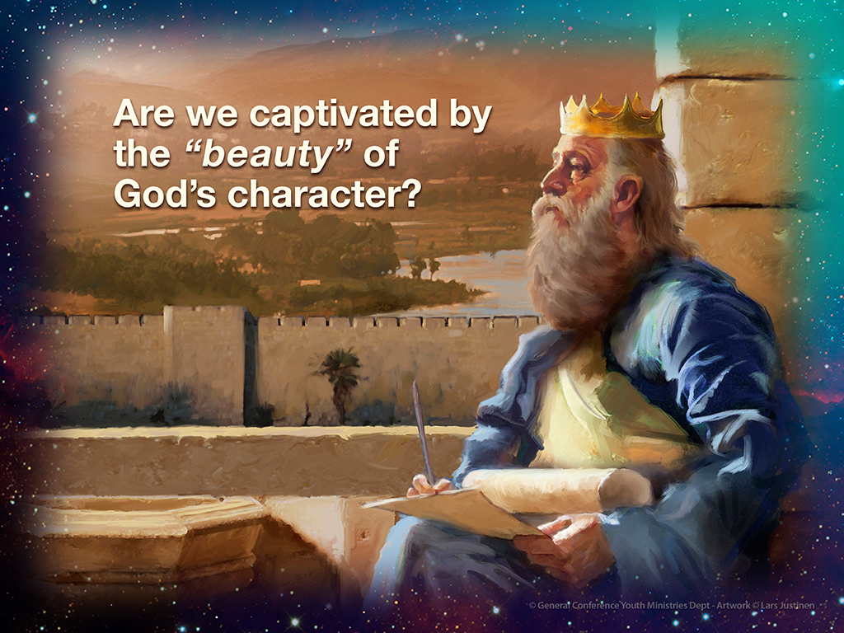

Slide 22
Notice that David’s focus is not
on the time of trouble, but rather
on the on the beauty of God’s character.
In the context of that focus, he has a sense of confidence, not fear, regarding the time of trouble. Now that is a healthy perspective on the time of trouble,
and on all end-time events!

Slide 23
Each of us needs to ask ourselves
if we resonate with David’s sentiments toward God. Are we captivated by the “beauty” of God’s character?
If not, we need to make it our highest priority to obtain a vision of God’s love
so true and clear that we are swept off
our feet into the love of our amazing Creator.

Slide 24
Outside of this experiential context,
last day events can only arouse fear
in our fragile hearts.

Slide 25
It is literally impossible for us to
rightly interpret end-time events
when we allow the events to eclipse Jesus.
Doing so inevitably distorts the eschatological picture into a disfigured composite of fear-based speculations
and false alarms calculated to get
people hyped up on predictions about
the future rather than settled into
Christ as their security.

Slide 26
A fixation on end-time events will inevitably develop an unhealthy
appetite for exposing the bad guys, magnifying the threat of danger,
and driving people into uncertainty regarding whether or not they can
make it through the time of trouble.

Slide 27
Eschatology is a vital part of our message. That’s for sure.
But, like all of our doctrines, it only serves its God-given purpose when we allow it to function as a window through which we discern God’s love.
So let’s approach end-time events from that perspective and see what we discover.

Slide 28
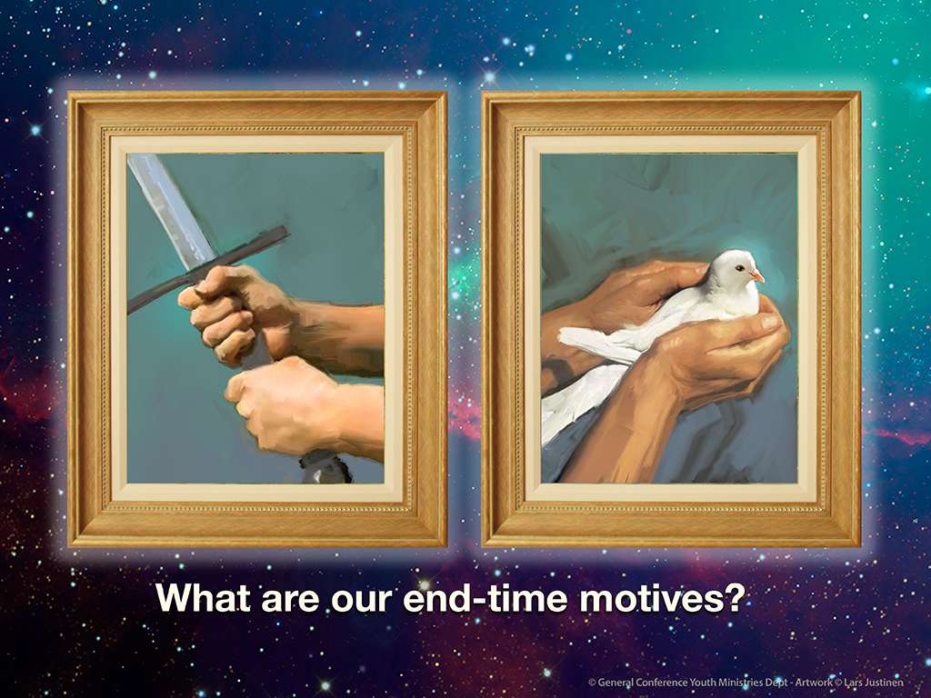

Slide 29
The Core Dynamic of End-Time Events
We will begin our exploration of
eschatology by asking a simple
question:
What is the core dynamic we can
expect to see unfold in the final
events of human history?
Jesus gives us the answer in
John 16:1-4.

Slide 30
John 16:1-4:
“These things I have spoken to you,
that you should not be made to stumble.
They will put you out of the synagogues; yes, the time is coming that whoever
kills you will think that he offers God service. And these things they will do
to you because they have not known
the Father nor Me. But these things
I have told you, that when the time
comes, you may remember that I told
you of them.”

Slide 31
Wow!
Don’t miss what Jesus is telling us
here, because it is hugely significant.
Essentially, He says, “This is what’s gonna go down at the end of the world: there will be those who hold a picture of God that will drive them to kill in God’s name.

Slide 32
Their theological construct will dictate violent actions. They will engage in a mass persecution campaign, all the while imagining that they are serving God as they do it.”

Slide 33
But if they knew God as God really is,
they would never exercise force in Him name. You see the implications, don’t you?
This means that the most crucial issue
you and I need to address is the picture of God’s character that we hold in our hearts.
It also means an accurate revelation of God’s character is the message we need to be passionate about giving to the world!
Why?

Slide 34
Because, according to Jesus, we
humans are liable to misinterpret the character of God in a way that will allow us to justify exercising coercion in His name.
In fact, this is the prevailing theological perspective that has dominated human history and led to so much of the violence that has characterized our world’s dark saga. In the ancient pagan form, people believed that God required their suffering
to appease His wrath.

Slide 35
Sometimes that meant doing certain deeds to inflict harm on one’s self.
Sometimes it meant performing a set of deeds prescribed by religious leaders. Sometimes it meant going to war in
God’s name.
And sometimes it even meant offering human sacrifice. This is what we might call appeasement theology.

Slide 36
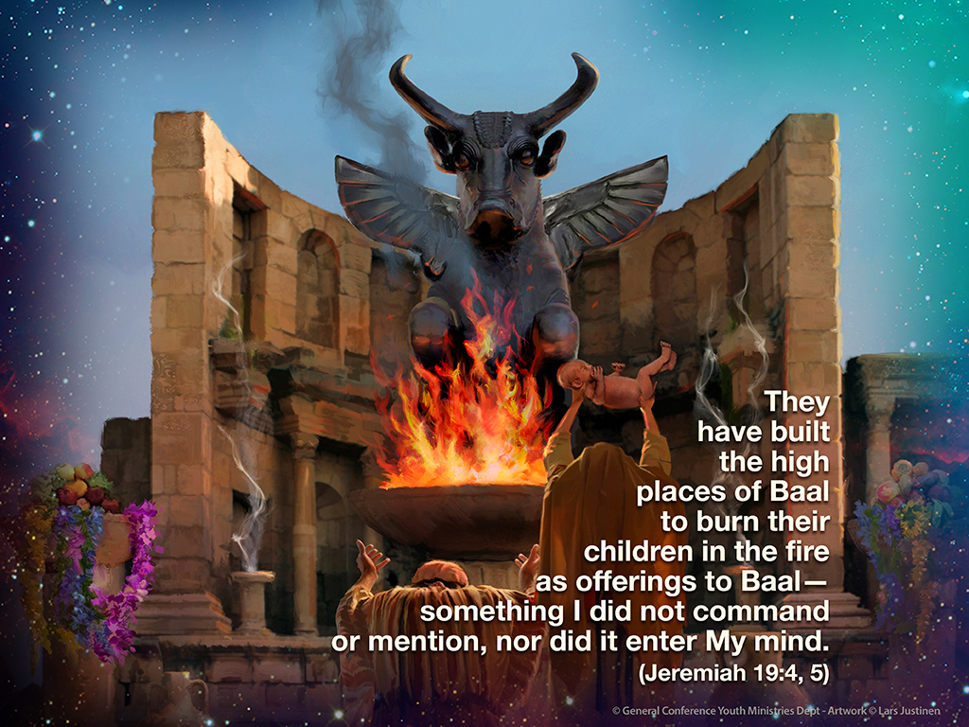

Slide 37
The basic idea is very simple and terribly dark— that God’s basic posture toward humans is one of condemnation and wrath, and He afflicts us with destructive judgments unless and until we offer some form of sacrifice to placate His anger.
The appeasement quest may take the form
of individual deeds of penance: emotional groveling, physical self-harm, paying
money to a church, or performing a set
of deeds prescribed by a religious system.

Slide 38
It may take the form of a corporate scapegoating crusade, in which a
person or a people group becomes
the sacrifice we offer to God.
However, the God of the Bible—the
one and only true God—explicitly told Israel of old that He is not an appeasement kind of God:

Slide 39
“For they have forsaken Me and made
this a place of foreign gods; they have burned incense in it to gods that neither they nor their ancestors nor the kings of Judah ever knew, and they have filled
this place with the blood of the innocent.
They have built the high places of Baal
to burn their children in the fire as
offerings to Baal— something I did not command or mention, nor did it enter
My mind.” (Jeremiah 19:4, 5)

Slide 40
Notice that last phrase: “nor did it enter
my mind”. Appeasement theology is completely foreign to God’s nature, but it
is deeply imbedded in the human psyche because it is the natural product
of our guilt.
Our sense of shame causes us to interpret
the bad things that happen to us as God’s arbitrary punishments, which in turn drives
us to seek God’s favor by means of
sacrifice in various forms.

Slide 41
Now think this through very carefully, because we are about to have a major epiphany regarding the deeper issue involved in the unfolding of final events.
Jesus was, in fact, crucified by religious people on the premise of a salvation-by-works, appeasement picture of God. The religious leaders realized that they were losing control of the people to Jesus. Through the rationale of their appeasement orientation,

Slide 42
they made a calculated, pragmatic decision that naturally arose from their distorted picture of God: “It is expedient for us that one man should die for the people, and not that the whole nation should perish.” (John 11:50)
They imagined that killing Jesus would avert the disaster they saw coming their way. Similarly, according to Jesus, the final persecution campaign of human :

Slide 43
history will be fueled by a distorted picture of God that will allow the persecutors to rationalize they are serving God by means of their coercive political-religious system.
Jesus stated clearly what’s going on when people seek to force others in God’s name:
“These things they will do to you because they have not known the Father nor Me.” In other words, to know God as God really is rules out using coercion in His name.

Slide 44
Amazing!
Now we understand the core issue that will play out in the end-time events of human history.
When the world is finally divided into the persecutors and the persecuted, every person will act out their picture of God.
Now let’s go a little deeper.

Slide 45
A Different Kind of Power
In Matthew 24 Jesus delineated a list of what we call “signs” of the end times.
In verse 14 He named the final and most significant sign of all: “And this gospel of the kingdom will be preached in all the world as a witness to all the nations, and then the end will come.”

Slide 46
When Jesus said this, He was using very specific and familiar language to the people of His time. In using the word translated as “gospel”, which is euaggelion in the Greek text, He was employing the common term for military victory.

Slide 47
When an ancient empire would win a battle by force of arms, euaggelion was the word used to herald the “good news” of victory.
Jesus came along and deliberately
employed the common word for military victory, flipping its meaning in order to signal the arrival of a new kind of
kingdom based on a new kind of power.
His kingdom is like no other. It is, in fact, totally opposite to our world’s power structures.

Slide 48
Jesus came to our world and founded His church upon the principle of non-coercive love. In the popular language of His time, He called the relational
dynamic of His kingdom, “agape”.
Describing the ultimate outworking of this principle, Jesus said,

Slide 49
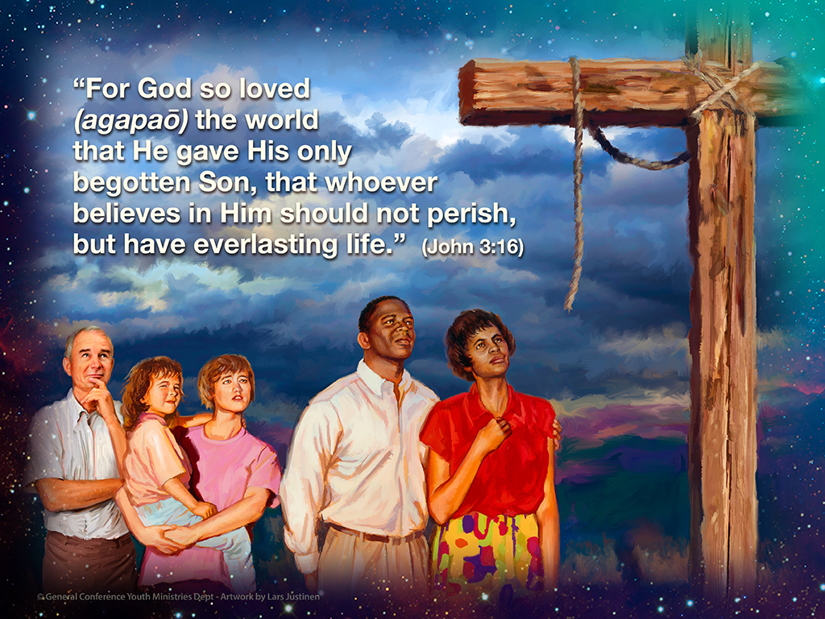

Slide 50
Giving totally defines God’s mode of existence.
At the cross God gave Himself to the
point of suffering and death in order to demonstrate His love for us, and that love is the power—the one and only power—
He exerts for our salvation.
The cross reveals that God is only interested in drawing human beings
to Himself by the attractive power of
His love.

Slide 51
Conversely, He is not interested in outward compliance under coercive pressure. Jesus also applied the principle of non-coercive love to
human relations in general and to church relations in particular.
Take a look at Matthew 20:25-28:
“You know that the rulers of the Gentiles lord it over them, and those who are great exercise authority over them.

Slide 52
Yet it shall not be so among you; but whoever desires to become great among you, let him be your servant.
And whoever desires to be first among you, let him be your slave—just as the Son of Man did not come to be served, but to serve, and to give His life a ransom for many.”

Slide 53
This is what Jesus intended His
church to look like, how He meant for
it to operate. And through His
church, this is how He wanted the world to see His character.
Jesus is decidedly pro-freedom and anti-force. His life, death, and teachings set in motion a relational system characterized by a “power-under”
dynamic rather than “power-over” manner of relating.

Slide 54
His kingdom stands diametrically
opposed to imposing theological, emotional, or civil coercion upon
human beings in matters pertaining
to one’s individual relationship with God.
After Jesus departed from the world, having established His church on the premise of what we might call the love-freedom relational dynamic,
His disciples advance His peculiar upside-down kingdom in two ways:

Slide 55
(a) by preaching the gospel, or
the good news of God’s non-coercive
love as the only legitimate basis for human relationship with God
and
(b) by living out His love within the
church as a covenant community, meaning that men and women only
joined the church on the premise of voluntary response to God’s love.

Slide 56
The church was not to be a civil
system imposing its beliefs by means of law, but rather a covenantal system setting forth the attractive beauty of God’s character as an invitation to which all were free to say yes or no.

Slide 57
Once we understand that non-
coercive love is the foundational principle of the gospel, we are
prepared to discern, by contrast, that every political and religious system
that attempts to use force in the name
of Christ is, in fact, anti-Christ.
And this brings us to the prophecies
of Daniel and Revelation.

Slide 58
Daniel and Revelation
Daniel and Revelation tell the story
of Jesus conquering deception
and force with truth and love.
That’s the core logic embedded in
Bible prophecy. If we miss that,
we’ve missed the whole point.
Let’s break it down.

Slide 59
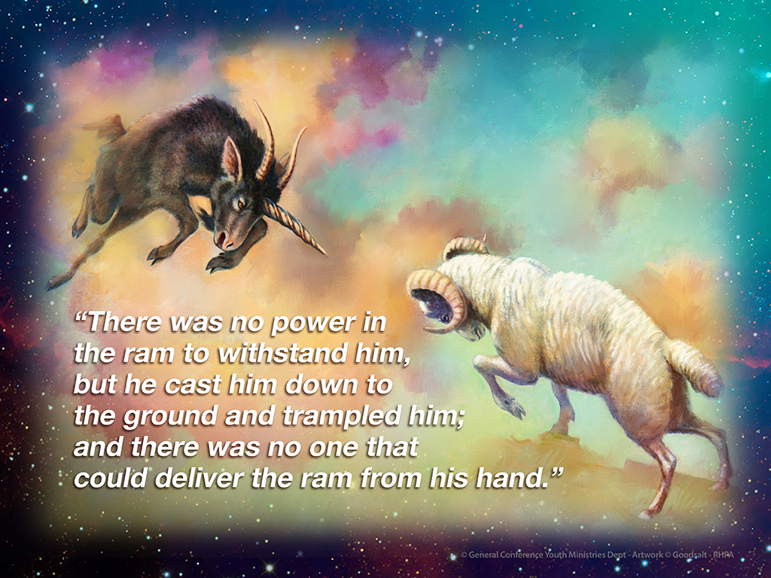

Slide 60
Daniel shows us a series of world empires. Each one seeks to advance
its claim of superiority by means of
brute strength, and each one
inevitably falls to the dominance of another. Daniel describes the self-defeating cycle of violence in Daniel 8:4-9:

Slide 61
I saw the ram pushing westward,
northward, and southward, so that no animal could withstand him; nor was there any that could deliver from his hand, but he did according to his will
and became great.

Slide 62
And as I was considering, suddenly
a male goat came from the west, across the surface of the whole earth, without touching the ground; and the goat had
a notable horn between his eyes.
Then he came to the ram that had two horns, which I had seen standing beside the river, and ran at him with furious power.

Slide 63
And I saw him confronting the ram;
he was moved with rage against him, attacked the ram, and broke his two
horns.
There was no power in the ram
to withstand him, but he cast him
down to the ground and trampled him;
and there was no one that could
deliver the ram from his hand.

Slide 64
Therefore the male goat grew very
great; but when he became strong,
the large horn was broken, and in
place of it four notable ones came
up toward the four winds of heaven.
And out of one of them came a little
horn which grew exceedingly great
toward the south, toward the east,
and toward the Glorious Land.”

Slide 65
Notice the escalating pattern of
self-exaltation Daniel outlines:
• “great”
• “very great”
• “exceedingly great”
And also notice the language of power
and violence:
• “with furious power”
• “confronting”
• “moved with rage”
• “attacked”
• “cast him to the ground”
• “trampled him”

Slide 66
Each kingdom advances over the
other by means of force.
Describing the last kingdom in the prophetic lineup, Daniel says this in
verses 24-25:
“His power shall be mighty, but not
by his own power; he shall destroy
fearfully, and shall prosper and
thrive; he shall destroy the mighty,
and also the holy people.

Slide 67
Through his cunning he shall cause
deceit to prosper under his rule;
and he shall exalt himself in his heart.
He shall destroy many in their prosperity.
He shall even rise against the Prince of princes; but he shall be broken without human means.”

Slide 68
As with the kingdoms that preceded it, destruction and deceit are the means
by which this kingdom exalts itself.
But then Daniel shows us something
new, something totally different.

Slide 69
This powerful system conquers everything in its path until it rises “against the Prince of princes”,
which is the Messiah.
In Jesus, self-exaltation has met
its match, but not in the way we
might think.
As this kingdom comes against Jesus, Daniel says that it will be “broken without human means”.

Slide 70
In other words, Jesus does not
conquer by the same principles
commonly employed by human
power structures.
He operates on principles that run
directly contrary to the principles employed by the kingdoms of this
world.

Slide 71
They use deception and force.
His weapons are truth in love.
In chapter 9 Daniel gives us a more detailed description of the Messiah’s
path to victory, and it is astounding.

Slide 72
Notice verse 26:
“Messiah shall be cut off, but not for Himself.”
And verse 27: “Then he shall confirm
a covenant with many for one week;
but in the middle of the week He shall bring an end to sacrifice and offering.”

Slide 73
This is a prophecy foretelling the
self-sacrificing death of Jesus.
The one true king of the world would voluntarily give His life at Calvary—
“but not for Himself”.

Slide 74
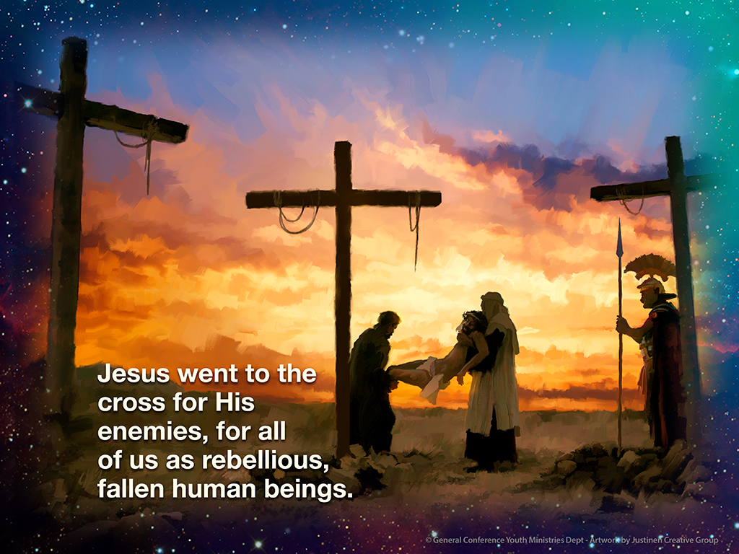

Slide 75
Powerful!
Daniel wants us to understand
that King Jesus operates by a
different kind of power.
Jesus went to the cross for His
enemies, for all of us as rebellious,
fallen human beings.

Slide 76
He allowed us to vent our rage upon
Him and He kept on loving us.
The way this prophecy played out
was that Jesus gave Himself without resistance to the combined power of
church and state.
The religious system of Judaism and
the political power of Rome united to
kill Jesus.

Slide 77
Astoundingly, He was crucified by a church-state alliance.
The amazing thing is that being God,
He actually had power over them, but He freely submitted to their violence.
In John 10:18, Jesus said, “No one takes it from Me, but I lay it down of Myself.”

Slide 78
In Christ we have before us the king of the universe conquering the kingdoms of our world. But how does He do it?
By sacrificing Himself to our hatred
and rage!

Slide 79
Human nature and all the kingdoms
of our world operate on the Human nature and all the kingdoms
of our world operate on the premise
of self-preservation at all costs.
Kill or be killed.
Tit for tat.
Blow for blow.
You hit me, I’ll hit you back.
And whoever has the superior brute strength, wins.

Slide 80
Jesus comes along into this system
of cyclical violence and does
something completely counterintuitive
to human nature: He loves in the face
of evil.
Peter explains in 1 Peter 2:23, 24:
“When He was reviled, did not revile in return; when He suffered, He did not threaten, but committed Himself to Him who judges righteously;

Slide 81
who Himself bore our sins in His own body on the tree, that we, having died
to sins, might live for righteousness—
by whose stripes you were healed.”

Slide 82
Only love for one’s enemies has the power to crush the enmity and birth
a new relational dynamic.
And that’s precisely the healing genius of the cross. What we see on display
in Jesus is a love that cannot be overcome by hate and violence.

Slide 83
All anti-love forces are crushed by
His love! No matter what we do to Him,
He will never stop loving us.
When we come up against God’s love,
we have encountered a force more
powerful than force. We can vent our
rage on Him until it breaks, but it will
not break Him.

Slide 84
Our knuckles bloody and our breath exhausted, He just stares with
forgiveness into our angry eyes until
we are either subdued by His love or irrevocably at odds with it.
That’s the central message of Daniel’s prophecies.

Slide 85
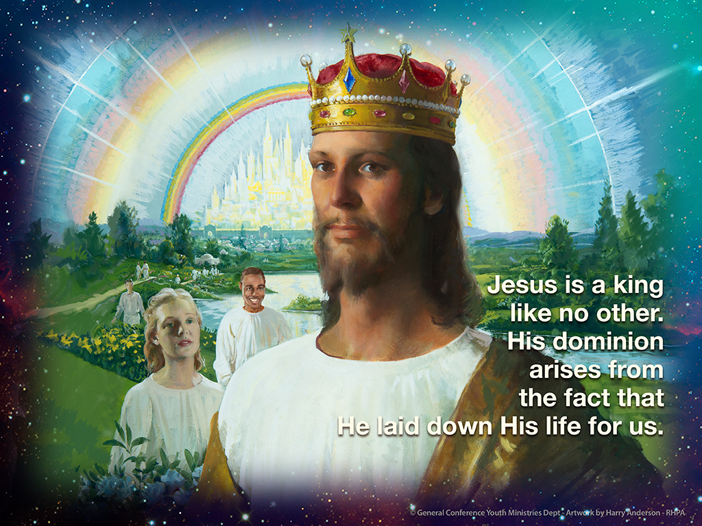

Slide 86
When we come to the book of
Revelation, we see the same story
playing out: love conquering evil.
John opens Revelation by telling us
that the Star of the book saves and
rules by means of self-sacrificing love.

Slide 87
“Grace to you and peace from Him
who is and who was and who is to
come, and from the seven Spirits
who are before His throne, and from
Jesus Christ, the faithful witness,
the firstborn from the dead, and the
ruler over the kings of the earth.

Slide 88
To Him who loved us and washed us from our sins in His own blood, and has made us kings and priests to His God and Father, to Him be glory and dominion forever and ever. Amen.” (Revelation 1:4-6)

Slide 89
John wants us to understand
that Jesus is a king like no other.
His dominion arises from the fact that
He laid down His life for us.
This message becomes clearer when John describes what’s going on in the throne room of the universe.
Let’s read Revelation 5:6, 7:

Slide 90
And I looked, and behold, in the
midst of the throne and of the four
living creatures, and in the midst
of the elders, stood a Lamb as though
it had been slain, having seven horns
and seven eyes, which are the seven
Spirits of God sent out into all the earth.
Then He came and took the scroll out
of the right hand of Him who sat on
the throne.”

Slide 91
Now notice verses 11-13:
“Then I looked, and I heard the voice
of many angels around the throne,
the living creatures, and the elders;
and the number of them was ten thousand times ten thousand, and thousands of thousands, saying with
a loud voice,

Slide 92
‘Worthy is the Lamb who was slain to receive power and riches and wisdom, and strength and honor and glory and blessing!’

Slide 93
And every creature which is in heaven
and on the earth and under the earth
and such as are in the sea, and all that
are in them, I heard saying:
‘Blessing and honor and glory and
power be to Him who sits on the throne, and to the Lamb, forever and ever!’”

Slide 94
Jesus is the center of focus and
praise precisely because He gave
His life for us.
It is against this backdrop of victory through self-sacrifice that Revelation brings to view the final events of history.
In contrast to the One who saves and rules by the power of non-coercive love,

Slide 95
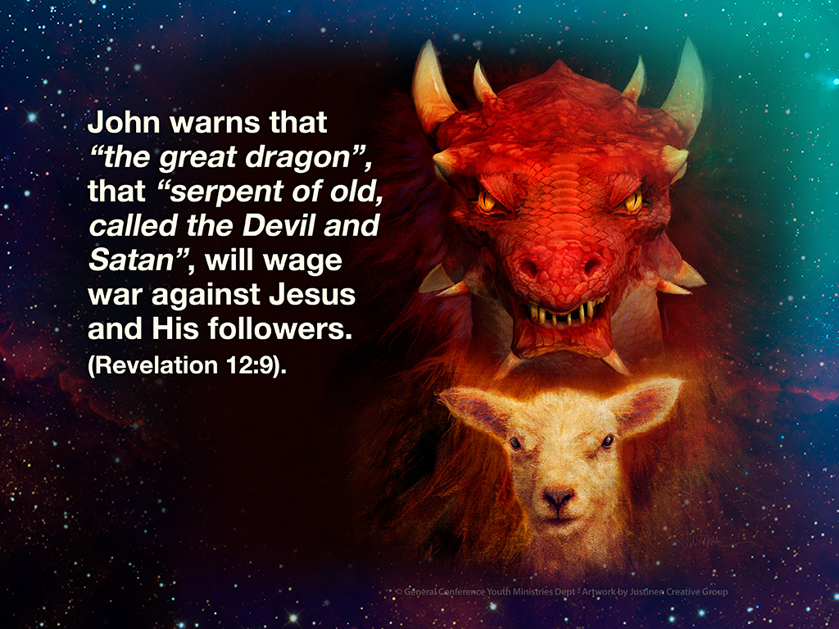

Slide 96
The striking point of the story is brought
into sharp focus in Revelation 12:11:
“And they overcame him by the blood
of the Lamb and by the word of their
testimony, and they did not love their
lives to the death.”
The message is clear.

Slide 97
The people of Jesus will overcome the
force of Satan’s end-time persecution
system by responding with the love of
Christ rather than retaliating.
In the story of Jesus, the true winners
win by losing, because non-violent love
is the deep secret principle of true
conquest.

Slide 98
Love that refuses to respond
to evil with evil!
Love that submits to abuse
rather than resorting to abuse!
Love that would rather die than
hate the haters!

Slide 99
Responding to hate and violence
with hate and violence only serves
to perpetuate hate and violence.
Force breeds force. As long as each
act of violence is responded to with
more violence, the cycle will literally
never end except with the complete
mutual destruction of both sides.

Slide 100
In Revelation 13 we encounter the
Sea-beast and the Land-beast,
Roman Catholicism and Protestant America.
The prophecy warns us that these two powers will eventually unite to enforce upon the world the “mark of the beast.”

Slide 101
Worship laws will be enacted that
will seek to coerce conscience
in the name of God.
Religious liberty will eventually be overturned and the lamblike beast will “speak like a dragon.”
Protestant America will become the political engine that will bring upon the world a crisis of individual conscience and character.

Slide 102
The system will dictate that
“no one may buy or sell except one who has the mark or the name of the beast, or the number of his name” (verse 17).
In other words, the system will leverage its economic power against all who would resist its dominance.

Slide 103
There are two kinds of power on
display in Revelation: Lamb Power versus Dragon Power.
The power employed by Satan and the earthly systems that follow his lead is that of force. In total contrast, the
power employed by Jesus is
self-sacrificing love.
Love versus force!

Slide 104
That’s the whole story of Daniel and Revelation in a nutshell. And if that’s
the story, then the crucial question
that come through to each of our
hearts is simply this:

Slide 105
Do you and I really know Jesus as the true revelation of God’s character?
When the final events of history unfold upon the world, each of us will act out our picture of God.

Slide 106
Each of us will either side with those who violate the principle of religious freedom in order to preserve ourselves, or we will stand faithful for liberty of conscience in harmony with God’s non-coercive love.
And on that note, the world will end.

Slide 107
Small group
Discussion Time

Slide 108
Share some stories of times you have been tempted to use coercion in the name of love,
or times you have seen others do so.
What was the result?
What do you think is the remedy?
Is it possible for Adventists to fall into the
trap of trying to make others (within or outside the church) believe or act in certain ways?
How can we confront and change this without giving into force ourselves

Slide 109
Is it possible to go too far in the
other direction and become a
doormat because we are trying to
“submit to abuse rather than abusing”?
What are some safeguards against this?
In what way have you “acted out your picture of God” during the past month?

Slide 110
2016 Youth and Young Adults Week of Prayer Sermons
Copyright © 2015-2016
General Conference of Seventh-day Adventist®
Youth Ministries Department
Sermon written by: Pastor Ty Gibson http://www.lightbearers.org/profile/ty-gibson/
Email: Ty@lightbearers.org
For additional use of any of the images in this presentation please contact GoodSalt Inc.
Phone: 800-805-8001 ● Website: http://www.goodsalt.com

