Slide 1
Slides for Day 6 of the
2016 Youth and Young Adults Week of Prayer Sermons
Copyright © 2015-2016 General Conference of
Seventh-day Adventist® Youth Ministries Department.
A PDF of the complete sermon can be downloaded here
Sermon written by: Pastor Ty Gibson http://www.lightbearers.org/profile/ty-gibson/
Email: Ty@lightbearers.org
For additional use of any of the images in this presentation please contact GoodSalt Inc.
Phone: 800-805-8001 ● Website: http://www.goodsalt.com

Slide 2

Jesus – the Essence of Our Faith

Slide 3
2016 youth and young adults
Week of Prayer
Theme:
Jesus—The Center of It All
Copyright ©2015 General Conference of SDA Youth Ministries Department
www.gcyouthministries.org

Slide 4
In this
Week of Prayer series
we will be exploring
eight key
Bible doctrines
of the
Seventh-day Adventist Church.

Slide 5
Welcome to day 6
of our re-examination of our core beliefs.

Slide 6
The doctrinal truths of Scripture can be thought of as a series of perceptual windows through which God's character may be viewed from various different angles.

Slide 7
For our purposes, let’s imagine the structure of truth as an octagon-shaped building.
On each of the eight sides of the structure, there is a window.
Each window represents one
of our doctrinal beliefs:

Slide 8
DAY 1: The Trinity
DAY 2: The Great Controversy
DAY 3: The Law of God
DAY 4: The Sabbath
DAY 5: The Sanctuary
DAY 6: Death and Hell
DAY 7: The End Time
DAY 8: The Second Coming

Slide 9
Remember our guiding metaphor?
The doctrinal truths of Scripture are like windows that look in upon the God’s attractive character as revealed in Christ.
No doctrine is an end in itself.

Slide 10

DEATH and HELL

Slide 11
In this Week of Prayer series,
we’ve been circling the temple of truth, looking in through a few of the doctrinal windows that compose the Seventh-day Adventist belief system.
What we’ve discovered over and over again is that each individual Bible truth points to the one big Truth of God’s love embodied in Jesus Christ.

Slide 12
Every true biblical doctrine serves as a perceptual lens through which God’s character of self-giving love is more clearly revealed. Ellen White brilliantly summarized the entire Bible as “the book that unfolds the character of God” (Signs of the Times, March 3, 1898).

Slide 13
In keeping with this view of Scripture, she also summarized the Adventist message as the “revelation of His character of love.” (Christ’s Object Lessons, p. 415)

Slide 14
The value of any given doctrine lies in
its ability to communicate something regarding kind of person God is.
Any truth claim that contradicts the foundational premise that “God is love” (1 John 4:8) proves itself false by virtue of that contradiction.

Slide 15
Notice how Ellen White describes the whole point of Bible study: “You should search the Bible; for it tells you of Jesus.”
As you read the Bible, you will see the matchless charms of Jesus. You will fall in love with the Man of Calvary, and at every step you can say to the world,

Slide 16
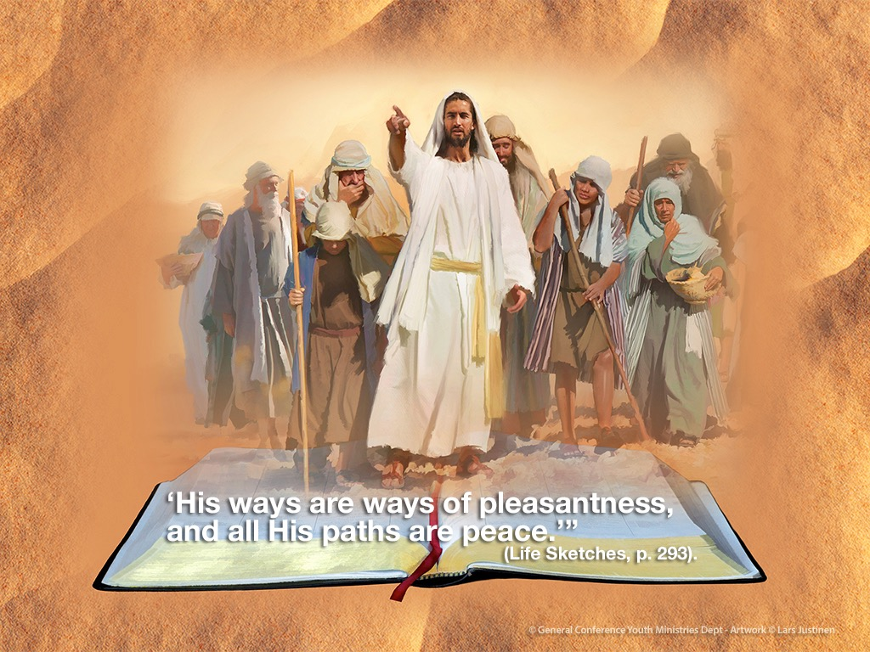

Slide 17
So cool!

Slide 18
Study the Bible, she says.
But why?
Because it reveals the matchless
charms of Jesus!
And what will happen to you as you encounter Jesus in Scripture?
You will fall in love with Him!

Slide 19
Problem is, we often study and preach the Bible with Jesus nowhere in sight,
or if He is in sight, it is as a footnote.
If there is anything we need to be clear on, it is this: Jesus is not part of our message. Jesus is our whole message. To the degree that He is not, we are not preaching “the truth,” no matter how much we imagine we are.

Slide 20
Our state-of-the-dead doctrine is an example of a biblical truth that has
massive potential to reveal God’s
amazing love in Christ.
Sadly, however, it has often been
reduced to a mere a text-by-text
argument for the sake of proving that people are unconscious when they
die and winning the argument that no
one goes straight to heaven or hell.

Slide 21
Let’s be clear: that part of the picture is vital, but why is it vital? Simply to prove the fact that the dead are really dead?
No! Rather, it is vital because the biblical truth about death opens a window of understanding into the true nature of Christ’s suffering and death at Calvary, which in turn reveals the true nature of God’s love with breathtaking clarity.

Slide 22
So let’s dive into this remarkable
subject and see what we discover.

Slide 23
Death According To the Bible
The first thing we need to understand
about death is that in the Bible we are taught that there are two kinds of death.
In the book of Revelation, we are told that there is something called, “the second death.” (Revelation 2:11; 20:6, 14; 21:8)

Slide 24
We can logically deduce from this
language that if there is a second
death and then there is of necessity
a first death.

Slide 25
In Matthew 10:28 Jesus explains the
basic difference between the two:
“And do not fear those who kill the body but cannot kill the soul. But rather fear
Him who is able to destroy both soul and
body in hell.”
The first death is merely the killing of
the body. This is the common death that everybody dies, that all human beings
are familiar with.

Slide 26
As Seventh-day Adventists we understand that the first death puts
a human being into an unconscious, sleep-like state.

Slide 27
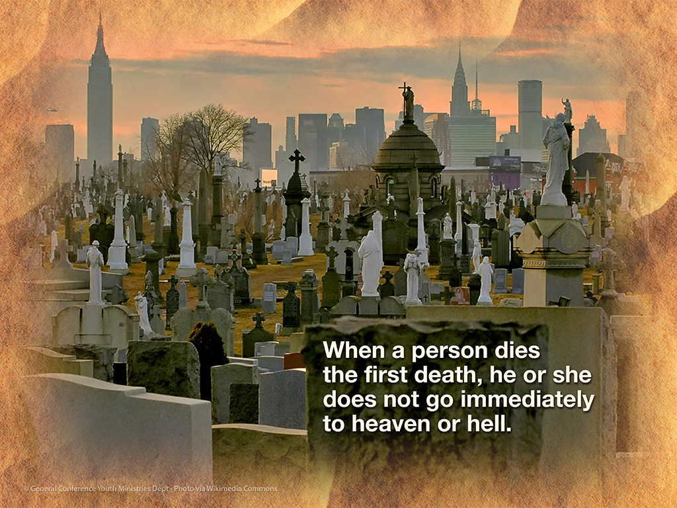

Slide 28
However, this is not the end of the story, because when a person dies the first
death that is not his or her end.
From the first death, there is a
resurrection, both of the saved and
the lost.
Jesus stated this explicitly:

Slide 29
“The hour is coming in which all who
are in the graves will hear His voice and come forth—those who have done good,
to the resurrection of life, and those who have done evil, to the resurrection of condemnation.” (John 5:28, 29)

Slide 30
Of course, the “dust” refers to the
body, which returns to the earth as organic matter after the first death.
The “spirit” that returns to God is
the total content of each individual’s personality, thoughts, feelings,
motives—everything that defines
the unique identity and moral character
of the person.

Slide 31
The “spirit” that “returns” to God
when a person dies first death God
simply preserves in an unconscious
state while awaiting the resurrection, when God will reconstitute the physical body with the spirit, at which point conscious life resumes.

Slide 32
Ellen White explained it like this:
“Our personal identity is preserved
in the resurrection, though not the
same particles of matter or material substance as went into the grave.
The wondrous works of God are a
mystery to man. The spirit, the character
of man, is returned to God, there to be preserved. In the resurrection every man will have his own character.

Slide 33
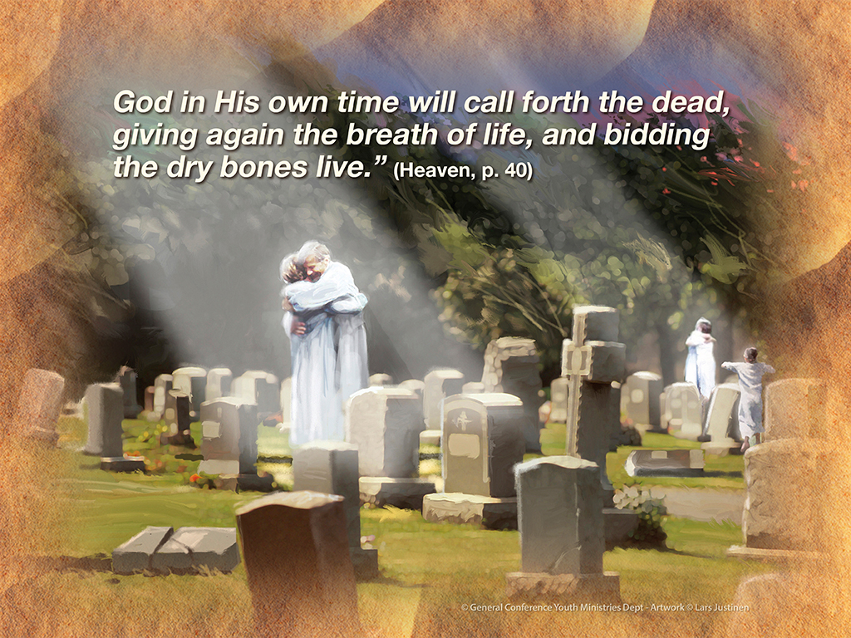

Slide 34
It’s kind of like taking a hard drive
out of a computer, which has the
record of all the unique information
that the owner of the computer had collected and configured, and setting it on the shelf for a while and then later on installing all that information in a new computer.

Slide 35
When a person dies the first death, the body decomposes in the earth and God preserves the specific makeup of the individual for the resurrection.

Slide 36
At that point, each individual faces
one of two destinies: to be given
the gift of immortality or to experience
the second death.
So what about the second death?
What is it?
How does it happen?

Slide 37
Let’s return to Matthew 10:28, where Jesus distinguished between the first and the second death:
“And do not fear those who kill the body but cannot kill the soul. But rather fear Him who is able to destroy both soul and body in hell.”

Slide 38
The word that is here translated
“soul” is psyche in the Greek text.
It basically refers to the mind in all of
its content, what we referred to earlier
as a person’s character, or the total content of one’s individual identity.

Slide 39
Whereas the first death merely involves the killing of the body, or the biological aspect of a person, the second death involves the complete eradication of the individual’s body and soul from existence.
It constitutes the final annihilation of the wicked, “as though they had never been.” (Obadiah 16)

Slide 40
The crucial part to understand is
how the second death happens and
what causes it.
Jesus gave us a pretty clear indication
in John 5:29. The wicked come back to life from the first death in what He called “the resurrection of condemnation”.

Slide 41
Condemnation is a psychological phenomenon. It happens in the mental
and emotional process when a person
faces the reality of his or her guilt for the relational violations he or she has committed.

Slide 42
When the wicked are resurrected, they won’t simply be physically destroyed a second time.
They will face their life’s record with
full, un-buffered clarity in the
contrasting light of God’s self-
sacrificing love for them.

Slide 43
Revelation 20 vividly describes the scene:
“Then I saw a great white throne and
Him who sat on it, from whose face the
earth and the heaven fled away.
And there was found no place for them.
And I saw the dead, small and great,
standing before God, and books were
opened.

Slide 44
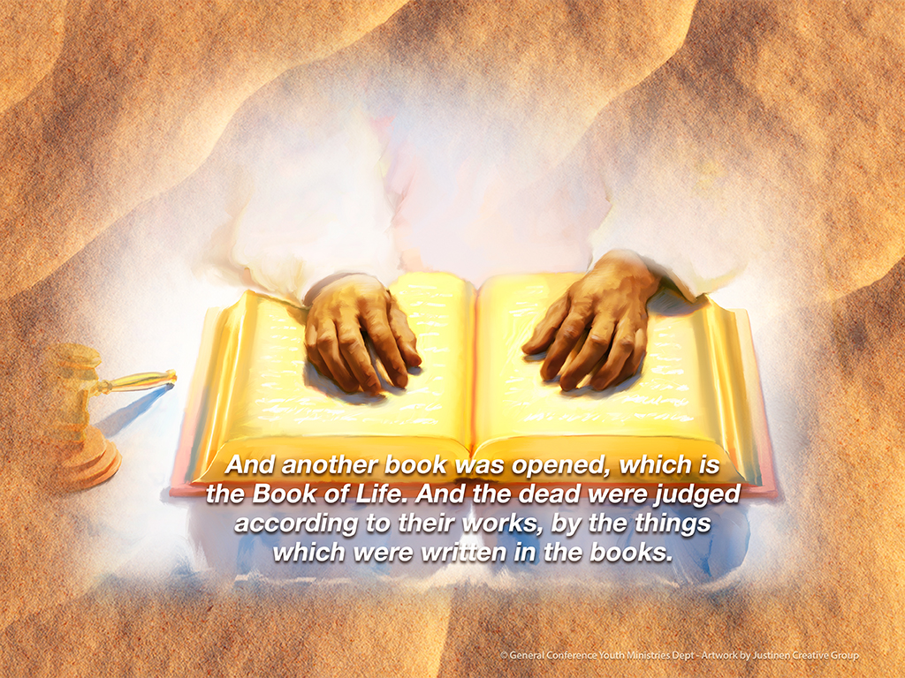

Slide 45
The sea gave up the dead who were in it, and Death and Hades delivered up the dead who were in them.
And they were judged, each one according to his works. Then Death and Hades were cast into the lake of fire. This is the second death. And anyone not found written in the Book of Life was cast into the lake of fire. (Revelation 20:11-15)

Slide 46
This is a very heavy and extremely
sad passage of Scripture, because it describes the final destruction of the wicked, every one of them a human
being that God loved dearly; every one
of them an individual who was given
the gift of eternal life in Christ;
every one of them a person that
persistently rejected God’s love to
their internal ruin.

Slide 47
What we want to notice in this passage
is precisely how the wicked experience
the second. There are four basic
features brought to view:

Slide 48
Number One
The second death is initiated by a full revelation of God Almighty, seated
upon “a great white throne” with His “face” fully exposed to the astonished gaze of all. Paul calls this event
“the day of wrath and revelation of the righteous judgment of God.” (Romans 2:5)

Slide 49
Wrath occurs in the light of revelation.
The revelation proceeds from God and takes on the form of self-awareness in those who behold it.

Slide 50
Number Two
As the wicked stand before God,
there will be found “no place for them”. These are no doubt the saddest words
in all of human literature. The second death is total aloneness, a deep inner sense of complete un-belonging.

Slide 51
The wicked, standing before God’s
throne and gazing upon His
countenance, realize with intense vividness that they are so out of
harmony with God’s kingdom that
there is absolutely “no place for them”.

Slide 52
Those who are irrevocably bent
toward selfishness don’t fit into a
universe governed by the absolute
rule of selfless love.
They cannot exist among or interact
with a society of beings who live
wholly for one another.

Slide 53
They can’t even comprehend such a society. The beautiful ebb and flow of giving and receiving is beyond their ability to engage in or even appreciate. Sin has hollowed their hearts of the very capacity for love.
Rebellion has stripped away them the gentle impulses of the soul. Selfishness has eradicated their sensitive humanity.

Slide 54
The second death confronts the
wicked with the bleak reality of an
ultimate meaninglessness, for there
isno meaning to life apart from
life’s Author.
Complete loneliness is all they can
feel, for there is no satisfying
relationship apart from the One to
whom we are most closely related.

Slide 55
A sense of total worthlessness
pervades their souls, for there can
never be any real sense of personal
worth apart from the God who created
our value in His own image.

Slide 56
Living for self ultimately leads to
self-hatred. Selfishness is, by its very nature, isolation from all others,
stealing from the soul the perceptions
and emotions necessary to give and receive love.

Slide 57
In a universe where the essential
life-sustaining principle is selfless
love, “there is found no place for them”.
They sink with regretful self-disgust
into acute feelings of total
abandonment.

Slide 58
Number Three
As the wicked stand before God,
“the books” are “opened” and they are “judged according to their works, by the things which were written in the books”.
In other words, they face the full reality
of their sin and all the guilt that it entails comes upon their consciousness with perfect awareness.

Slide 59
This is what Jesus was referring to when he said that they are resurrected to “condemnation”.

Slide 60
Every selfish deed of their lives passes before their minds with vivid clarity.
The second death brings the soul
face-to-face with the full, ugly reality
of one’s sin, untempered by any sense
of divine mercy.
Sin, once committed, is an existing
reality in the mind.

Slide 61
It is on record in the conscience and
must be resolved either by forgiveness
or by suffering.
Forgiveness is possible only by means
of embracing God’s merciful love.
Suffering is the only alternative to forgiveness, which is why God can
only forgive by means of enduring in Himself the suffering inherent in sin.

Slide 62
The weight of sin’s terrible
condemnation crushes out all the
vital life forces of the soul. All human beings are sinners.
Therefore, all are under condemnation. That condemnation will eventually, ultimately impose an unbearable shame upon those who refuse to see the healing reality of God’s pardoning love.

Slide 63
A conscious sense of God’s love and acceptance is the only power with the capacity to neutralize the power of
sin and prevent it from destroying
the soul.

Slide 64
In order to grasp what the Bible means when it says, “the books were opened… and the dead were judged,” try to
imagine what it would be like if you
were made perfectly conscious of
every sin you’ve ever committed—
every wrong thought and feeling
and action.

Slide 65
Perfect awareness, all at once,
with every ugly detail staring at your
inner soul with no way of escape.
Then add to that horrendous picture
an absolute absence of mercy.

Slide 66
No concept of forgiveness.
No sense of acceptance.
No picture of a God who freely and
eagerly pardons all sin.
What would that moment in time
be like for you?

Slide 67
I know what it would be like for me.
There are no words adequate to
describe the mind-shattering ordeal.

Slide 68
The only reason we have never had
to face the full potency of our guilt is because the plan of salvation, set into motion by a loving Creator, has
erected a veil of mercy in the human conscience to act as a buffer to
preserve us from sin’s full effect.

Slide 69
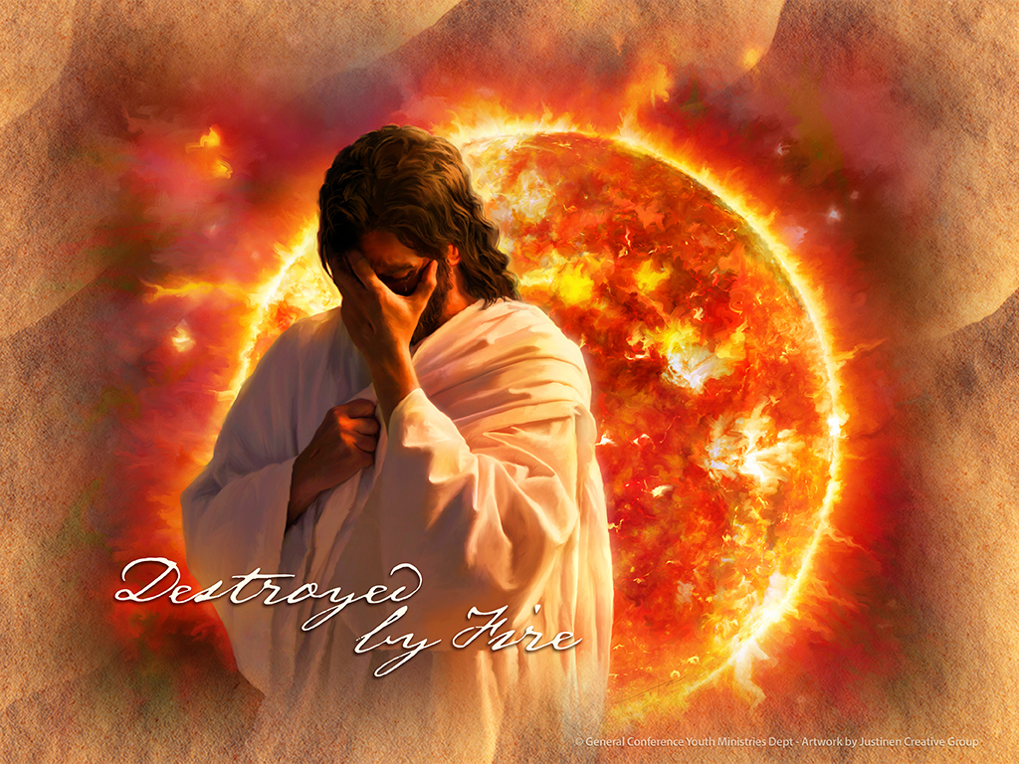

Slide 70
Number Four
Then, as the wicked face their life’s records and experience the total weight of their guilt, they are destroyed by fire.
Throughout the Bible God is associated with fire.

Slide 71
Moses encountered God in a
burning bush. (Exodus 3:2)
God’s Law is called a “fiery Law”. (Deuteronomy 33:2)
God’s “glory” is described as “fire”. (Exodus 24:17)
God’s throne is ablaze with fire
and from it proceeds a river of fire.
(Daniel 7:9, 10)

Slide 72
God’s love is said to be a flame of fire (Song of Solomon 8:6, NASB).
And Paul simply states, “Our God is a consuming fire” (Hebrews 12:29).

Slide 73
God’s total being is described as a consuming fire for one simple reason: because the pure reality of His selfless love stands in distinct contrast to all
that is contrary to love.

Slide 74
Ellen White got straight to the core
of this reality:
“The word of the Lord to Israel was,
‘I will turn My hand upon thee,
and purely purge away thy dross,
and take away all thy sin.’ (Isa. 4:4; 1:25)
To sin, wherever found,
Our God is a consuming fire.’
(Hebrews 12:29)

Slide 75
In all who submit to His power the
Spirit of God will consume sin.
But if men cling to sin, they become identified with it.
Then the glory of God, which
destroys sin, must destroy them.”
(The Desire of Ages, p. 107)

Slide 76
Humans were originally created
in a perfectly innocent state of being, capable of living in God’s immediate presence with total peace and pleasure. (Genesis 1-2)
When sin entered our psychological make-up, all we could experience in God’s presence was the torment of our shame. (Genesis 3:7-10)

Slide 77
The redeemed will live in God’s
presence and experience no shame.

Slide 78
God explained to Moses,
“You cannot see My face; for no man shall see Me, and live.” (Exodus 33:20)
The dynamic here is not, “If you see Me, I’ll kill you,” but rather, “If you see Me, you’ll die of the contrast between My holiness and your sinfulness.”

Slide 79
Sin cannot survive the presence of God.

Slide 80
However, when we jump to the end
of the story, Scripture says of the
redeemed: “They shall see His face,
and His name shall be in their foreheads.” (Revelation 22:4, KJV)
By the power of God’s grace, a
restoration of innocence has occurred
“in their foreheads”, in their minds.
In this way the redeemed will live in
God’s presence and experience no shame.

Slide 81
This is not the case with the wicked.
The Bible informs us that all human beings, both the righteous and the
wicked, are destined for the fiery
reality of God’s presence, but both
will not experience the fire in the
same manner.

Slide 82
While those who are restored to
innocence will finally enter God’s presence and be perfectly at home
there, for the wicked, God’s presence
will be a “consuming fire.”

Slide 83
Describing the final destruction of the wicked, Ellen White says this:
“This is not an act of arbitrary power
on the part of God.
The rejecters of His mercy reap that
which they have sown. God is the
fountain of life; and when one chooses
the service of sin, he separates from
God, and thus cuts himself off from life.

Slide 84
He is “alienated from the life of God.”
Christ says, “All they that hate Me love death.” (Ephesians 4:18; Proverbs 8:36)
God gives them existence for a time
that they may develop their character
and reveal their principles.

Slide 85
This accomplished, they receive the results of their own choice.
By a life of rebellion, Satan and all who unite with him place themselves so out of harmony with God that His very presence is to them a consuming fire.
The glory of Him who is love will
destroy them.” (The Desire of Ages, p. 764)

Slide 86
What we have just discovered is
the true nature of hell. Hell is
equivalent to the second death.
God will not subject the wicked to
eternal torture in the flames of some underworld or some remote region
of His universe.

Slide 87
They will be resurrected to face the record of their lives in one final reckoning, then they will be eternally annihilated “as though they had never been.” (Obadiah 16)

Slide 88
Here’s the most remarkable thing of all:
not one person need experience the second death, because Jesus experienced it for all of us—and conquered it.
He alone tasted the second death
for every person and He alone could
not be held in it because He alone
was sinless.

Slide 89
Oh, What Love!

Slide 90
Now, then, once we understand the nature of the second death in contrast to the first death, we are prepared to comprehend what Jesus endured for us as He agonized in Gethsemane and died on the cross.
Both the first death and the second death are the result of sin, but the first is temporary and occurs by means of physical causes, such as disease or tragedy or old age.

Slide 91
The second death, however, does not
occur on merely a physical level,
but on the psychological level as well,
due to the lethal power of one’s guilt.
The first death, in a sense, is not really death at all. Jesus called it sleep.

Slide 92
Consider, for example, the young girl
that Jesus resurrected.
As He approached the girl’s home,
after being asked to come and heal her, Jesus said to the mourners,
“Do not weep; she is not dead, but sleeping.” (Luke 8:52)

Slide 93
Notice Jesus did not merely say the
girl was sleeping, but He went a step further. “She is not dead,” He plainly stated.
Not understanding His meaning,
“they ridiculed Him, knowing that she
was dead” (Luke 8:53), but Jesus was
not off in His diagnosis.

Slide 94
He knew the girl was dead in the
first-death sense, but He also knew
she was not dead in the ultimate,
second-death sense.
In order to demonstrate His point, He proceeded to awaken the girl from her first-death sleep.

Slide 95
When the Bible says “the wages of
sin is death,” (Romans 6:23) it does not merely mean the first death.
When the Bible says of Jesus
“Christ died for our sins” (1 Corinthians 15:3) and that He went to the cross so
that He “might taste death for everyone,” (Hebrews 2:9) it does not
merely mean the first death.

Slide 96
The ultimate wages of sin is the second death.
It logically follows that Jesus can only save us from what He has endured and conquered for us.

Slide 97
If Jesus only experienced the first
death, then he can only save us from
the first death and we must still face
the second ourselves.
However, the glorious good news is
that Jesus faced the full, horrific reality
of the second death. Pay attention as
Jesus and His disciples enter the
Garden of Gethsemane.
Something astounding is about to happen.

Slide 98
No, that’s an understatement.

Slide 99
Something far more than astounding
is about to happen.
All of history is about to converge at a single point of destiny, toward which
each day and every event have been relentlessly rushing.

Slide 100
Just now, in the next relatively brief
period of time, the zenith revelation of God’s love will unfold in the suffering
and death of Jesus.
And the world, indeed the universe,
will never again be the same.
Watch.

Slide 101
Jesus is staggering under the weight
of some invisible burden.
The disciples can see that something
is wrong. Jesus explains what’s
happening to Him:
“My soul is exceedingly sorrowful,
even to death.” (Matthew 26:38)
Here He opens to our understanding
the nature of His suffering.

Slide 102
Notice that He used the same word
He had employed earlier to describe
the second death as distinct from
the first death:
“And do not fear those who kill the
body but cannot kill the soul.
But rather fear Him who is able to
destroy both soul and body in hell.”

Slide 103
Again, the word here translated “soul”
is psyche in the Greek text and that is precisely the word Jesus uses now to communicate what He’s enduring.
In Gethsemane, Jesus says He is dying
at the psyche level of His being.
He is dying from the inside out, under
the lethal power of our sin and guilt.

Slide 104
No physical abuse has yet been
inflicted upon Him.
And yet, He is dying!
No blood has yet been drawn from
His flesh by violence.
And yet, He is bleeding!
Luke tells us:

Slide 105
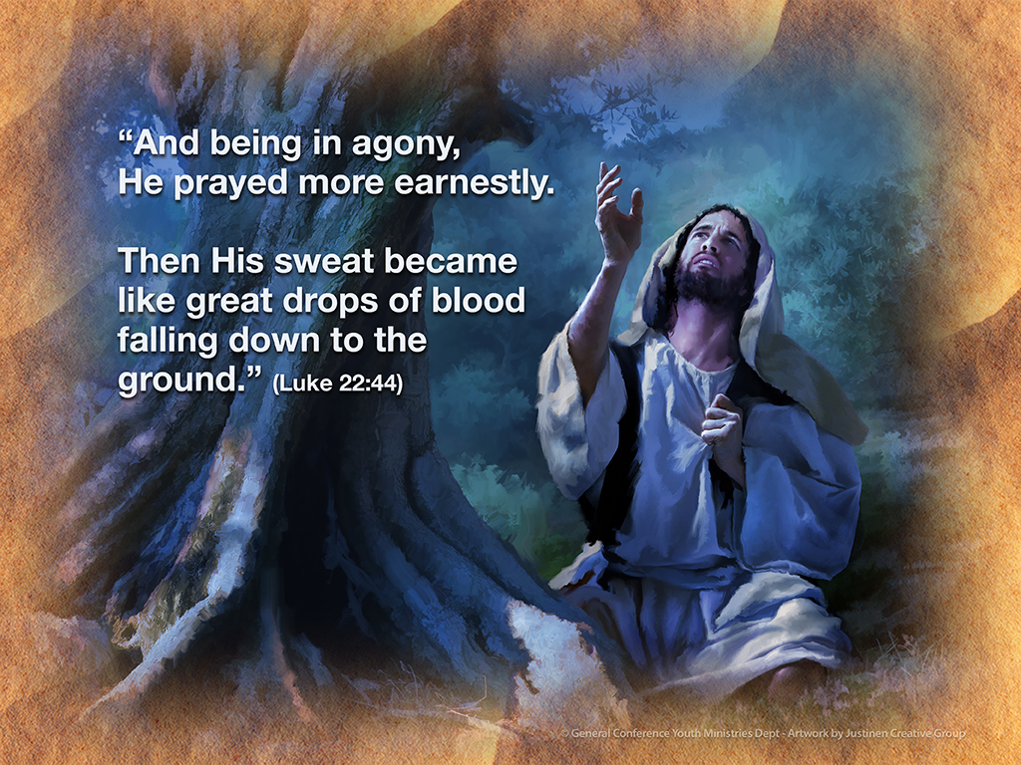

Slide 106
He is bleeding through His pores due
to the intense internal stress the shame of our sin is imposing on Him.
Isaiah 53 offers astounding insight to what Jesus endured for us.
Notice verse 6: “All we like sheep have gone astray; we have turned, every one, to his own way; and the Lord has laid on Him the iniquity of us all.”

Slide 107
Then verse 10 says “His soul” was
made “an offering for sin”.
And, finally, look at verse 12:
“He poured out His soul unto death,
and He was numbered with the transgressors, and He bore the sin
of many, and made intercession
for the transgressors.”

Slide 108
This is nothing short of astounding, because this means that Jesus entered
the dark realm of our sin and shame.
He took it all into His own conscience
as if He were the guilty party instead
of us.
From Gethsemane, Jesus is taken to
the cross. Yes, nails were hammered through His hands and feet. Yes, His
body was tortured.

Slide 109
And yet, He never uttered a word
about the physical pain, because His mental suffering was so intense that
it nearly eclipsed His physical pain.

Slide 110
Take in every line of this amazing statement by Ellen White:
“Many have suffered death by slow tortures; others have suffered death
by crucifixion.
In what does the death of God’s dear
Son differ from these?

Slide 111
It is true He died upon the cross a
most cruel death; yet others, for His
dear sake, have suffered equally,
so far as bodily torture is concerned.
Why, then, was the suffering of Christ more dreadful than that of other
persons who have yielded their lives
for His sake?

Slide 112
If the sufferings of Christ consisted
in physical pain alone, then His death was no more painful than that of
some of the martyrs.

Slide 113
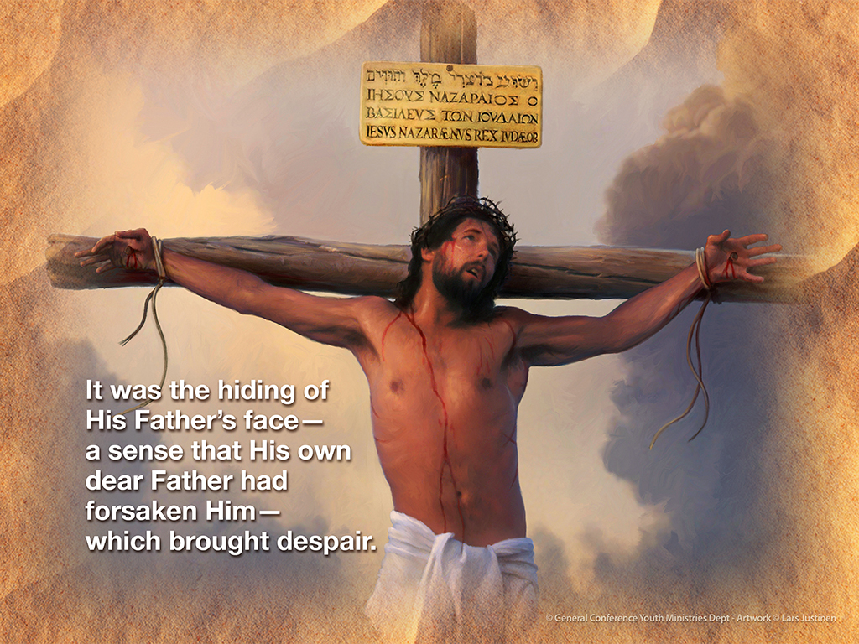

Slide 114
But bodily pain was but a small
part of the agony of God’s dear Son.
The sins of the world were upon Him,
also the sense of His Father’s wrath
as He suffered the penalty of the law transgressed.

Slide 115
It was these that crushed His divine
soul. It was the hiding of His Father’s
face—a sense that His own dear
Father had forsaken Him—
which brought despair.

Slide 116
The separation that sin makes
between God and man was fully
realized and keenly felt by the innocent, suffering Man of Calvary.
He was oppressed by the powers of darkness. He had not one ray of light to brighten the future.”
(Testimonies for the Church, Vol. 2, p. 214)
Wow!

Slide 117
Bodily pain was but a small part
of the agony of God’s dear Son?
He had not one ray of light to brighten the future?
What does this mean?
What, really, did Jesus suffer for you and me?

Slide 118
Ellen White blows our minds with this
deeper insight:
“The Savior could not see through the
portals of the tomb.
Hope did not present to Him His coming
forth from the grave a conqueror, or tell
Him of the Father’s acceptance of the sacrifice. He feared that sin was so
offensive to God that their separation
was to be eternal” (The Desire of Ages, p. 753).

Slide 119
Astounding!
For a sustained period of time,
as our guilt enveloped His heart in impenetrable emotional darkness,
Jesus could not see life for Himself
beyond the grave. But here’s the
amazing thing:
He was not trapped. His back was not
up against a wall with no way out.

Slide 120
There are two things He said before
the cross that indicate that He was
not trapped:
“Therefore My Father loves Me,
because I lay down My life that I may
take it again. No one takes it from Me,
but I lay it down of Myself. I have power
to lay it down, and I have power to take
it again. This command I have received from My Father.” (John 10:17, 18)

Slide 121
And in Gethsemane He told Peter:
“Do you think that I cannot now pray
to My Father, and He will provide Me
with more than twelve legions
of angels?” (Matthew 26:53)

Slide 122
Don’t miss what all this means.
Jesus faced the prospect of eternal
death, and yet, for love of your soul
and mine, He did not pull back.
He was literally willing to die for ever
and never be reunited to His Father
to save us. Paul called what happened
at Calvary, “the love of Christ which
passes knowledge.” (Ephesians 3:19)

Slide 123
When Jesus gave His life on the
cross, He demonstrated with
astounding clarity and beauty that
God literally loves all others more
than His own existence.
This is the incredible truth the
Seventh-day Adventist understanding
of death and hell opens to view.

Slide 124
This is the truth that the false
doctrines of natural immortality and
eternal torment block from view.

Slide 125
Someone will say, “But Jesus could
not have experienced the second
death, because the second death is
eternal destruction, from which there
is no resurrection.”
Ah, but here’s the glorious good news:
Jesus did not simply experience the second death. He conquered it as He experienced it.

Slide 126
Peter declared: “Whom God raised
up, having loosed the pains of death, because it was not possible that He
should be held by it.” (Acts 2:24)

Slide 127
Notice the language here.
“It was not possible” for death to
hold Jesus.
But why?

Slide 128
For one simple and profound reason:
“The sting of death is sin, and the
strength of sin is the law”
(1 Corinthians 15:56)
... but Jesus never sinned.
Under the fiercest temptations to
save Himself, He kept on loving all
of us at any cost to Himself.

Slide 129
That selfless love, maintained with unbroken integrity straight through Gethsemane and Calvary, constituted
perfect harmony with the law of God.
By love alone, Jesus triumphed over
the second death.
Therefore, it was impossible for the
second death to hold Him.
His resurrection is proof of His victory
over our sin, our guilt, and our death.

Slide 130
Tears come to my eyes and
adoration surges in my heart as
the true significance of the Savior’s sacrifice dawns upon my mind.
How could He love me so deeply, so passionately, so selflessly?
Is this really what God is like?

Slide 131
Can it truly be that the Almighty
God of the universe is this
incredibly beautiful?
Calvary answers with a resounding
yes!

Slide 132
Small group
Discussion Time

Slide 133
Question 1
What is your internal reaction to
this lesson? Is this the same or
different from your previous ideas
of death and judgment?
Explain.

Slide 134
Question 2
The author speaks of guilty ones
facing “the relational violations they
have committed”.
What do you think he means by that?
Could those be the most important sins? Why or why not?
.

Slide 135
Question 3
Have you truly confessed to God
from your heart the sins you have committed? If not, you may still do so.
If so, have you truly accepted from
your heart that Jesus covered those
sins completely and your forgiveness
is as complete as if you’d never sinned?
What would help you to accept this completely?

Slide 136
Question 4
Name some specific ways you can pass on the glorious gift of total forgiveness.

Slide 137
2016 Youth and Young Adults Week of Prayer Sermons
Copyright © 2015-2016
General Conference of Seventh-day Adventist®
Youth Ministries Department
Sermon written by: Pastor Ty Gibson http://www.lightbearers.org/profile/ty-gibson/
Email: Ty@lightbearers.org
For additional use of any of the images in this presentation please contact GoodSalt Inc.
Phone: 800-805-8001 ● Website: http://www.goodsalt.com

