Slide 1
Images for Day 5 of the
2016 Youth and Young Adults Week of Prayer readings.
A PDF of the complete sermon can be downloaded here
Sermon written by: Pastor Ty Gibson http://www.lightbearers.org/profile/ty-gibson/
Email: Ty@lightbearers.org
For additional use of any of the images in this presentation please contact GoodSalt Inc.
Phone: 800-805-8001 ● Website: http://www.goodsalt.com

Slide 2
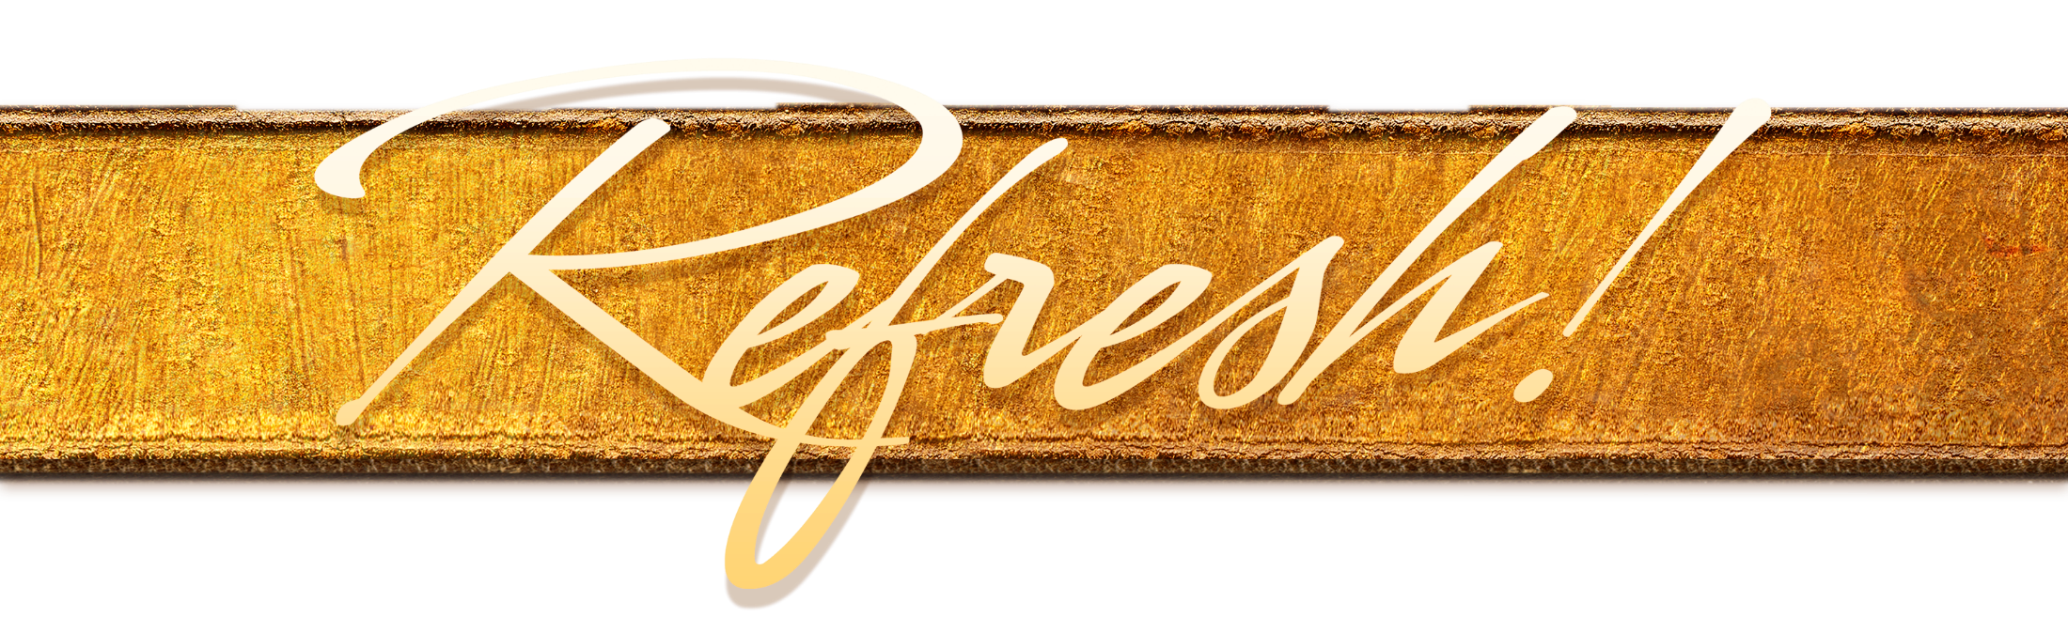
Jesus – the Essence of Our Faith

Slide 3
2016 youth and young adults
Week of Prayer
Theme:
Jesus—The Center of It All
Copyright ©2015 General Conference of SDA Youth Ministries Department
www.gcyouthministries.org

Slide 4
In this
Week of Prayer series
we will be exploring
eight key
Bible doctrines
of the
Seventh-day Adventist Church.

Slide 5
Welcome to day 5
of our re-examination of our core beliefs.

Slide 6
Remember our Guiding Metaphore?
The doctrinal truths of Scripture can be thought of as a series of perceptual windows through which God's character may be viewed from various different angles.

Slide 7
For our purposes, let’s imagine the structure of truth as an octagon-shaped building.
On each of the eight sides of the structure, there is a window.
Each window represents one of our doctrinal beliefs:

Slide 8
DAY 1: The Trinity
DAY 2: The Great Controversy
DAY 3: The Law of God
DAY 4: The Sabbath
DAY 5: The Sanctuary
DAY 6: Death and Hell
DAY 7: The End Time
DAY 8: The Second Coming

Slide 9
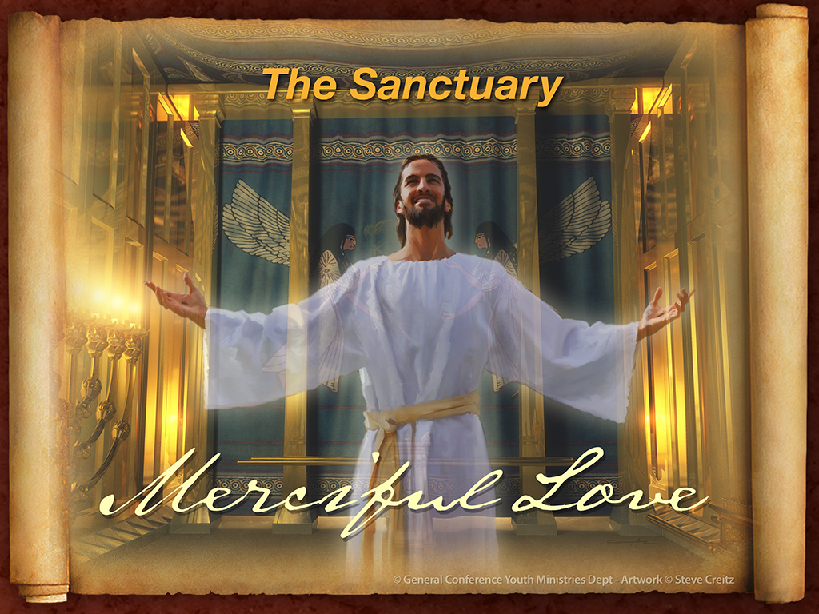

Slide 10
MERCIFUL LOVE
When Ellen White was a teenage girl she had a mind blowing dream about a huge temple. She wrote:
“I dreamed of seeing a temple to which many people were flocking. Only those who took refuge in that temple would be saved when time should close.”

Slide 11
In the dream, she felt urgency to take refuge in the building, but she was afraid of being laughed at by the mocking crowd.

Slide 12
With self-conscious fear she made her way slowly to the temple.
Upon entering, she immediately saw that the building was designed with an unusual and striking architectural feature: “On entering the building, I saw that the vast temple was supported by one immense pillar.”

Slide 13
Here was a large building, and the whole thing was being held up by “one immense pillar”. As she pondered what this might mean, she noticed something about the pillar:
“…to this [pillar] was tied a Lamb all mangled and bleeding. We who were present seemed to know that this Lamb had been torn and bruised on our account.”
(Early Writings, pp. 78-79)

Slide 14
Ah, now we see the point of the vision.

Slide 15
Here God revealed to the young Ellen White that the entire temple of truth that He was revealing to the Advent people would find its “one immense pillar” of support in the cross of Christ.

Slide 16
A riveted focus on the cross would be crucial for a proper grasp of the entire theological structure. Jesus must be kept in clear view as the real point of every point of truth.

Slide 17
Referencing the “pillar” symbol,
Ellen White later wrote that the
cross “is the central pillar on which hangs the far more exceeding and eternal weight of glory which is for those who accept the cross.
Under and around the cross of Christ, that immortal pillar, sin shall never revive, nor error obtain control.”
(SDA Bible Commentary, Vol. 7A, p. 457)

Slide 18
And on another occasion, with even greater clarity, she penned these words: “There is one great central truth to be kept ever before the mind in the searching of the Scriptures—Christ and Him crucified.
Every other truth is invested with influence and power corresponding to its relation to this theme.” (The Faith I Live By, p. 50)

Slide 19
Ellen White was specific, definite, and passionate about viewing all truth in the light that streams form Calvary.
The cross of Christ, upon which Jesus suffered and died with perfect love for humanity, is the central pillar that supports the entire structure of doctrinal truth.

Slide 20
The moment we reduce truth to a list of factual points to be argued and proven, we have emasculated the truth of its power to save.
But as soon as we realize that every doctrine is a window into God’s love, that’s when its true beauty shines forth and real power is released into action.

Slide 21
Alright, then, with that little introduction before us, we are now prepared to explore the doctrine we commonly refer to as
The Sanctuary.

Slide 22
A PATH LIES BEFORE US
When King David looked at the sanctuary, he saw a path. In Psalm 77, verse 13, he said, “Your way, oh God, is in the sanctuary.” The word here translated “way” is derek. It means a path or a journey. The word conveys the idea of traveling to a set destination, moving from somewhere to somewhere else.

Slide 23
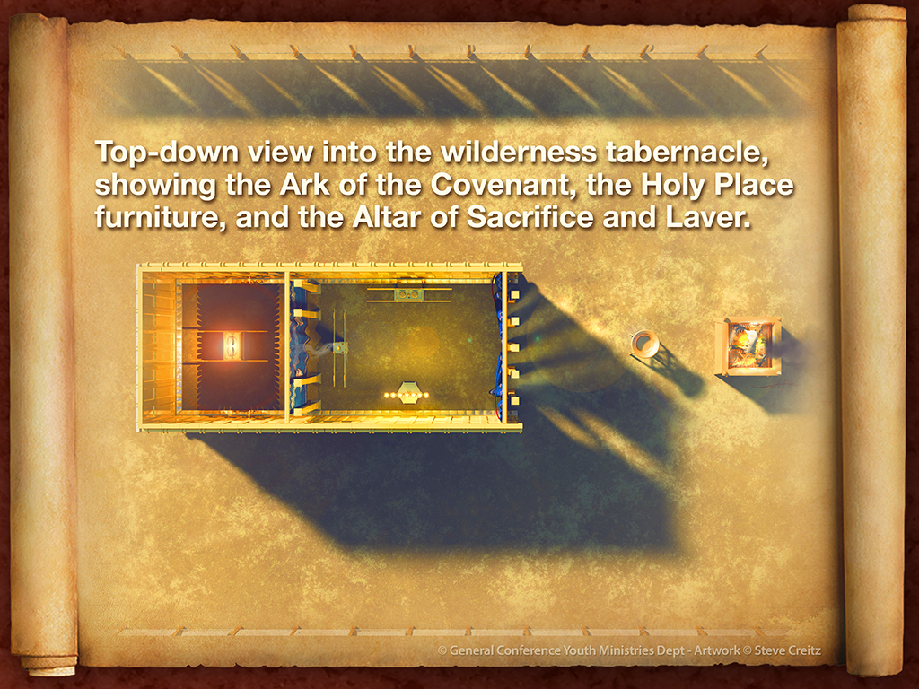

Slide 24
The obvious next question is, from where to where?
Well, if we just take a look at the basic layout of the sanctuary, sure enough, a path is immediately evident.
Let’s take a quick tour to get a basic feel for the journey, and then we’ll take a more detailed look.

Slide 25
First, there is the camp of Israel. This is where the people live in tents surrounding the sanctuary, three tribes of Israel on each side—North, South, East and West—with the sanctuary in middle of the encampment.
God told Moses: “Let them make Me a sanctuary, that I may dwell among them” (Exodus 25:8).

Slide 26
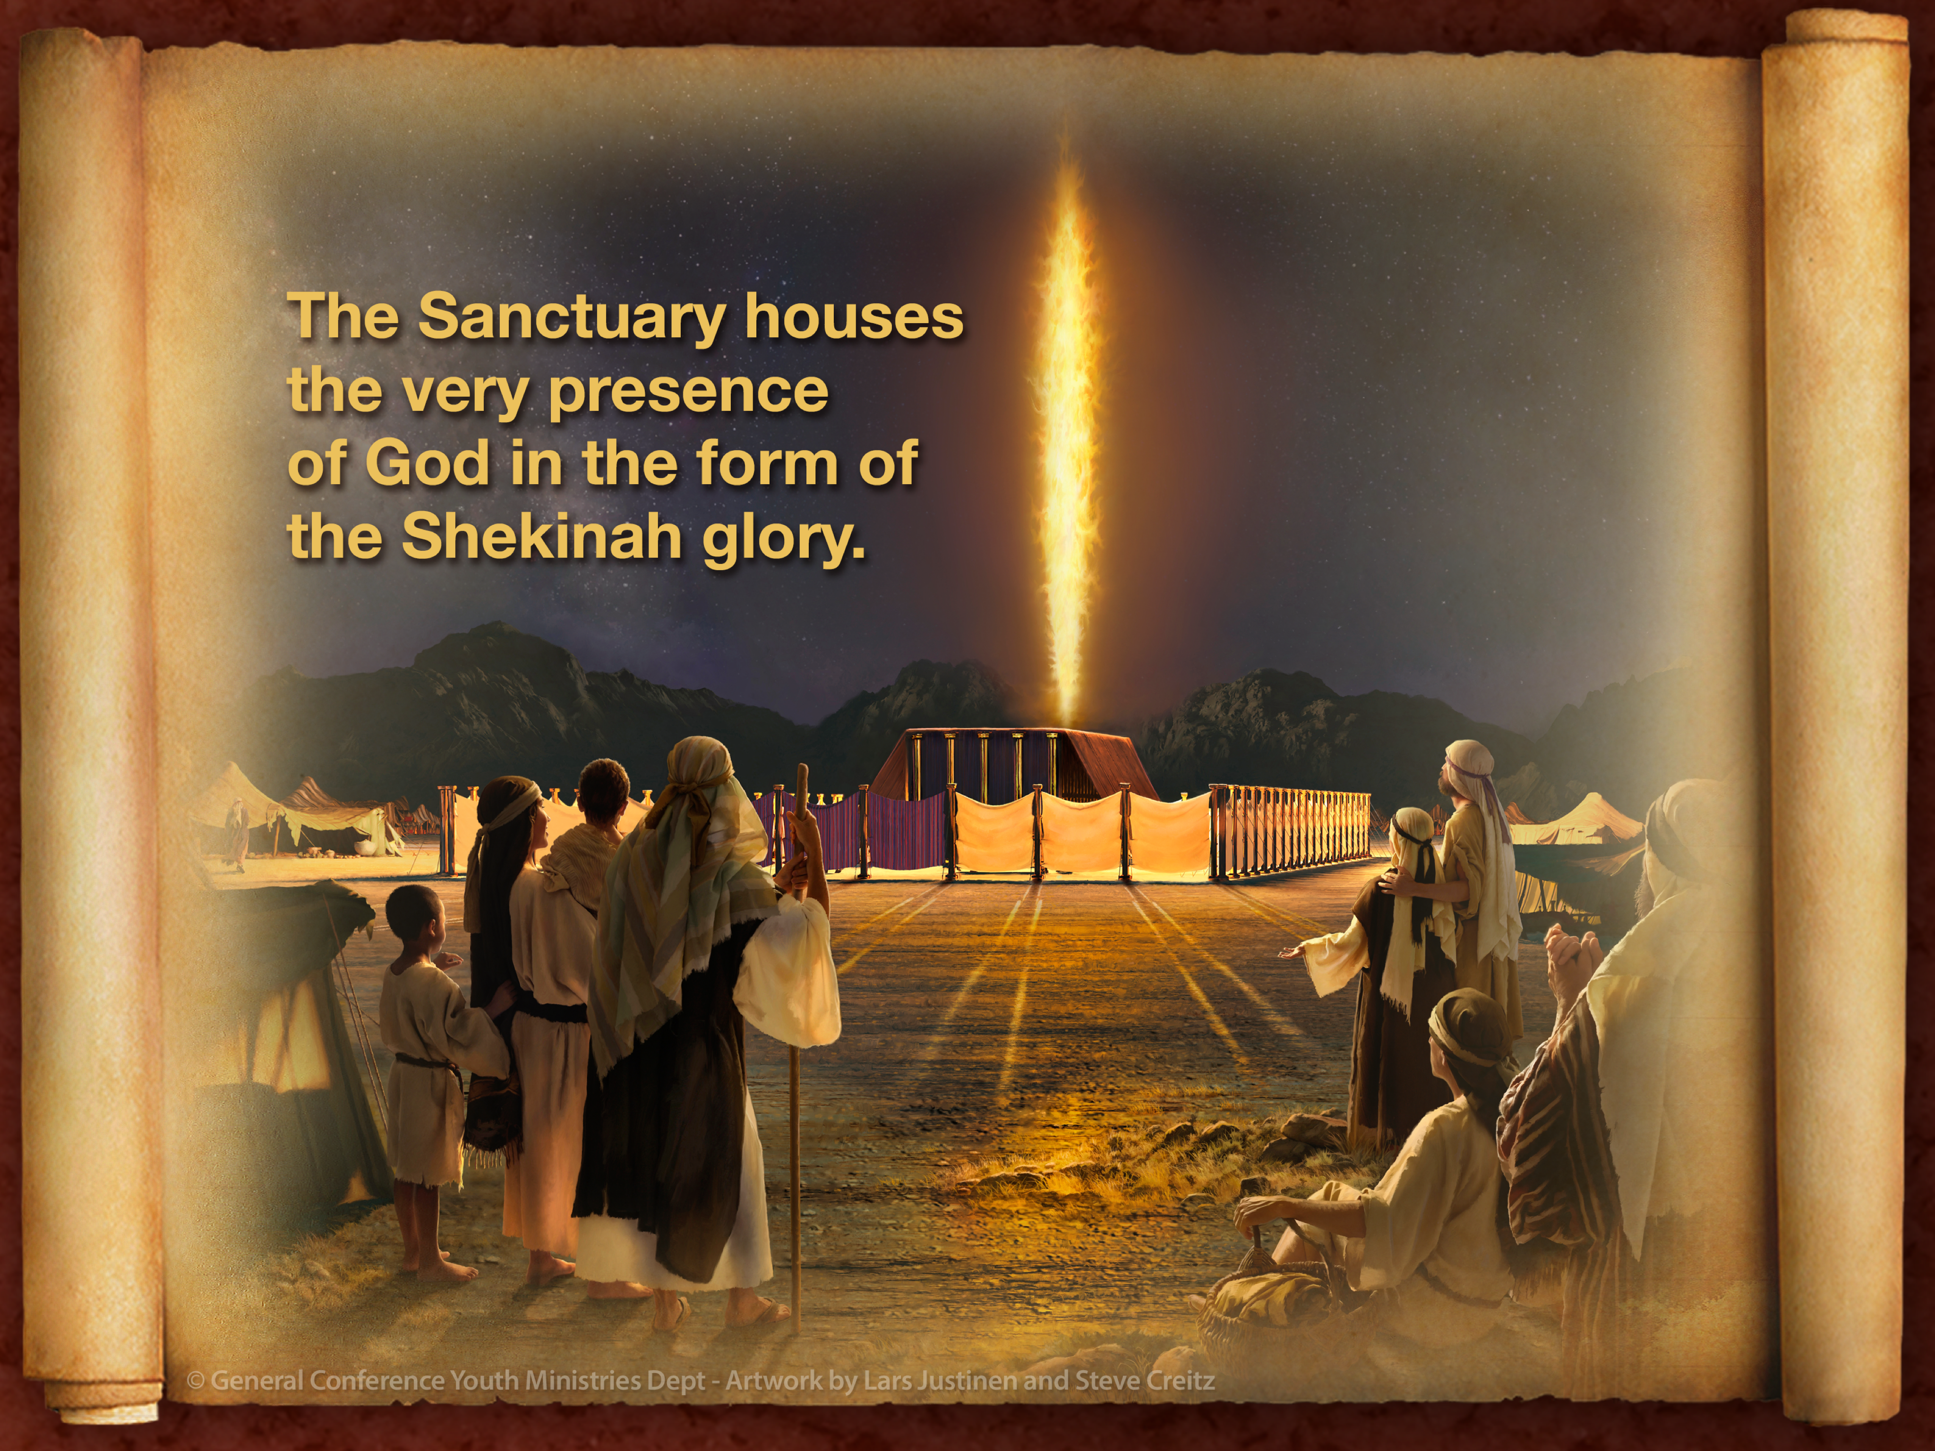

Slide 27
We’ll come back to this in just a moment, but for now we simply want to notice that God wants to be with His people, and He wants to make it possible for them to be with Him, even though at present, for their safety, He can only dwell with them behind a series of veils.

Slide 28
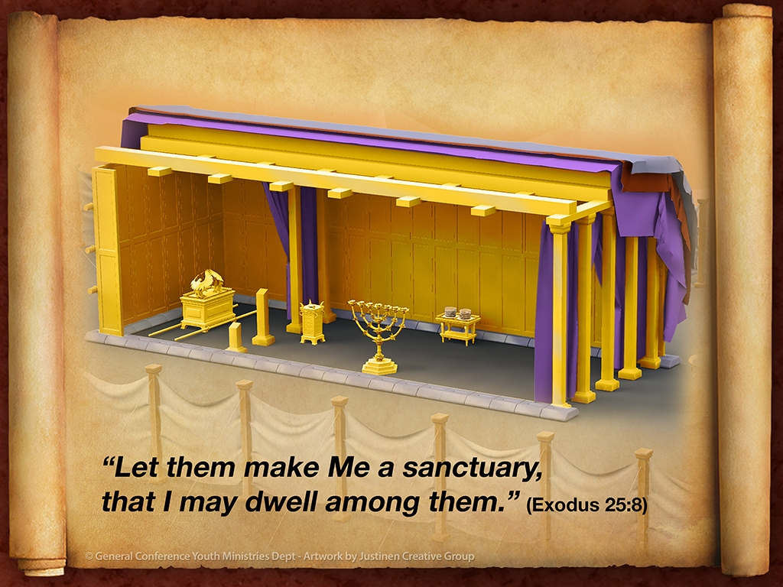

Slide 29
As we move from the camp toward the building, we notice that the sanctuary is enclosed by a high white linen wall.
White symbolizes moral purity, righteousness, and innocence. The message of the high white wall is clear: we are on the other side of innocence, on the outside of righteousness.

Slide 30
We are sinners separated from God by our unlikeness to His character, which means, by our lack of love.
But then we notice that God has provided a door of hope, a point of access, because on the east side there is an entrance through the high white wall, in the form of a beautiful curtain woven of blue, purple and red, in addition to white.

Slide 31
As we enter in through the curtain, we find ourselves standing before a large, brass altar.
A priest is there leading out in a ceremony.
We see a man on his knees, his hands bearing down upon the head of a little lamb, almost crushing the submissive animal.

Slide 32
The man confesses his sins, symbolically offloading his guilt to the innocent victim. Then the priest places a knife in the man’s hand.
With one rapid move, the throat is slit and the blood of the lamb flows from its body, some of which is caught by the priest in a bowl. The lifeless sacrifice is then placed on the altar and burned to ashes.

Slide 33
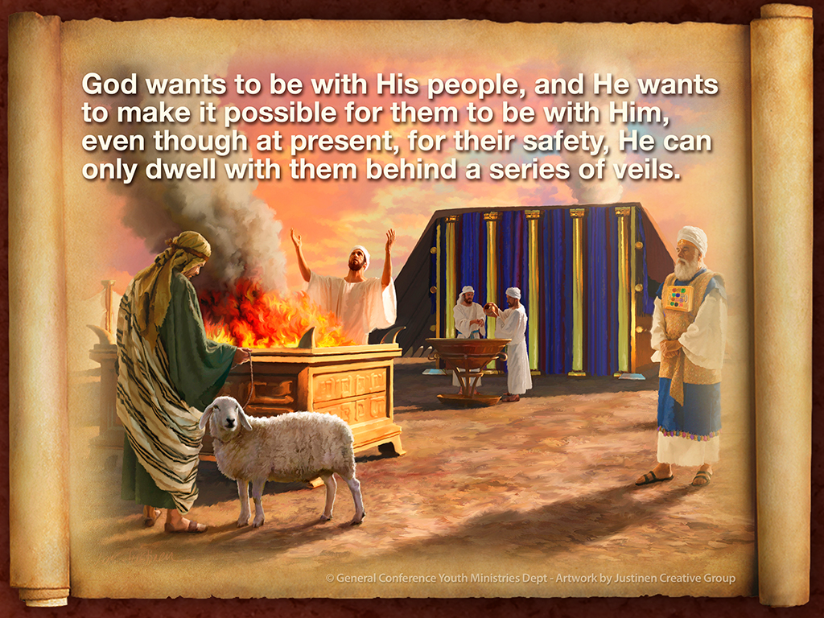

Slide 34
We move forward in the symbolic path and watch as the priest washes his hands and feet in the second piece of brass furniture in the courtyard, called the laver of washing.

Slide 35
The priest then proceeds with the bowl of blood into the first apartment of the sanctuary,
called the Holy Place.

Slide 36
Standing in the Holy Place, as we look to the right, we see a gold table with two stacks of fresh-baked flatbread placed upon it.
As we turn around and look to the left, we see a candlestick with seven branches, each one bearing a bright, flickering flame.

Slide 37
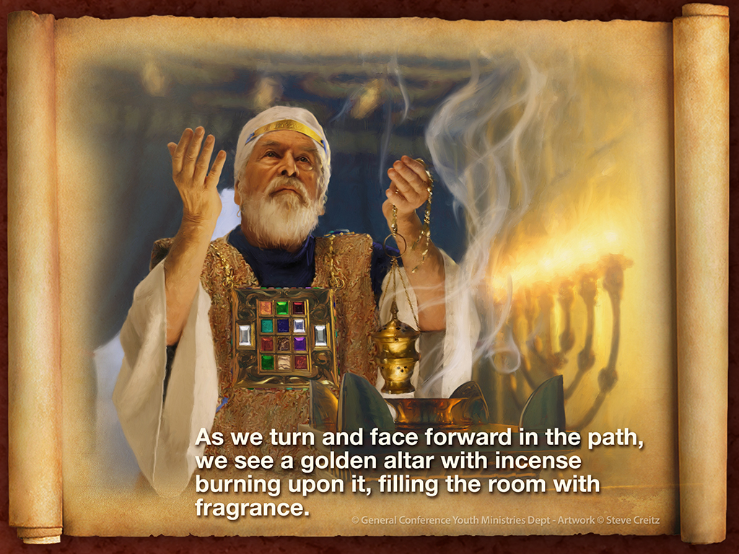

Slide 38
As we turn and face forward in the path, we see a golden altar with incense burning upon it, filling the room with fragrance.

Slide 39
We then notice that the priest is doing something that looks very planned and intentional: he is dipping his fingers in the bowl of blood and sprinkling the red liquid on the veil that hangs just beyond the altar of incense.
He counts under his breath: one, two, three… He dips and sprinkles exactly seven times.

Slide 40
Curious as to what lies beyond the veil, we draw it aside and step into the second room of the sanctuary, called the Most Holy Place or the Holy of Holies.

Slide 41
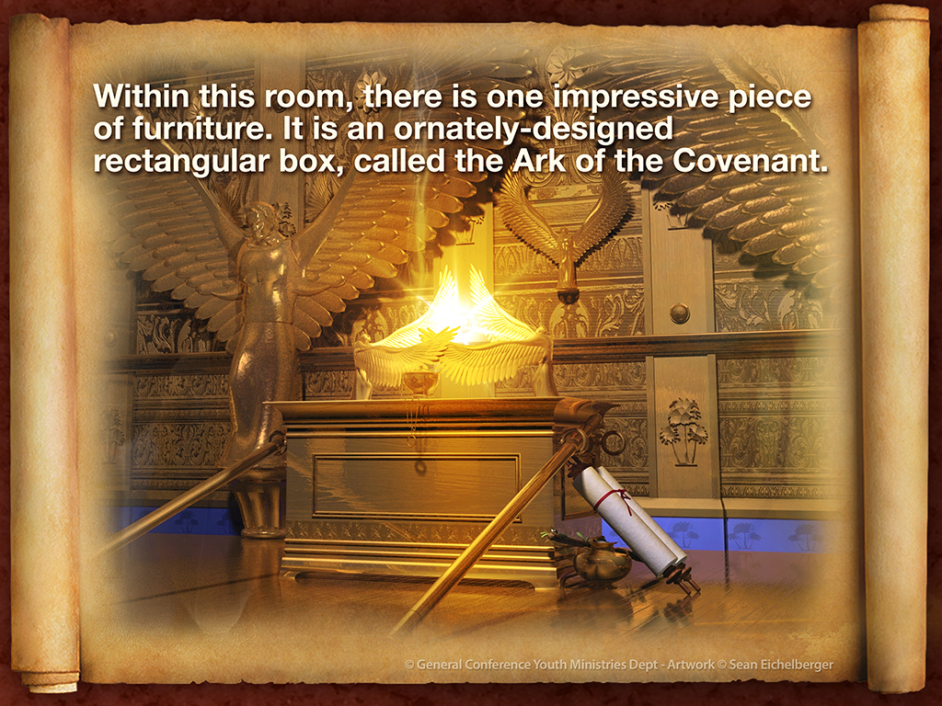

Slide 42
Inside the box are the two tables of stone, on which the very finger of God has engraved the Ten Commandments.

Slide 43
On top of the box is a solid gold lid, called the Mercy Seat. On either end of the Ark there are two solid gold angelic figures.
These are called the two covering cherubs. As we turn and look around, we notice that the veil and the ceiling are embroidered with golden angels.

Slide 44
Most impressive of all, above the Ark, radiating between the two covering cherubs is a bright light.
This is the Shekinah glory, the visible presence of God.

Slide 45
Clearly, the path marked out in the sanctuary has three basic steps, or experiential phases:
The Courtyard
The Holy Place
The Most Holy Place

Slide 46
We can summarize what we’ve learned so far like this:
The sanctuary provides a way, a path, and an experiential journey for the people to get back into immediate, unveiled fellowship with God.
It is God’s plan for restoring intimacy between Himself and us!

Slide 47
JESUS IS THE JOURNEY
When we come to the New Testament, we learn that every symbol of the sanctuary pointed to Jesus, depicting the various aspects of His saving ministry to sinners.

Slide 48
First of all, as we open the Gospel of John, we see that Jesus is described with sanctuary language. Notice John 1:14: “The Word became flesh and dwelt among us, and we beheld His glory, the glory as of the only begotten of the Father, full of grace and truth.”
The word translated here as “dwelt” literally means tabernacle or sanctuary.

Slide 49
So Young’s Literal Translation reads, “The Word became flesh, and did tabernacle among us.”
Getting even more personal, another Bible version says, “The Word became flesh and blood, and moved into the neighborhood.”
(The Message)

Slide 50
And John tells why Jesus came: so that we might behold the “glory” of God.
This is an obvious reference to the Shekinah glory that resided in the Most Holy Place of the Old Testament sanctuary.

Slide 51
The translators of The Complete Jewish Bible got this. Notice how they translated the text: “The Word became a human being and lived with us, and we saw his Sh’khinah, the Sh’khinah of the Father’s only Son, full of grace and truth.”
John’s intent in clear. Jesus is the reality to which the symbolic sanctuary pointed.

Slide 52
As we’ve already seen, God said to Moses in the Old Testament,
“Let them make Me a sanctuary, that I may dwell among them.”
(Exodus 25:8)
Now this same God has shown up in the world dwelling among us in a tabernacle made of flesh and blood.

Slide 53
Through Him, human beings are now being led into the Holy of Holies, into the immediate presence of the Shekinah glory.

Slide 54
But things get even clearer, and more amazing, as we move through the Gospel of John.
In John 2:19-21 we read: “Jesus answered and said to them, ‘Destroy this temple, and in three days I will raise it up.’ Then the Jews said, ‘It has taken forty-six years to build this temple, and will You raise it up in three days?’

Slide 55
But He was speaking of the temple of His body.”
Here we see that Jesus is explicitly identified Himself as the “temple” to which the ancient temple was pointing.
He has come to the world to act out in reality all that the sanctuary presented in symbol.

Slide 56
Remember what we read in Psalm 77:13?
“Your way, oh God, is in the sanctuary.”
Now notice what Jesus said about Himself in John 14: 6: “I am the way, the truth, and the life. No one comes to the Father except through Me.”

Slide 57
Jesus claims to be the “way” or the path that the sanctuary depicted.
The vital thing that we realize here is that the destiny to which the sanctuary path pointed, and to which Jesus takes us, isn’t merely a place, but rather a person. Jesus says He is the way “to the Father”.

Slide 58
The sanctuary doesn't convey dry theological facts. It presents before us an experiential journey deeper and deeper into the heart of God.
And Jesus is that journey. Literally every symbol of the sanctuary pointed to Him and the great work of salvation He would embark upon to get us back to Most-Holy-Place intimacy with God.

Slide 59
Watch this as we make the connections.

Slide 60
Each of the three phases of the sanctuary could only be accessed through a veil. Jesus said of Himself, “I am the door. If anyone enters by Me, he will be saved”
(John 10:9).

Slide 61
And the apostle Paul said that through Jesus we have “a new and living way, which He consecrated for us, through the veil, that is, His flesh.” (Hebrews 10:20).

Slide 62
The main ceremony of the sanctuary was the sacrifice of the lamb on the brass altar.
Pointing to Jesus as the sacrifice for our sins, John the Baptist proclaimed, “Behold! The Lamb of God who takes away the sin of the world.” (John 1:29)

Slide 63
The laver that was used for ceremonial washing pointed to Jesus as “the living water” (John 4:11) and teaches us about “the washing of regeneration and renewing of the Holy Spirit.” (Titus 3:5)

Slide 64
The bread on table in the Holy Place pointed to Jesus, who said,
“I am the bread of life. He who comes to Me shall never hunger, and he who believes in Me shall never thirst.” (John 6:35)

Slide 65
The seven-branched lampstand was kept burning to provide light in the sanctuary.
Jesus said of Himself, “I am the light of the world. He who follows Me shall not walk in darkness, but have the light of life.” (John 8:12)

Slide 66
The altar of incense pointed to a specific aspect of Christian experience: “He was given much incense, that he should offer it with the prayers of the saints.”
(Revelation 8:3)
The fragrant incense burning in the sanctuary symbolized our prayer arising to God through Jesus.

Slide 67
The Ten Commandments, God’s ten laws of self-giving love, were kept inside the Ark of the Covenant, symbolizing God’s desire to write the principles of His love in our hearts and minds:
“I will put my laws into their minds, and in their hearts I will write them.”

Slide 68
Describing the roundtrip journey He made from the Father to our world and back again, Jesus said, “I came forth from the Father and have come into the world. Again, I leave the world and go to the Father.” (John 16:28)

Slide 69
Jesus came from the Most Holy Place into our sinful, separated encampment here on earth.
He then took hold of our wayward hearts and made the journey back to the Most Holy Place, inviting us to follow Him on the path He has marked out for us.

Slide 70
So what is the sanctuary all about?
It’s all about Jesus!
It’s all about Jesus fulfilling the many dimensions of His saving ministry on our behalf!

Slide 71
It’s all about Jesus leading us
step-by-step back to a completely restored relationship with the Father!

Slide 72
SALVATION HISTORY
Okay, let’s back up now, take a deep breath, and look at the sanctuary from another angle.

Slide 73
What we’ve seen so far is that the sanctuary symbolically represents the personal journey of the individual believer in Christ.
But the sanctuary also represents salvation history as a whole.

Slide 74
The Courtyard, with its altar of sacrifice directs our attention to A.D. 31, when Jesus was crucified on our behalf.
After His resurrection, Jesus ascended to heaven where He took up His role as our heavenly High Priest in the Holy Place of the
“true tabernacle” in heaven.

Slide 75
This phase of His ministry began in A.D. 31 and continued until 1844, at which time He moved into the Most Holy Place of the heavenly sanctuary to engage in the final phase of His High Priestly ministry.

Slide 76
Within the scope of the Jewish year, there were two basic ceremonial services that depicted the entire story of redemption: the daily service and the yearly service.
The Daily Service, which is outlined for us in Leviticus 1-4, was a very simple but meaningful series of ceremonial enactments.

Slide 77
The process centered around the priest making regular sacrifices for the sins of the people and symbolically transferring their sins into the sanctuary by sprinkling the blood on the veil before the Most Holy Place.

Slide 78
This pointed to the perfect sacrifice for sin that was to be made by Christ when He would die on the cross.
There was an illuminating genius in this daily symbolic service.

Slide 79
While the surrounding pagan nations were engaging in the heinous practice of human sacrifice, prompted by demons masquerading as gods (Deuteronomy 32:16-17; Psalm 106:37), the Hebrew people were being taught through the sanctuary that God would give Himself to suffer and die for humanity.

Slide 80
God was communicating the awesome truth that our salvation cannot be earned by any sacrifice we might make.
God cannot be appeased, because He already loves us. We don’t need to persuade Him by our deeds to save us, because He has already determined to save us at any and all cost to Himself.

Slide 81
Day by day throughout the year the ceremony was repeated, reinforcing in the people’s minds that God would make all the sacrifice necessary for our salvation.
The ceremony was a constant, receptive declaration from God, saying, I love you so much that I will suffer and die to rescue you from sin and death.

Slide 82
The Yearly Service is outlined in Leviticus 16.
On the last day of the annual sacrificial cycle, the symbolism of the sanctuary service reached its completion. The event was called, Yom Kippur, the Day of Atonement.

Slide 83
On this climactic day, a special ceremony was enacted to symbolize the final resolution of the sin problem—complete atonement and the total eradication of evil.

Slide 84
As all of Israel gathered before the sanctuary, two goats were brought to the high priest. One was designated “for Lord” and the other for “the scapegoat”, Azazel in Hebrew.
The Lord’s goat was slain, again pointing forward to the sacrifice of Christ on the cross as the only means of salvation.

Slide 85
Again, God was saying,
Me—not you! I will make the sacrifice for your salvation, not you.
Some of the blood of the Lord’s goat was brought into the Most Holy Place and sprinkled seven times on the mercy seat over God’s broken law,

Slide 86
thus indicating that final and full atonement was made for all the sins Israel had confessed throughout the year in the daily service.

Slide 87
Thus, the Day of Atonement equated to a final, irrevocable judgment in favor of the people, in favor of their salvation, in favor of their perfect standing before God.

Slide 88
Then the high priest placed both hands on the head of the scapegoat and confessed over it the sins of the people.
However, Azazel’s goat was not slain. Rather, it was led into
“an uninhabited land” to perish in “the wilderness” alone.

Slide 89
Since the scapegoat was explicitly not “the Lord’s goat”, and since its blood was not shed as a sacrifice, Azazel must symbolize another figure that bears responsibility for the existence of evil and the fall of humanity.

Slide 90
The ancient Hebrew people understood that Azazel represented Satan, the originator of evil and the tempter of mankind, and Jewish scholars to this day hold this view.

Slide 91
So, then, we see that the Day of Atonement pointed forward to the day of final reckoning or judgment, during which each person’s case will be sealed and Satan will bear responsibility for evil as its author.

Slide 92
The part that gives some people nightmares is the idea that they must face the judgment.
And yet, it is precisely here that we encounter one of the most beautiful pictures of God imaginable.

Slide 93
THE JUDGEMENT
John works the judgment through for us with a series of powerful insights. Follow his excellent gospel-calibrated reasoning. In 1 John 3:20, 21, he says this: “For if our heart condemns us, God is greater than our heart, and knows all things. Beloved, if our heart does not condemn us, we have confidence toward God” (1 John 3:20, 21).

Slide 94
First, John wants us to know that an internal sense of condemnation is natural to the sin problem. Yes, our hearts condemn us, and rightfully so.
We are sinners, after all. We carry a sense of guilt in our consciences for the wrongs we have done.

Slide 95
But then John says, “God is greater than our hearts.”
That is, God’s love is more powerful than the condemnation we feel for our sins. He knows everything about me and you and He loves us still.

Slide 96
When we believe this, the condemnation in our hearts
recedes and we have
“confidence toward God”.

Slide 97
Then, in chapter four, John expands the idea.
Take in every line:

Slide 98
“Whoever confesses that Jesus is the Son of God, God abides in him, and he in God. And we have known and believed the love that God has for us. God is love, and he who abides in love abides in God, and God in him.

Slide 99
Love has been perfected among us
in this: that we may have boldness in the Day of Judgment; because as
He is, so are we in this world.
There is no fear in love; but perfect love casts out fear, because fear involves torment. But he who fears
has not been made perfect in love.
We love Him because He first loved us.
(1 John 4:15-19)

Slide 100
What a picture!
Boldness in the Day of Judgment—Not fear! Not even timidity!
But boldness!
How can that be?

Slide 101
What John teaches us here is so absolutely vital to a healthy understanding of the judgment.
He wants us to understand that when we are grounded in God’s love—when we “know and believe the love that God has for us”—we will “have boldness in the day of judgment”.

Slide 102
God’s love “casts out fear” from our hearts and takes up all the emotional space inside of us.

Slide 103
I do not enter the judgment with confidence in my righteousness, but with utter dependence on His.
This is the glorious secret of the Most Holy Place, the delightful truth of the Day of Atonement.

Slide 104
As we enter that inmost room for judgment, we see that the law of God, which is the righteous standard of the judgment, is covered with the mercy seat, and the mercy seat itself is covered with blood.

Slide 105
Here, in symbolism, is the great truth of “Christ’s Our Righteousness”.
The law that points out our sin and declares our guilt is answered by the mercy of God. Jesus lived a life of perfect righteousness, and God regards me as righteous in Him.
Jesus died for me.

Slide 106
His blood was shed for me, revealing that God’s love supersedes my sin and guilt.
Paul says it like this: “Where sin abounded, grace abounded much more.” (Romans 5:20)
This is breathtaking good news!

Slide 107
But with all this bright light about God’s mercy, there is a danger and a warning.
James informs us that there is one way we can thwart the power of God’s mercy toward us in the judgment, and it’s by being unmerciful to others: “For judgment is without mercy to the one who has shown no mercy.

Slide 108
Mercy triumphs over judgment.”
(James 2:13)
If I relate to others with condemnation for their sins,
I reveal that I have not really embraced God’s mercy toward
me for my sins.

Slide 109
God's mercy is there for me in the judgment, but I won’t be able to see it if I block it from my vision by being unmerciful to others.
By being hard on people, I set up in myself mental and emotional walls that make it impossible for me to perceive God's love for me.

Slide 110
Condemnation of others for their wrongs creates narrow psychological parameters in the mind so that God's mercy cannot be perceived or received.
It is clear, then, that having a judgmental attitude toward others is literally the most dangerous thing a human being can do.

Slide 111
The truth of the judgment is a call to receive and give mercy. And that makes it extremely good news, unless, of course, I choose to live in condemnation of others.
But why go that route? There is a beautiful, healing path stretched out before each of us in Christ:

Slide 112
Through the door of His inviting love, to the altar of sacrifice, there to receive complete forgiveness for all our sins, making our way over to the laver to be washed clean of a guilty conscience, into the Holy Place to feed on the bread of life, to live by the illuminating light of God’s goodness that streams from Jesus,

Slide 113
and to lift our grateful prayers to God mingled with the fragrance of Christ’s righteousness, and finally onward into the Most Holy Place to be judged by God with eternal favor and to have His law of love written in our hearts.

Slide 114
Come on!
Let’s take the journey set before us by God’s merciful love.

Slide 115
Small group
Discussion Time

Slide 116
Discussion 1
The lesson says being judgmental and condemning of others is “the most dangerous thing a human being can do.”
What if you are not that way toward others, but only toward yourself?
Is that any better?
Why or why not?

Slide 117
Discussion 2
Share stories from your life that exemplify when you:
Came into the courtyard of God’s love;
Entered the Holy Place of prayer and communion with Him, and
Entered the Most Holy Place where you have full relation with the God of the universe.

Slide 118
Discussion/Activity 3
If possible, set up six stations in the room, perhaps with things that symbolize the first curtain, then the altar and laver, the second veil followed by the bread, candlestick, and incense, and the third veil leading to the Ark of the Covenant.

Slide 119
Discussion/Activity 3 (cont’d)
1. Station 1: the altar of sacrifice,
2. Station 2: the laver,
(FIRST CURTAIN)
3. Station 3: the bread
4. Station 4: the seven branched candlestick,
5. Station 5: the altar of incense,

Slide 120
Discussion/Activity 3 (cont’d)
(SECOND CURTAIN)
Station 6: the Ark of the Covenant. Silently and prayerfully, walk along this path together. Enter through the door of His inviting love, pausing at the altar of sacrifice, there to receive complete forgiveness for all your sins.

Slide 121
Discussion/Activity 3 (cont’d)
Make your way over to the laver to be washed clean of a guilty conscience, then into the Holy Place to feed on the bread of life, to live by the illuminating light of God’s goodness that streams from Jesus.

Slide 122
Discussion/Activity 3 (cont’d)
Station 6b: Finally, move onward into the Most Holy Place to be judged by God with eternal favor and to have His law of love written in your hearts.

Slide 123
2016 Youth and Young Adults Week of Prayer Sermons
Copyright © 2015-2016
General Conference of Seventh-day Adventist®
Youth Ministries Department
Sermon written by: Pastor Ty Gibson http://www.lightbearers.org/profile/ty-gibson/
Email: Ty@lightbearers.org
For additional use of any of the images in this presentation please contact GoodSalt Inc.
Phone: 800-805-8001 ● Website: http://www.goodsalt.com

