Slide 1
Image slides for Day 4 of the
2016 Youth and Young Adults Week of Prayer Sermons
Copyright © 2015-2016 General Conference of Seventh-day Adventist® Youth Ministries Department.
A PDF of the complete sermon can be downloaded here
Sermon written by: Pastor Ty Gibson http://www.lightbearers.org/profile/ty-gibson/
Email: Ty@lightbearers.org
For additional use of any of the images in this presentation please contact GoodSalt Inc.
Phone: 800-805-8001 ● Website: http://www.goodsalt.com

Slide 2


JESUS – THE ESSENCE OF OUR FAITH

Slide 3
2016 youth and young adults
Week of Prayer
Theme:
Jesus—The Center of It All
Copyright ©2015 General Conference of SDA Youth Ministries Department
www.gcyouthministries.org

Slide 4
In this
Week of Prayer series
we will be exploring
eight key
Bible doctrines
of the
Seventh-day Adventist Church.

Slide 5
Welcome to day 4
of our re-examination of our core beliefs.

Slide 6
The doctrinal truths of Scripture can be thought of as a series of perceptual windows through which God's character may be viewed from various different angles.

Slide 7
For our purposes, let’s imagine the structure of truth as an octagon-shaped building. On each of the eight sides of the structure, there is a window.
Each window represents one of our doctrinal beliefs:

Slide 8
DAY 1: The Trinity
DAY 2: The Great Controversy
DAY 3: The Law of God
DAY 4: The Sabbath
DAY 5: The Sanctuary
DAY 6: Death and Hell
DAY 7: The End Time
DAY 8: The Second Coming

Slide 9
Remember our guiding metaphor?
The doctrinal truths of Scripture are like windows that look in upon the God’s attractive character as revealed in Christ.
No doctrine is an end in itself.

Slide 10

The Sabbath

Slide 11
In our previous message, we discovered vital insights regarding the law of God, allowing ourselves to be instructed by the apostle Paul.
First, we saw that the only legitimate way to preach the law is in the form of the new covenant. Any sermon on the law that consists of simply proving that the law ought to be obeyed, without a clear declaration of the gospel of grace, is moving us in the wrong direction.

Slide 12
Secondly, we noted that the law functions as a tutor to lead us to Christ so that we might be justified by faith and not by obedience to the law.
It is within the scope of the law’s function to reveal our sin and thus our need of a Savior, but the law has absolutely no saving power.

Slide 13
Lastly, we learned that the law possesses a certain kind of glory.
Paul describes that glory as the revelatory power to administer condemnation, or awareness, of our sin. But now, Paul says, the glory of the law is superseded by the greater glory of Christ’s righteousness,
which the Holy Spirit administers.

Slide 14
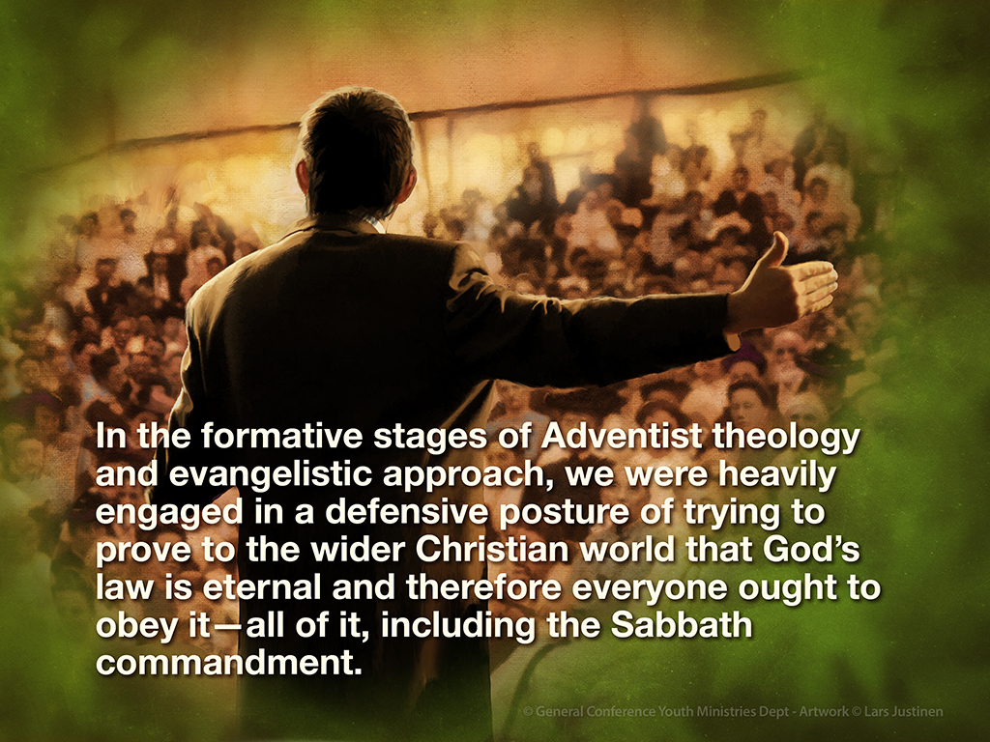

Slide 15
In the formative stages of Adventist theology and evangelistic approach, we as a people did not get this.
We were heavily engaged in a defensive posture of trying to prove to the wider Christian world that God’s law is eternal and therefore everyone ought to obey it—all of it, including the Sabbath commandment.

Slide 16
We tended to see Sunday keepers as theological “opponents” who needed to be argued into obedience of the law, and as a result our own theology of the law went in the wrong direction.

Slide 17
Because of our mishandling of the law, Ellen White observed that we as Seventh-day Adventists had earned an unfortunate reputation in the eyes of other Christians.
Here’s how she articulated the impression we had made: “… Seventh-day Adventists talk the law, the law, but do not teach or believe Christ.”
(Ellen White, Testimonies to Ministers, pp. 91-92)

Slide 18
We will return to this statement in a moment and consider its historical context.
But right now, let’s just feel the weight of her assessment. If there is any reputation the church does not want
to bring upon itself, this is it.

Slide 19
We are, after all, called to preach the everlasting gospel to the world, which is the good news of salvation by grace alone, through faith alone, in Christ alone, and not by the works of the law.
And yet, here was our own prophet, Ellen G. White, telling us that we had done precisely the thing we ought not to have done: we had given the impression that Jesus was nowhere on our radar.

Slide 20
And the bad press continues to this day.
Every Adventist evangelist and pastor has to battle the accusation that we are legalists. Our general response to the charge has been to deny the charge, true to our deeply entrenched Laodicean self-view that we are rich and increased with doctrinal goods and have need of nothing.

Slide 21
But Ellen White didn’t deny it. In fact, she spent a large part of her prophetic ministry confronting us with the fact that we had preached the law in a wrong light and had failed to preach the gospel with clarity.
She went to her grave urging us as a church to change course, saying things like this:

Slide 22
“The danger has been presented to me again and again of entertaining, as a people, false ideas of justification by faith.
I have been shown for years that Satan would work in a special manner to confuse the mind on this point.

Slide 23
The law of God has been largely dwelt upon and has been presented to congregations, almost as destitute of the knowledge of Jesus Christ and His relation to the law as was the offering of Cain.” (1888 Materials, p. 810)

Slide 24
“The preaching of Christ crucified has been strangely neglected by our people. Many who claim to believe the truth have no knowledge of faith in Christ by experience… There must be a life-giving power in the ministry.
Life must be infused into the missionaries in every place, that they may go forth giving the trumpet no uncertain sound,

Slide 25
but with heaven-sent, awakening power, such as can be found only in the preaching of Jesus Christ— His love, His forgiveness, His grace.”
(1888 Materials, pp. 842, 844-855)

Slide 26
These statements, and many more like them, flowed directly out of the 1888 General Conference Session, at which God tried to bring the gospel into Adventist theology through two young men by the names of Ellet Joseph “E.J.” Waggoner and Alonzo T. Jones.
In one of the most comprehensive and rich statements Ellen White ever penned, she assessed what these men preached like this:

Slide 27
“Many had lost sight of Jesus. They needed to have their eyes directed to His divine person, His merits, and His changeless love for the human family. All power is given into His hands, that He may dispense rich gifts unto men, imparting the priceless gift of His own righteousness to the helpless human agent. This is the message that God commanded to be given to the world.

Slide 28
It is the third angel’s message, which is to be proclaimed with a loud voice, and attended with the outpouring of His Spirit in a large measure.”
(Testimonies to Ministers, p. 91.2)

Slide 29
And it was in this context that she went on to say:
“The message of the gospel of His grace was to be given to the church in clear and distinct lines, that the world should no longer say that Seventh-day Adventists talk the law, the law, but do not teach or believe Christ.”
(Testimonies to Ministers, pp. 91-92)

Slide 30
What an amazing outline of what Adventism could have become and
still may become!
Imagine how evangelistically powerful it would be if the first thing people thought of when they hear of Seventh-day Adventists was something like, “Oh, yeah, that’s the church that can’t stop talking about God’s love for everybody.”

Slide 31
Wow, that would be incredible—wouldn’t it?

Slide 32
The doctrine I’m referring to is the biblical truth regarding the Sabbath.
As a people, we’ve tended to reduce the Sabbath to a right-day-versus-wrong-day argument. Ask the average Adventist congregation, “Do we have the truth on the Sabbath?” You’ll get an enthusiastic chorus of “Amen!”

Slide 33
Then ask, “What is the Sabbath truth?” People will call out answers like, “The seventh day is the Sabbath, not the first day!”
“It’s Saturday, not Sunday!”
“The Catholic church changed the Sabbath from Saturday to Sunday!”

Slide 34
All this is true and important, but it’s not the truth that resides within the Sabbath itself.
When we limit the Sabbath to an effort to prove that people ought to obey the fourth commandment, we miss what the Sabbath actually means.

Slide 35
In this message we will explore what the Sabbath is actually all about, and what we are about to discover is truly amazing.
So let’s reexamine the Sabbath and see what a treasure trove of gospel insight we have right under our Seventh-day noses.

Slide 36
Rest Built Into the Story
Let’s begin by taking a fresh look
at the origin of the Sabbath in Genesis. But this time—rather than merely quoting chapter 2:1-3 as a piece of isolated evidence to prove that the Sabbath was given in Eden and therefore ought to be kept by all human beings and not just by the Jews—we will pause to take into account the narrative context in which the Sabbath was instituted.

Slide 37
By looking at the full story in which the Sabbath emerges, we will discover the beautiful truth it signifies.
In Genesis 1 and 2 we see that God proceeds with creation in an intentional artistic pattern: forming material spaces and then filling those spaces with life.

Slide 38
On the first three days the Creator forms spaces by dividing the material elements of creation. On the next three days He fills those spaces with living things.

Slide 39
On day one God forms the heavens and the earth and separates the light from the darkness, and then on day four He fills that space with the sun, the moon and the stars.
On day two God forms the spaces of water and sky, and then on day five He fills those spaces with fish and birds.

Slide 40
On day three God forms the space of the dry land, and then on day six God fills the land with animals and mankind.
Then comes the climax of the entire process: God creates the Sabbath and fills it with Himself.

Slide 41
The seventh day is a unique space, because it’s not a material space, but rather a relational space, and it is not filled with material things, but rather with the blessing of God’s fellowshipping presence.

Slide 42
“Thus the heavens and the earth, and all the host of them, were finished. And on the seventh day God ended His work which He had done, and He rested on the seventh day from all His work which He had done. Then God blessed the seventh day and sanctified it, because in it He rested from all His work which God had created and made.” (Genesis 2:1-3)

Slide 43
What’s being described here is not rest from physical exhaustion, for which sleep is required, but rest in the sense of satisfaction, for which enjoyment is required.
God isn’t tired, He’s happy, pleased, fulfilled. He’s been giving, giving, giving; pouring out His energy to create. Now He has completed the task and is receiving back into Himself the pleasure of reciprocated love from His creation.

Slide 44
Which is precisely His plan for us—that we would be “blessed” first by receiving from Him in a position of rest and then that we would engage in the expenditure of our energy to give out of ourselves back to Him and to one another.

Slide 45
So God “sanctified” the seventh day. The word literally means unique or distinct.
God gave us the Sabbath as a unique space in time for the enjoyment of fellowship between Himself and us, as a constant recurring reminder that the exact nature of our relationship with Him is one of reciprocal love.

Slide 46
But that’s not all. The story is more beautiful still.

Slide 47
Notice that human beings were created on the latter half of the sixth day, after all God’s “work” of creation was already “finished”.
Therefore, they did not participate in the work of Creation, nor did they even witness God engaging in the act of creating. Imagine the scene:

Slide 48
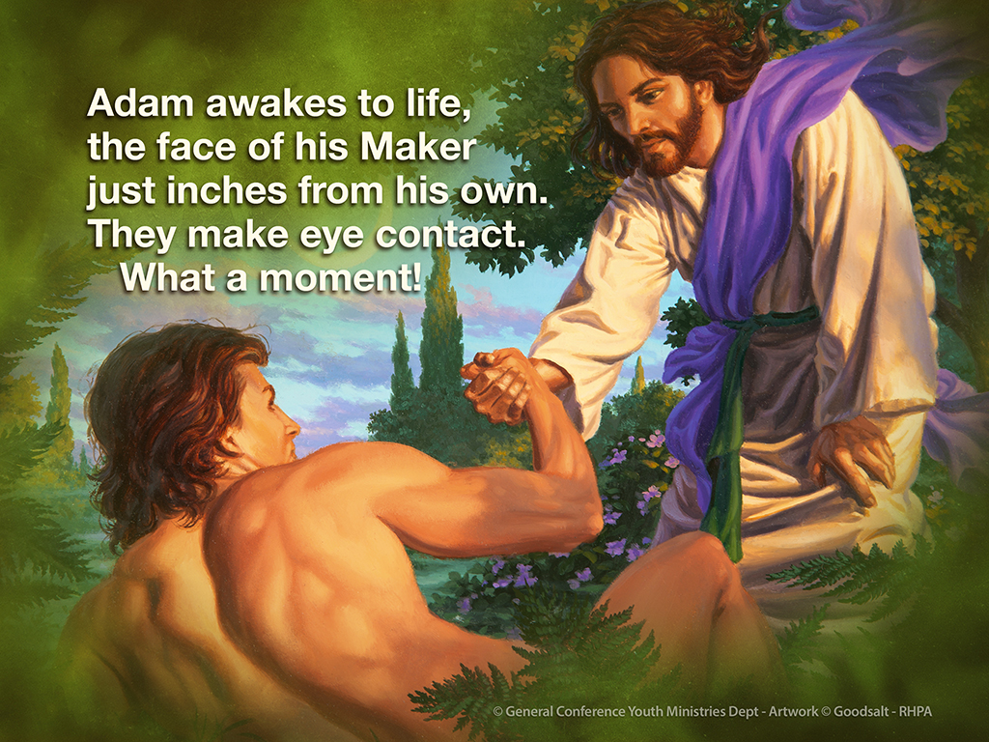

Slide 49
God says something like,
Hello! Welcome to existence! I’m your Creator and I made all this beauty for you.
In that moment something is necessary for the relationship to proceed: faith, belief, trust that what God is telling Him is true.

Slide 50
Paul gets at this in Hebrews 11:1:
“Now faith is the substance of things hoped for, the evidence of things not seen.”
Then verse 3: “By faith we understand that the worlds were framed by the word of God, so that the things which are seen were not made of things which are visible.”

Slide 51
Adam did not see God create anything, but he finds in himself a confidence, a dependence, a delightful repose in the One addressing him.
Faith is built into his nature. He senses that he is loved and God’s love draws forth trust from his heart. God then creates Eve.

Slide 52
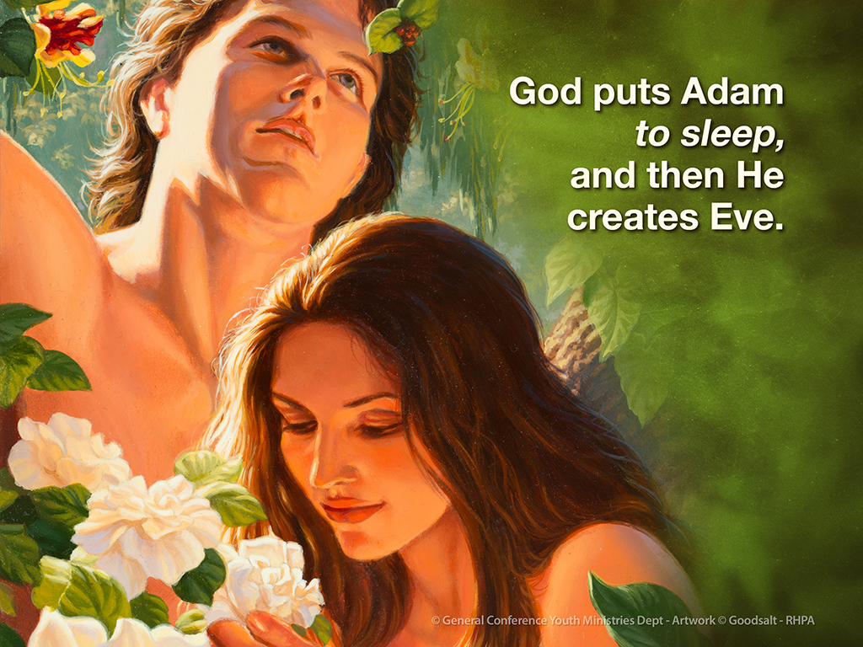

Slide 53
But he doesn’t turn to Adam and say, “Watch this,” and poof, she is created in Adam’s sight. No.
He puts Adam to sleep, and then He creates Eve. She, like Adam, awakes to live by faith and Adam opens his eyes a second time to trust His Maker’s word that this most beautiful of all creatures standing before him came forth from God’s creative power.

Slide 54
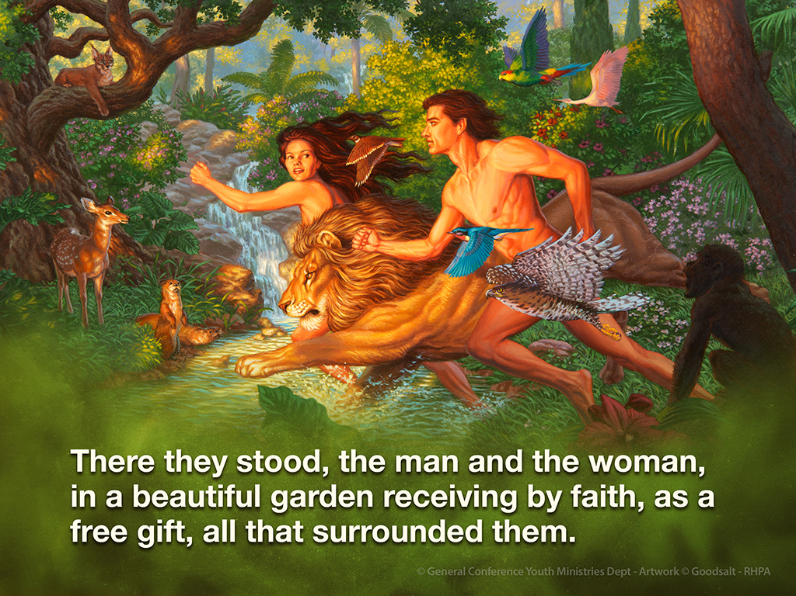

Slide 55
And get this: the Sabbath was their first full day of life.
They rested first, contemplating the reality of their utter dependence on their Maker, and then, energized by His love, they went to work tending the garden on first day of the week.

Slide 56
The story of the Creation, positioning
Adam and Eve as recipients of a finished work, communicates a powerful message: We human beings are creatures of rest before we are creatures of work.

Slide 57
We are mentally, emotionally, and relationally engineered for receiving from God before we are able to give back to God and others. “We love Him because He first loved us.” (1 John 4:19)
That’s the nature of the Creator-creature relationship.

Slide 58
The Creation—Salvation Continuum
Okay, then, our first discovery regarding the Sabbath is that it is a memorial of God’s finished work of creation, reminding us of our position in creation as trusting recipients of His love.

Slide 59
Now we will discover that the Sabbath is also a memorial of redemption.
The connection is obvious once we see it.

Slide 60
There is a super logical reason why the Sabbath doubles as a memorial of both creation and salvation, and it is this: both are accomplished by the creative power of God alone.

Slide 61
Salvation is, in fact, an act of re-creation on God’s part. Within the storyline of Scripture there is what might be described as a creation-salvation continuum.
Watch as it beautifully unfolds.

Slide 62
The Old Testament opens with the words, “In the beginning God created the heavens and the earth” (Genesis 1:1), and then the story of creation follows, the “Let there be light,” and so on.
The New Testament Gospel of John opens with, “In the beginning was the Word, and the Word was with God, and the Word was God” (John 1:1), and then the story of redemption follows.

Slide 63
In Genesis 1, the first declaration of the creative venture is, “Let there be light, and there was light.” (Genesis 1:3)
In the John 1, the first declaration of the redemption venture is, “In him was life, and the life was the light of men. The light shines in the darkness, and the darkness has not overcome it.” (John 1:4, 5; ESV)

Slide 64
In Genesis, once God “finished” the work of creation, “on the seventh day God ended His work which He had done, and He rested on the seventh day from all His work which He had done.” (Genesis 2:2)

Slide 65
In John, as Jesus comes to the end of His salvation ministry, He employs the seventh day language of Genesis 2 and says to the Father, “I have finished the work which You have given Me to do.” (John 17:4)

Slide 66
And as He hangs upon the cross, He exclaims, “It is finished!” (John 19:30)
The next verse informs us that it was “the preparation day”, or Friday, when Jesus declared His work of salvation “finished” and then he rested in the tomb on the Sabbath day.

Slide 67
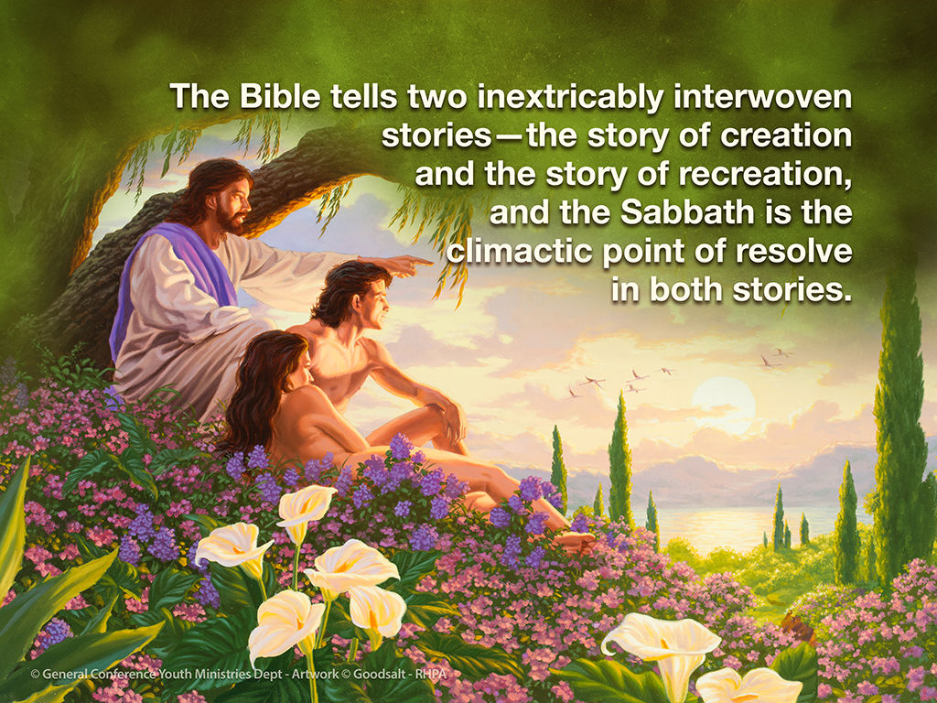

Slide 68
This is quite astounding and powerful, actually, because when the Sabbath is seen in its natural narrative setting, it preempts legalism.

Slide 69
By signifying not only the finished work of creation, but also the finished work salvation, the Sabbath negates the entire salvation by works enterprise and centers our total trust in Christ.
It is unfortunate that we have skipped over this telling of the Sabbath truth and settled for a mere right-day versus wrong-day proof-text approach.

Slide 70
If we had held the Sabbath forth as the reminder of God’s saving grace that it is, it would have immunized us against legalism and our witness to the world would be much more winning.

Slide 71
The Pharisees of Jesus’s day turned God’s Sabbath into a legalistic rule with which to hammer, judge, and bind people. And we have repeated their history in our own way, from our own angle.

Slide 72
Years ago I heard a pastor ask an Adventist youth, “What does the Sabbath mean to you?”
The boy thought for a moment and answered, “Sit down, shut up, and color, or you’ll end up with the mark of the beast.”

Slide 73
While some may view it as humorous, for many Adventists this response nevertheless represents their overall impression about the Sabbath.
Ellen White tried to prompt us to view the law in the light of the gospel.

Slide 74
On one occasion she said: “The law of ten commandments is not to be looked upon as much from the prohibitory side, as from the mercy side” (Selected Messages, vol. 1, p. 235).

Slide 75
On another occasion she wrote: “The Ten Commandments, ‘Thou shalt,’ and, ‘Thou shalt not,’ are ten promises.” (Bible Echo, June 17, 1901)
This holds true for the fourth commandment. The Sabbath is not about what we can’t do for a twenty four hour period of time each week. It’s about what God has done and will do for us by His merciful grace.

Slide 76
When understood within the context of the overall biblical story, the Sabbath is a constant reminder of our utter dependence on Jesus for salvation and, therefore, the very antithesis of legalism.

Slide 77
The Unforced Rhythms of Grace
It is not at all surprising, then, that Jesus defined salvation as involving rest from the anxiety of laboring to merit God’s favor:
“Come to Me, all you who labor and are heavy laden, and I will give you rest.

Slide 78
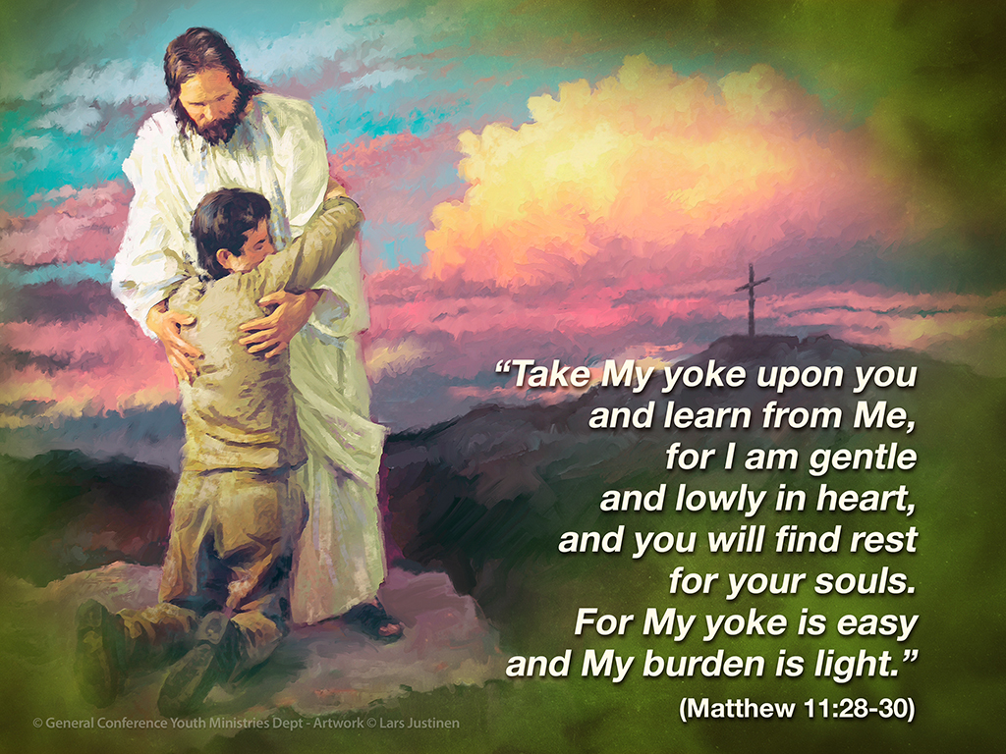

Slide 79
The “labor” from which Jesus offers “rest” is not physical labor, but the emotional anxiety of laboring under a false picture of God’s character, which leads us to believe that His acceptance must be earned.

Slide 80
We know this is His point because He offers rest for our “souls”, which is psyche in the original Greek text. He’s literally saying, “I want to release your mind from its labor.”
This is the deeper rest that we really need: the rest of knowing that God loves us and saves us by His grace, not because we have done sufficient work to make ourselves worthy of His love.

Slide 81
As we enter into the rest He offers, we discover that God is not a hard, exacting taskmaster at all. Far from it.
When we get on the inside of God’s heart, we find that serving Him is “easy” and “light”.
Why?

Slide 82
Because that’s just how love operates. It completely rearranges a person’s perspective on what is heavy and hard. For the person who is in love, heavy and hard are nearly foreign concepts. Ellen White says it this way:

Slide 83
“We must not trust at all to ourselves or to our good works; but when as erring, sinful beings we come to Christ, we may find rest in His love. God will accept every one that comes to Him trusting wholly in the merits of a crucified Savior. Love springs up in the heart.

Slide 84
There may be no ecstasy of feeling, but there is an abiding, peaceful trust. Every burden is light; for the yoke which Christ imposes is easy. Duty becomes a delight, and sacrifice a pleasure.” (Faith and Works, p. 38)

Slide 85
Wow! That is so cool!
Can you imagine any better experience?
Of course you can’t!
When Jesus says, “Come to Me, all you who labor and are heavy laden, and I will give you rest,” He is offering the most liberated life imaginable.

Slide 86
Another version of the Bible brilliantly captures the idea like this: “Learn the unforced rhythms of grace”
(The Message).

Slide 87
Unforced…
I’m at rest.
Rhythms…
and yet I’m moving.
Of grace…
because God’s unmerited
love powerfully moves me
from the inside out.

Slide 88
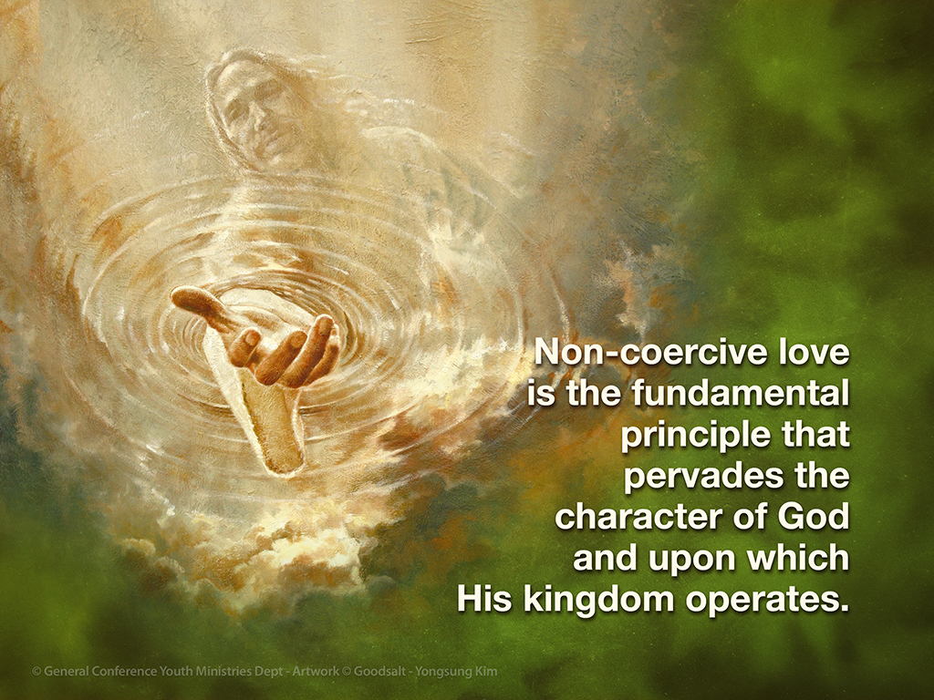

Slide 89
Through the prophet Jeremiah God declared both His heart toward us and His method of saving us:
“Yes, I have loved you with an everlasting love; therefore with loving-kindness I have drawn you.”
(Jeremiah 31:3.

Slide 90
This is so amazing.
Notice the logical relationship between how God feels about us and how He approaches us. Because God loves us, He seeks to draw us to Himself by the attractive influence of His loving-kindness, rather than to force us by His superior power or manipulate us by His superior wisdom.

Slide 91
God’s only goal is to attract and empower us.
That’s all.

Slide 92
And that’s a lot.
Monumental, in fact.
No greater achievement is conceivable, even for Almighty God, because,
astounding as it may seem, you and I are
free to literally say no to God. So He has embarked upon the delicate task of saving us from sin while leaving our freewill unmolested, intact, and operable.
What a God!

Slide 93
Ellen White ingeniously observed,
“Love is the agent He uses to expel sin from the heart.”
(Thoughts from the Mount of Blessing, p. 76).

Slide 94
Grace is the form God’s love takes in relating to sinners.
The genius of grace is that it simultaneously frees me and captivates me. The moment I realize there is absolutely nothing I can do to earn God’s favor, I am free to say No to His will and yet I eagerly say Yes.

Slide 95
But if I believe, intellectually or even emotionally, any form of the salvation-by-works lie, I am morally crippled, immobilized, and defeated.
I labor toward God under feelings of guilt, and guilt weakens rather than strengthens my will.

Slide 96
Ellen White issues this warning and
encouragement:
“We should not make self the center and indulge anxiety and fear as to whether we shall be saved. All this turns the soul away from the Source of our strength. Commit the keeping of your soul to God, and trust in Him.

Slide 97
Talk and think of Jesus. Let self be lost in Him. Put away all doubt; dismiss your fears. Say with the apostle Paul,
‘I live; yet not I, but Christ liveth in me: and the life which I now live in the flesh I live by the faith of the Son of God, who loved me, and gave Himself for me.’ Galatians 2:20. Rest in God.” (Steps to Christ, p. 71)

Slide 98
There is a stabilizing security in knowing that my salvation is His work and not mine.
That is the rest Jesus offers. But it’s more than just rest He offers, because with rest comes energy!

Slide 99
Resting in Christ alone for my salvation, His grace arouses me, energizes me, and motivates me with the pure and powerful motive of love as the only true basis for obedience.
I am propelled from the inside out by the unforced rhythms of His grace. Suddenly the Sabbath makes more sense than it ever has before.

Slide 100
Theological sense, for sure.
But also emotional sense.
And relational sense.
I find myself face-to-face, heart-to-heart with a God who already loves me, already favors me, already accepts me, not because I’ve done anything to deserve it, but simply because He’s good. And right here, right now, in this realization, I rest. This is what the Sabbath truth is all about.

Slide 101
Small group
Discussion Time

Slide 102
Unfortunately, we all know stories of Seventh-day Adventists (ourselves?) who have acted in judgmental and unloving ways. Take some time to share stories that you know personally of Adventists who have shown forth the glory of God’s unconditional love in their actions.
The lesson says God created the seventh day and filled it with Himself. But God is in every day, right?

Slide 103
In what way or ways is God’s presence somehow different on the Sabbath? How can you tell?
Do you think of yourself as resting first, then working, or as resting to “get over” and recover from work?
What would happen in your life if you completely gave yourself over to the former concept instead of the latter?

Slide 104
What is your reaction to the concept that the story of creation and the story of redemption are intertwined, and Sabbath is at the heart of both?
How will this change you?
How can you begin to relax into the “unforced rhythms of grace”? Be specific.

Slide 105
2016 Youth and Young Adults Week of Prayer Sermons
Copyright © 2015-2016
General Conference of Seventh-day Adventist®
Youth Ministries Department
Sermon written by: Pastor Ty Gibson http://www.lightbearers.org/profile/ty-gibson/
Email: Ty@lightbearers.org
For additional use of any of the images in this presentation please contact GoodSalt Inc.
Phone: 800-805-8001 ● Website: http://www.goodsalt.com

