Slide 1
Slides for Day 3 of the
2016 Youth and Young Adults Week of Prayer readings.
A PDF of the complete sermon can be downloaded here
Sermon written by: Pastor Ty Gibson http://www.lightbearers.org/profile/ty-gibson/
Email: Ty@lightbearers.org
For additional use of any of the images in this presentation please contact GoodSalt Inc.
Phone: 800-805-8001 ● Website: http://www.goodsalt.coma

Slide 2

Jesus – the Essence of Our Faith

Slide 3
2016 youth and young adults
Week of Prayer
Theme:
Jesus—The Center of It All
Copyright ©2015 General Conference of SDA Youth Ministries Department
www.gcyouthministries.org

Slide 4
In this
Week of Prayer series
we will be exploring
eight key
Bible Doctrines
of the
Seventh-day Adventist® Church.
In this
Week of Prayer series
we will be exploring
eight key
Bible doctrines
of the
Seventh-day Adventist Church.

Slide 5
Welcome to day 3
of our re-examination of our core beliefs.

Slide 6
Remember our Guiding Metaphore?
The doctrinal truths of Scripture can be thought of as a series of perceptual windows through which God’s character may be viewed from
various different angles.

Slide 7
For our purposes, let’s imagine the structure of truth as an octagon-shaped building.
On each of the eight sides of the structure, there is a window.
Each window represents one of our doctrinal beliefs:

Slide 8
DAY 1: The Trinity
DAY 2: The Great Controversy
DAY 3: The Law of God
DAY 4: The Sabbath
DAY 5: The Sanctuary
DAY 6: Death and Hell
DAY 7: The End Time
DAY 8: The Second Coming

Slide 9
Remember our guiding metaphor?
The doctrinal truths of Scripture are like windows that look in upon the God’s attractive character as revealed in Christ.
No doctrine is an end in itself.

Slide 10
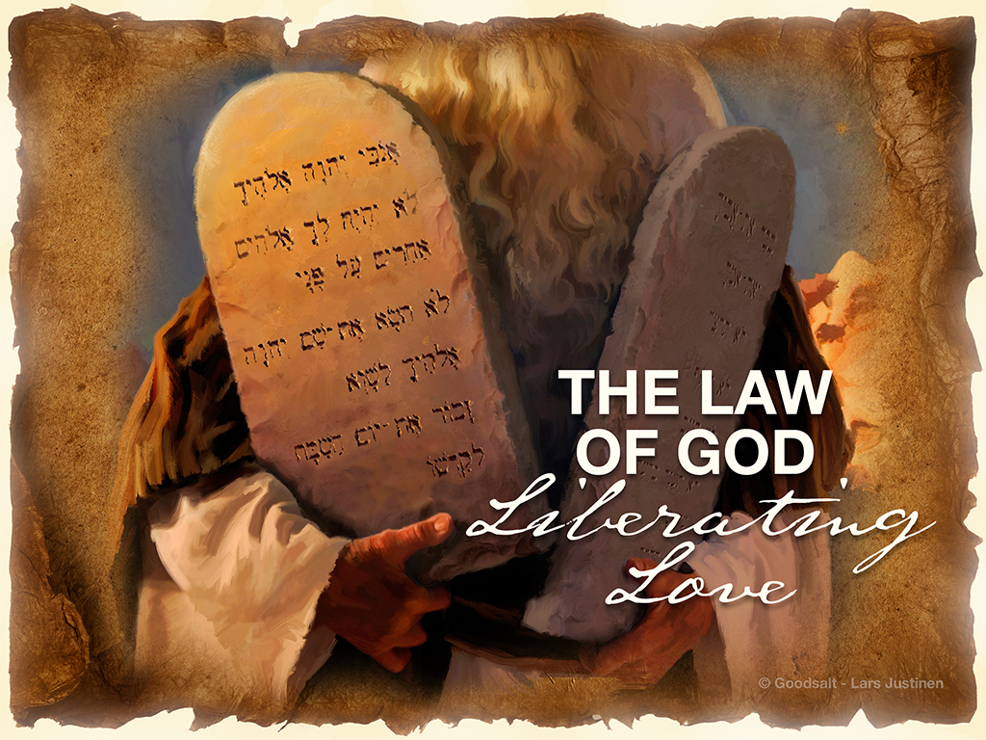

Slide 11
The Ten Commandments figure prominently into our doctrinal system as Seventh-day Adventists. While much of the Christian world preach what is called “antinomianism”—the idea that God’s law was “abolished” when Jesus died on the cross—we believe God’s law is eternal and changeless.

Slide 12
Ellen White had a lot to say about our bent, as a group, toward a wrong view and wrong use of God’s law. Notice this very insightful and pointed statement:
“On the one hand, religionists generally have divorced the law and the gospel, while we have, on the other hand, almost done the same from another standpoint.

Slide 13
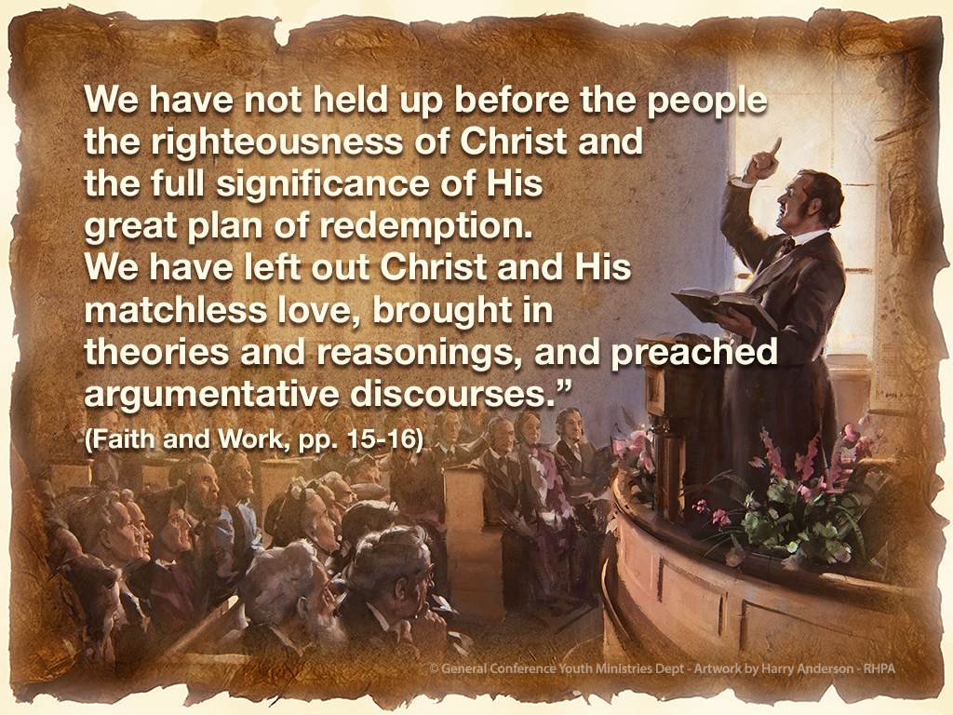

Slide 14
“We,” she says, “have not held up before the people the righteousness
of Christ and the full significance
of His great plan of redemption.
We have left out Christ and His matchless love.”

Slide 15
Over and over again she warned that we as a group were mishandling God’s law. At one point she was so tired of hearing our preachers hammer away defending the law that she said this:

Slide 16
“Let the law take care of itself. We have been at work on the law until
we get as dry as the hills of Gilboa, without dew or rain. Let us trust
in the merits of Jesus Christ of Nazareth” (Sermons and Talks, Vol. 1, p. 137).

Slide 17
“The danger has been presented to me again and again of entertaining, as a people, false ideas of justification by faith. I have been shown for years that Satan would work in a special manner to confuse the mind on this point.

Slide 18
The law of God has been largely dwelt upon and has been presented to congregations, almost as destitute of the knowledge of Jesus Christ and His relation to the law as was the offering
of Cain.” (Faith and Works, p. 18)

Slide 19
“Let the subject be made distinct
and plain that it is not possible to effect anything in our standing
before God or in the gift of God to us through creature merit.
Should faith and works purchase the gift of salvation for anyone, then the Creator is under obligation to the creature.”
(Faith and Works, pp. 19-20)

Slide 20
“Here is an opportunity for falsehood to be accepted as truth.
If any man can merit salvation by anything he may do, then he is in the same position as the Catholic to do penance for his sins. Salvation, then, is partly of debt, that may be earned as wages.” (Faith and Works, pp. 19-20)

Slide 21
“If man cannot, by any of his good works, merit salvation, then it must be wholly of grace, received by man as a sinner because he receives and believes in Jesus.
It is wholly a free gift. Justification by faith is placed beyond controversy.”
(Faith and Works, pp. 19-20)

Slide 22
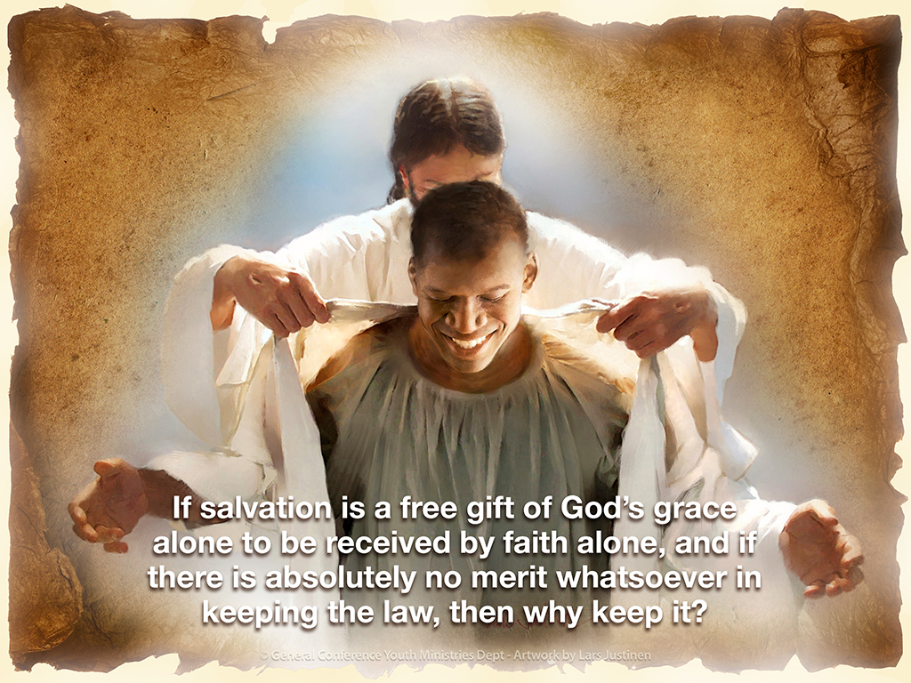

Slide 23
By denying the essential goodness
of God’s character, Satan’s course
of action was calculated to erode
trust toward God and incite rebellion against Him.

Slide 24
We are afraid that if we make the good news too good by making salvation too free, people won't feel or see any reason to obey God's law.
Actually, the opposite is the case—but until we get the gospel, I mean really get it, we are much more comfortable keeping it mostly out of sight and hammering away, proof-text-by-proof-text, on the necessity of keeping the law.

Slide 25
The truth is that obedience rendered out of a sense of obligation, with any notion that it contributes in the slightest degree to our salvation, isn't actually obedience.
It’s a covert form of rebellion masqueraded as obedience.

Slide 26
Not only that, it’s an insult to God because it demeans His grace by supposing that anything we might do could earn His favor.

Slide 27
God isn't a heavenly vending machine into which we put the appropriate coinage in order to get what we want from Him.
Neither is God a pagan deity whose favor can be earned by rendering to Him our good deeds.

Slide 28
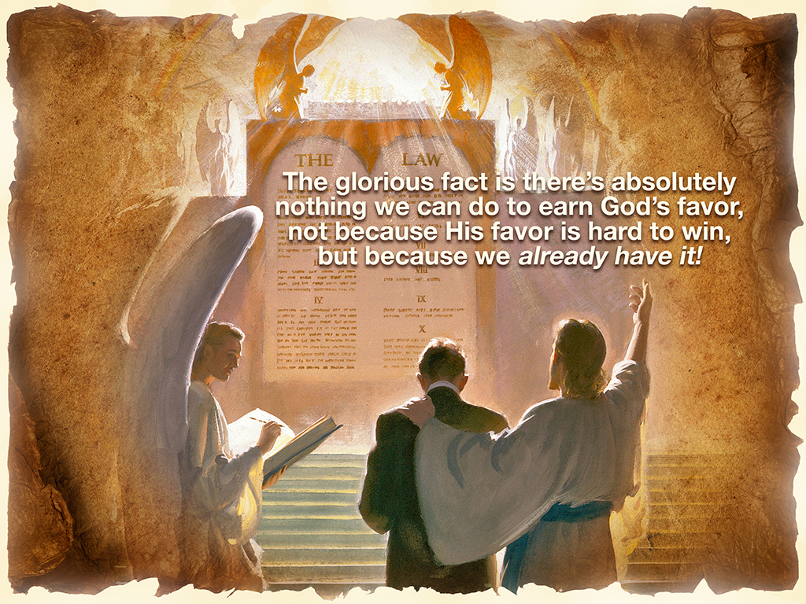

Slide 29
God is bursting with eager grace,
full-throttle love, and lavish mercy—and there’s not a thing we have done or can do to earn it.
This is why Paul proclaimed what he called “the redemption that is in
Christ Jesus.” (Romans 3:24)

Slide 30
Let the significance of this language register deeply in your heart.
Salvation is an accomplished reality in the person and work of Christ, and there is nothing we can contribute to it.
It's all there in Him.

Slide 31
Well, then, what about the law?
Glad you asked. Any thinking Adventist would.
The Letter Kills, But The Spirit Gives Life

Slide 32
Take a look at 2 Corinthians 3.
If you are Adventist, it is likely you’ve never really given this passage serious attention, because it doesn’t fit with the way we generally frame our view of God’s law.

Slide 33
The immutability of God’s law
is one of our fundamental beliefs.
And yet, this passage is Paul’s magnum opus on the law and it
pretty much doesn't even figure in
to Adventist teaching on the law.

Slide 34
Here is Paul articulating his best gospel thinking on the law and yet this passage rarely, if ever, shows up in Adventist preaching.
We simply don’t know what to do with it because we are trying to say one thing about the law and Paul is trying to say something different.

Slide 35
I boldly urge that what the apostle
to the Gentiles teaches about the law in 2 Corinthians 3 is vitally needed amongst us as a people.

Slide 36
Let’s start with verse six.
With the light of the gospel blazing
in his consciousness,
Paul clearly stated what his evangelistic mission was, and what ours ought to be.

Slide 37
He says that God has “made us sufficient as ministers of the new covenant, not of the letter but of the Spirit; for the letter kills, but the Spirit gives life.”

Slide 38
The ministers of God—which includes all of us as believer in Christ—are to be deliberate about communicating “the new covenant”.
That’s the message God has called us to proclaim. In other words, we are to handle the law of God with an intentional new covenant orientation.

Slide 39
Why is this important?
Because, as Paul puts it, “the letter kills.” To preach the law as merely a list of moral rules to be obeyed, leaving any degree of impression that law-keeping grants access to God—
to His favor, to His love, to His acceptance—is spiritually dangerous.
“The letter kills.”

Slide 40
The law without the gospel messes
us up because it distorts our picture
of God.
It leaves us with a heavy emotional sense of obligation to do things for God rather than with a sense of gratitude to God for what He has
done for us.

Slide 41
“Christ is the end of the law for righteousness to everyone who believes.”
In Galatians 3:24, 25 he says,
“The law was our tutor to bring us to Christ, that we might be justified by faith. But after faith has come, we are no longer under a tutor.”

Slide 42
There is some very important sense
in which Christ is the end of the law for those who believe, some vital sense in which the law serves as a tutor to bring us to Christ, some crucial sense in which the believer becomes dead to the law through the death of Christ, some experiential sense in which the believer is delivered from the law.

Slide 43
As Adventists, we need to process what Paul teaches about the law if we are ever to really proclaim the gospel with loud-cry, latter-rain power.
In general Christian denominations have failed to see what Paul is really getting at regarding the law, and as a result they have gone the antinomianism route. They simply negate the law altogether.

Slide 44
Historically, Adventism came along and rediscovered God’s forgotten law. As a people we have rightfully exalted the Ten Commandments as immutable, eternal, and changeless.
However, while we have steered clear of antinomianism, we have also for the most part failed to grasp what Paul has to say about the law.

Slide 45
As a result, our own prophet repeatedly rebuked us for preaching a wrong spin on God’s law.
But if we push ourselves to deal with what Paul says about the Ten Commandments, avoiding the ditch of antinomianism on the left and steering clear of the ditch of legalism on the right, we will discover powerful insights to the gospel that we’ve never known before.

Slide 46
Since the time of Christ and the apostles, antinomianism on the one hand and legalism on the other are the only options that have been prominently articulated for the world.
There is a deep and beautiful and powerful genius in Paul’s treatment
of the law that remains largely undiscovered and un-preached.

Slide 47
Historically, Adventism came along and rediscovered God’s forgotten law.
As a people we have rightfully exalted the Ten Commandments as immutable, eternal, and changeless.

Slide 48
However, while we have steered
clear of antinomianism, we have also for the most part failed to grasp what Paul has to say about the law.
As a result, our own prophet repeatedly rebuked us for preaching
a wrong spin on God’s law.

Slide 49
But if we push ourselves to deal
with what Paul says about the
Ten Commandments, avoiding the ditch of antinomianism on the left and steering clear of the ditch of legalism on the right, we will discover powerful insights to the gospel that we’ve never known before.

Slide 50
Since the time of Christ and the apostles, antinomianism on the one hand and legalism on the other are the only options that have been prominently articulated for the world.

Slide 51
There is a deep and beautiful and powerful genius in Paul’s treatment
of the law that remains largely undiscovered and un-preached.

Slide 52
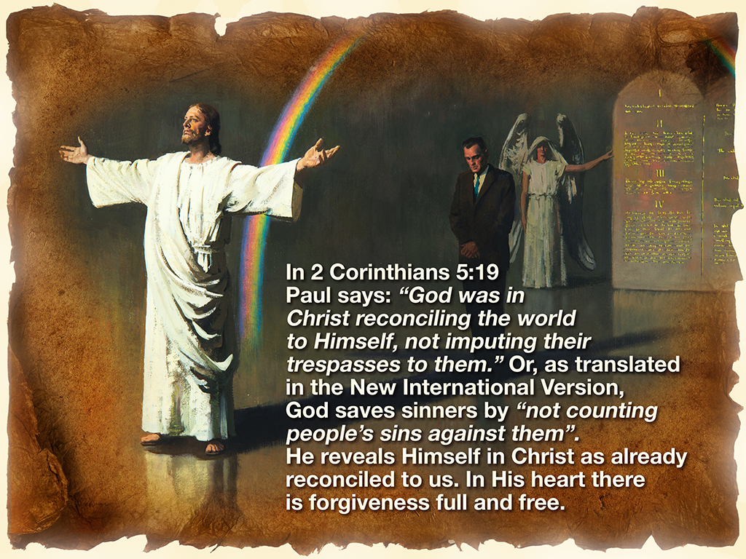

Slide 53
God loves every sinner in the world with a perfectly reconciled love that can’t be bought. All that remains to be done is for each of us to see it, believe it, and be reconciled to Him.
Said another way, the objective reality of salvation is an already-accomplished fact in the person and work of Christ. There is nothing we can do to contribute to it.

Slide 54
The subjective experience of that objective fact occurs when we embrace it by faith, when we say Yes! to God’s love, to His forgiveness, to His acceptance as it is revealed in the life and death and resurrection of Jesus.
Faith creates no new facts, it simply believes the facts as they are in Jesus.

Slide 55
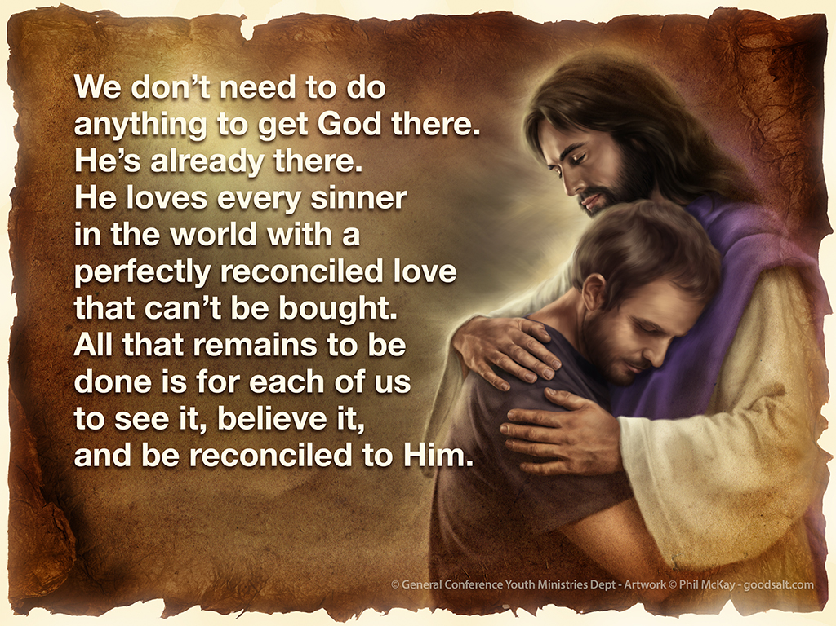

Slide 56
Return again to 2 Corinthians 3 and take in Paul’s grand finale in his explanation of the two views of the law. Verses 12-18:
“Therefore, since we have such hope, we use great boldness of speech—unlike Moses, who put a veil over his face so that the children of Israel could not look steadily at the end of what was passing away.”

Slide 57
Verses 12-18 continued:
“But their minds were blinded. For until this day the same veil remains unlifted in the reading of the Old Testament, because the veil is taken away in Christ.
But even to this day, when Moses is read, a veil lies on their heart. Nevertheless when one turns to the Lord, the veil is taken away.”

Slide 58
Now the Lord is the Spirit; and where the Spirit of the Lord is, there is liberty. But we all, with unveiled face, beholding as in a mirror the glory of the Lord, are being transformed into the same image from glory to glory, just as by the Spirit of the Lord.

Slide 59
Here Paul describes a human condition in which people know the Bible, but they don’t know it.
They are textually literate and spiritually unenlightened at the same time. They know the word, but they don’t know the Word. They know chapters and verses and facts, but they don’t know the deeper relational realities to which they point. “When Moses is read, a veil lies on their heart.”

Slide 60
Preaching the truth without preaching the Truth! Blindness, indeed!
But, dear fellow Adventist, there is bright illumination to be had… in Christ! “The veil is taken away in Christ,” Paul proclaims.

Slide 61
“When one turns to the Lord, the veil is taken away.” “Beholding, as in a mirror, the glo-ry of the Lord.”
Not a casual look, as if Jesus was one doctrine in a lineup sermons! Not a passing glance, as if Jesus were a district topic among many—say, night six in a 24-part series!
No!

Slide 62
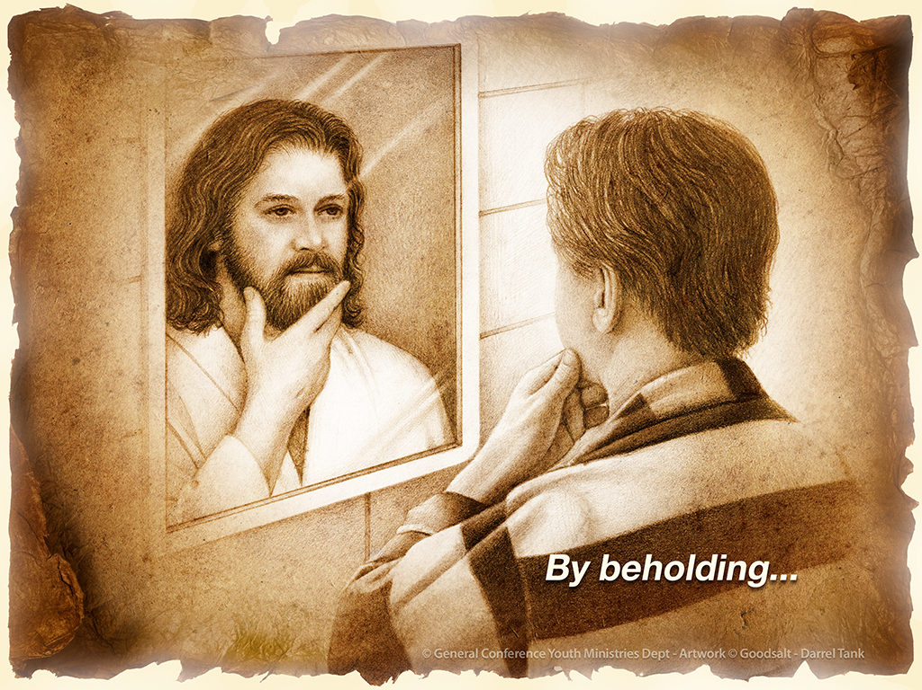

Slide 63
“Beholding” is the word Paul used. He’s telling us to look upon, to ponder, to contemplate Christ as with transfixed gaze!
To give Jesus our full, focused, undivided intellectual, emotional, theological attention.

Slide 64
And as we do, he tells us exactly what will happen to us, in us, for us: We will be “transformed into the same image from glory to glory.”

Slide 65
He had earlier explained that there are two glories before us—the glory of the Sinai event and the glory of the Calvary event; the glory of the letter ministering condemnation and the glory of the Spirit ministering the gift of righteousness; the glory of the law that brings death and the glory of the new covenant that brings life.

Slide 66
Now he tells us that as we behold Jesus we will undergo the fundamental, essential, ultimate transformational shift from the one glory to the other, from relating to God through the law for salvation to relating to God through Christ for salvation.

Slide 67
Paul has placed before us
two distinct options:

Slide 68
1. Old covenant experience, which was never God’s intention, is driven by an emotional sense of condemnation as the motivator toward obedience.
Old covenant experience produces an outward appearance of obedience—
a pretend, surface, hypocritical, judgmental obedience.

Slide 69
Old covenant experience is characterized by a sense of externally imposed pressure to obey the law in order to get acceptance with God.

Slide 70
2. New covenant experience is driven by a deep sense of God’s love as the motivator toward obedience.
New covenant experience produces an authentic internal upsurge of obedience to God’s law—true, heartfelt, free from all condemnation.

Slide 71
New covenant experience is characterized by a liberating sense that I already have God’s acceptance, before I render a single act of obedience to the law, which then creates in me a new power to obey that I’ve never known before.

Slide 72
Paul hasn’t done away with the law.
He has simply and necessarily set forth the limits of the law’s power and placed it within its legitimate sphere of function.
He has not negated the law altogether, but he has emphatically negated the law as a means of salvation.

Slide 73
The law serves one purpose, and the Bible clearly tells us what that purpose is: “The law was our tutor to bring us to Christ, that we might be justified by faith.” (Galatians 3:24, 25)

Slide 74
A Pharisee of the Pharisees, Paul experienced the definitive theological epiphany: The glory of the law is superseded by the glory of the living Christ! Paul has made the shift, and he’s urging each of us to make the shift too—“from glory to glory,” from the glory of the law to the glory of the gospel.

Slide 75
When we make that shift, Adventism will finally become the powerful theological revolution God intends it to be.
And we’ll know when it’s happening, because when it does, “One interest will prevail, one subject will swallow up every other—Christ our righteousness.”
(Ellen White, Review and Herald, December 23, 1890)

Slide 76
Small group
Discussion Time

Slide 77
The lesson says there are two ways humans relate to the idea that we must obey to earn salvation, or God’s love or favor:
lockstep “obedience” that leads to Pharisaism and judgmental thinking, or
trying and trying, failing, and giving up in despair.
Which of these extremes has your life mostly leaned toward?

Slide 78
When did you come to truly understand the principle taught in this lesson—that our salvation is found only in Christ, apart from the law, and our joyous obedience is made possible by that miraculous acceptance?

Slide 79
If it was in the past, share a specific story of a change that happened in your life as a result. If you are just now coming to understand it, praise God and watch for stories to share. It will change your life!

Slide 80
2016 Youth and Young Adults Week of Prayer Sermons
Copyright © 2015-2016
General Conference of Seventh-day Adventist®
Youth Ministries Department
Sermon written by: Pastor Ty Gibson http://www.lightbearers.org/profile/ty-gibson/
Email: Ty@lightbearers.org
For additional use of any of the images in this presentation please contact GoodSalt Inc.
Phone: 800-805-8001 ● Website: http://www.goodsalt.com

