Slide 1
Every Union One Year in Mission VISION CASTING

Slide 2
Dear Youth Director,
Right now, you are standing under the shadow of Jericho. The young armies of the Lord under your command are just waiting for their orders.
What will you do? Will you consult with the many excuses tempting you to abandon the cities of the world to the giants of crime, vice, poverty and godlessness or will you command God’s young people to move forward? Even now God is saying to you, as He did to Joshua “See! I have given Jericho into your hand, its king and the mighty men of valor” (Joshua 6:2).
Right now, you hold in your hand a simple yet effective strategy for tearing down walls and rescuing the lost Rahab’s of the world. One year in Mission when intentionally planned, promoted, and implemented by youth directors at every level of the church is a mighty catalyst for city evangelism, revival and discipleship.

Slide 3
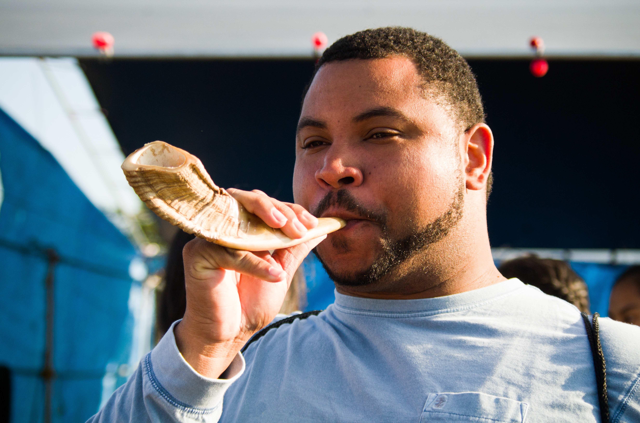
I believe God through this youth and young adult initiative wants to blow the “ram’s horn,” as He did before the fall of Jericho. The ram’s horn is a beautiful symbol of the everlasting gospel. Just like it took the death of a ram to produce a horn, it took the death of our Savior to produce Salvation for the world. No wonder the Bible commands us to “…declare the Lord’s death until he comes” (1 Cor. 11:26).
Youth directors, now is the time to take the cities in your Divisions, Unions and Conferences for Jesus! “…and it happened when the people heard the sound of the trumpet, and the people shouted with a great shout, that the walls fell down flat. Then the people went up into the city, every man straight before him,
AND THEY TOOK THE CITY” (Joshua 6:20).
Take the city!
Pastor Gary
GC Youth Ministries Director

Slide 4
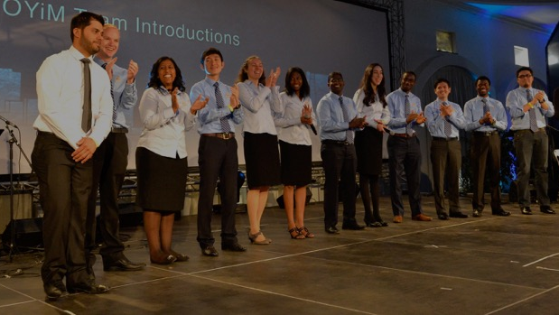
One Year in Mission understanding what OYiM is all about
What is “One Year in Mission”?
OYiM is a global youth initiative designed to give teams of young professional (18+) an opportunity to magnify Jesus in the cities of the world through the
Three Angels Message!
FACT: The Apostle Paul was the first OYiM Missionary to Antioch (Acts 11:26).

Slide 5
Why do we need OYiM?
Because city evangelism “is the essential work for this time” and will result in starting “a mighty movement such as we have not yet experienced”
(Medical Ministry p. 304).
The “everlasting gospel” is the only real antidote for the poverty, crime, vice, racism, disease and corruption found in the cities of the world
(see Netflix documentaries, “Underworld Inc.” and “DOPE”).

Slide 6
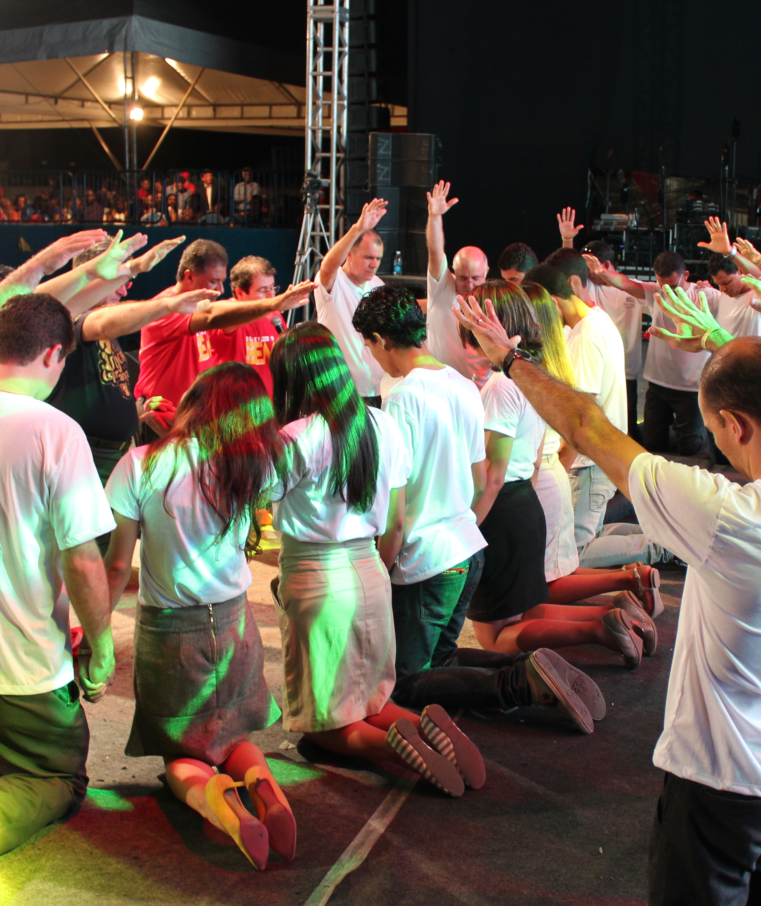
What outcomes are expected from OYiM?
Several examples can be found in the Bible, but for now we will use Antioch (in the book of Acts). The gospel preached specifically to the unsaved (11:20, 13:38-39, 4613:46), New churches planted (13:1), Ministry to the suffering provided (11:29), Local churches revived (11:14-15), Souls saved and discipled (13:43, 48), Entire cities and regions positively impacted. (13:44, 49), Opposition and persecution from within and without (13:45,50). New church leaders raised up and sent (13:2-4).

Slide 7
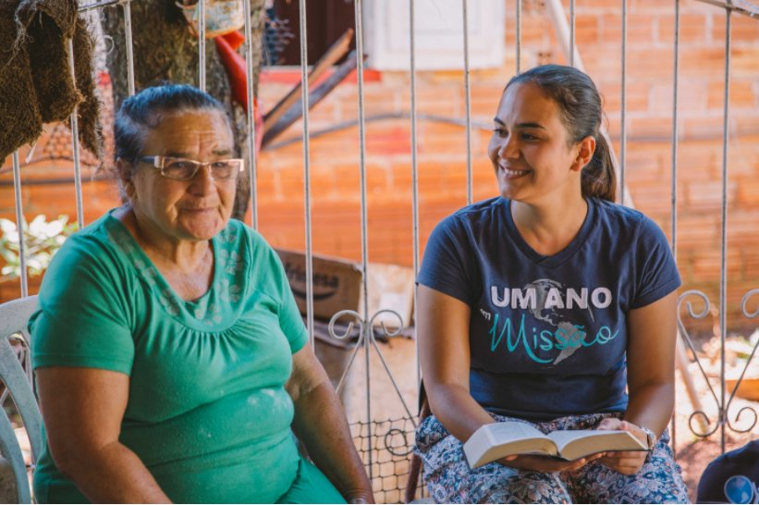
What method does OYiM use?
Since only one method works, OYiM missionaries will practice “Christ’s method alone” (Ministry of Healing, p 143). They will work together as a team to plan and implement an effective strategy that contextualizes Christ’s methods (socialize, sympathize, serve, share) with their city’s unique culture.

Slide 8
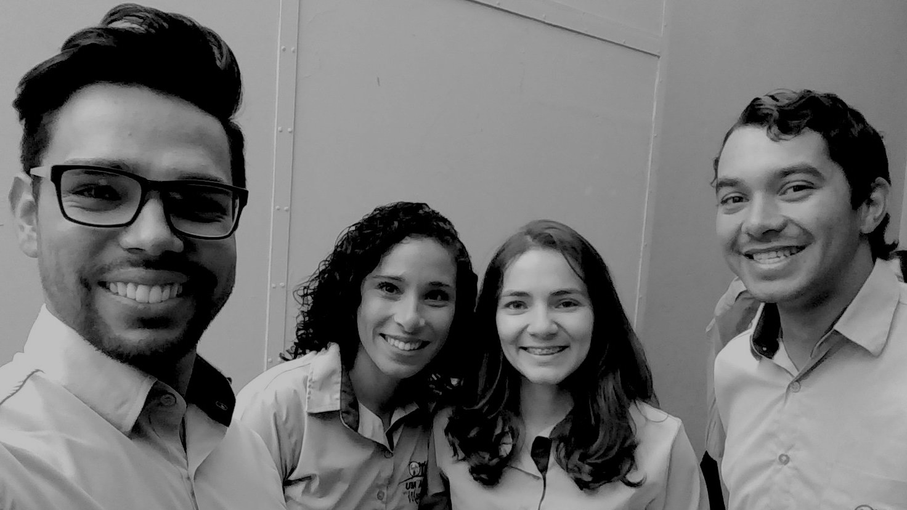
Who can be an OYiM Missionary?
Missionaries need to be young adults ages 18-35 who have, at the very minimum, graduated from high school. They should be:
Committed Seventh-day Adventist
Active in their local church
Good team player
Highly recommended by their pastor
Willing and able take an entire year off from work/school to focus on this ministry

Slide 9
Aren’t our other mission initiatives enough?
Without question the Seventh-Day Adventist church has many wonderful mission initiatives around the world and the General Conference Youth Ministries Department (GC) supports them all! However, OYiM is unique because it targets urban populations, and empowers teams of young people (15-30) to work together. OYiM also provides mission opportunities for young adults who may not attend our schools or who have already completed their post-secondary/higher education (college, universities, trade schools, etc).
OYiM is a global initiative certified by the 13 Divisions and the 2 attached fields, Middle East and North Africa (MENA) and Israel.

Slide 10
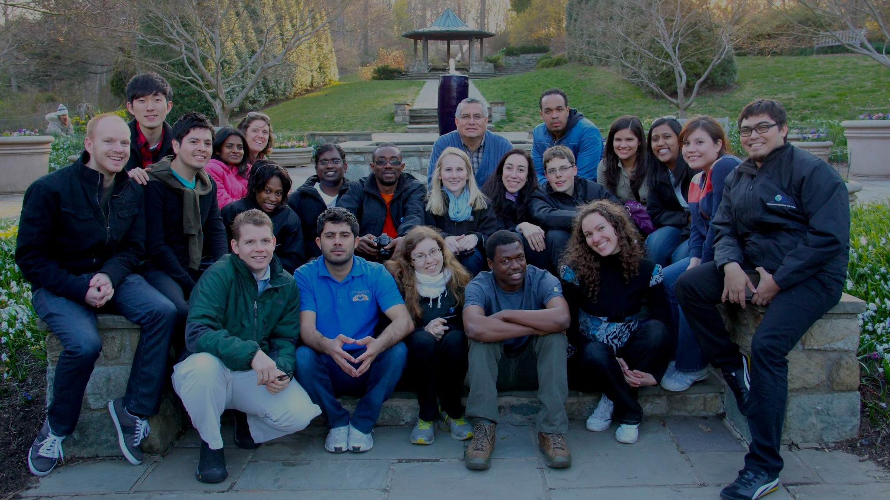
What is our new Vision for OYiM?
In an effort to expand the impact of OYiM and to heed the call to reach the cities, the General Conference Youth Ministries Department, with consensus from the GC and Division Presidents are challenging every Union around the world to work with their Division to plan, recruit and conduct a One Year in Mission.
Praise the Lord that would be 122 OYiMs in 2019-2020!

Slide 11
How would the Division Youth Leaders lead this global initiative?
Step 1: (Jan-July 2018) The Division Youth Directors should promote the vision among their Union Youth Directors and Presidents. The GC Youth Ministries Department will make the resources (visual presentation, promo video and manual) available on their website, youth.adventist.org for free download. During this time, the Division Youth Leader should also encourage their Union Youth Directors to apply for funds quickly and if necessary appoint an OYiM Division Coordinator.

Slide 12
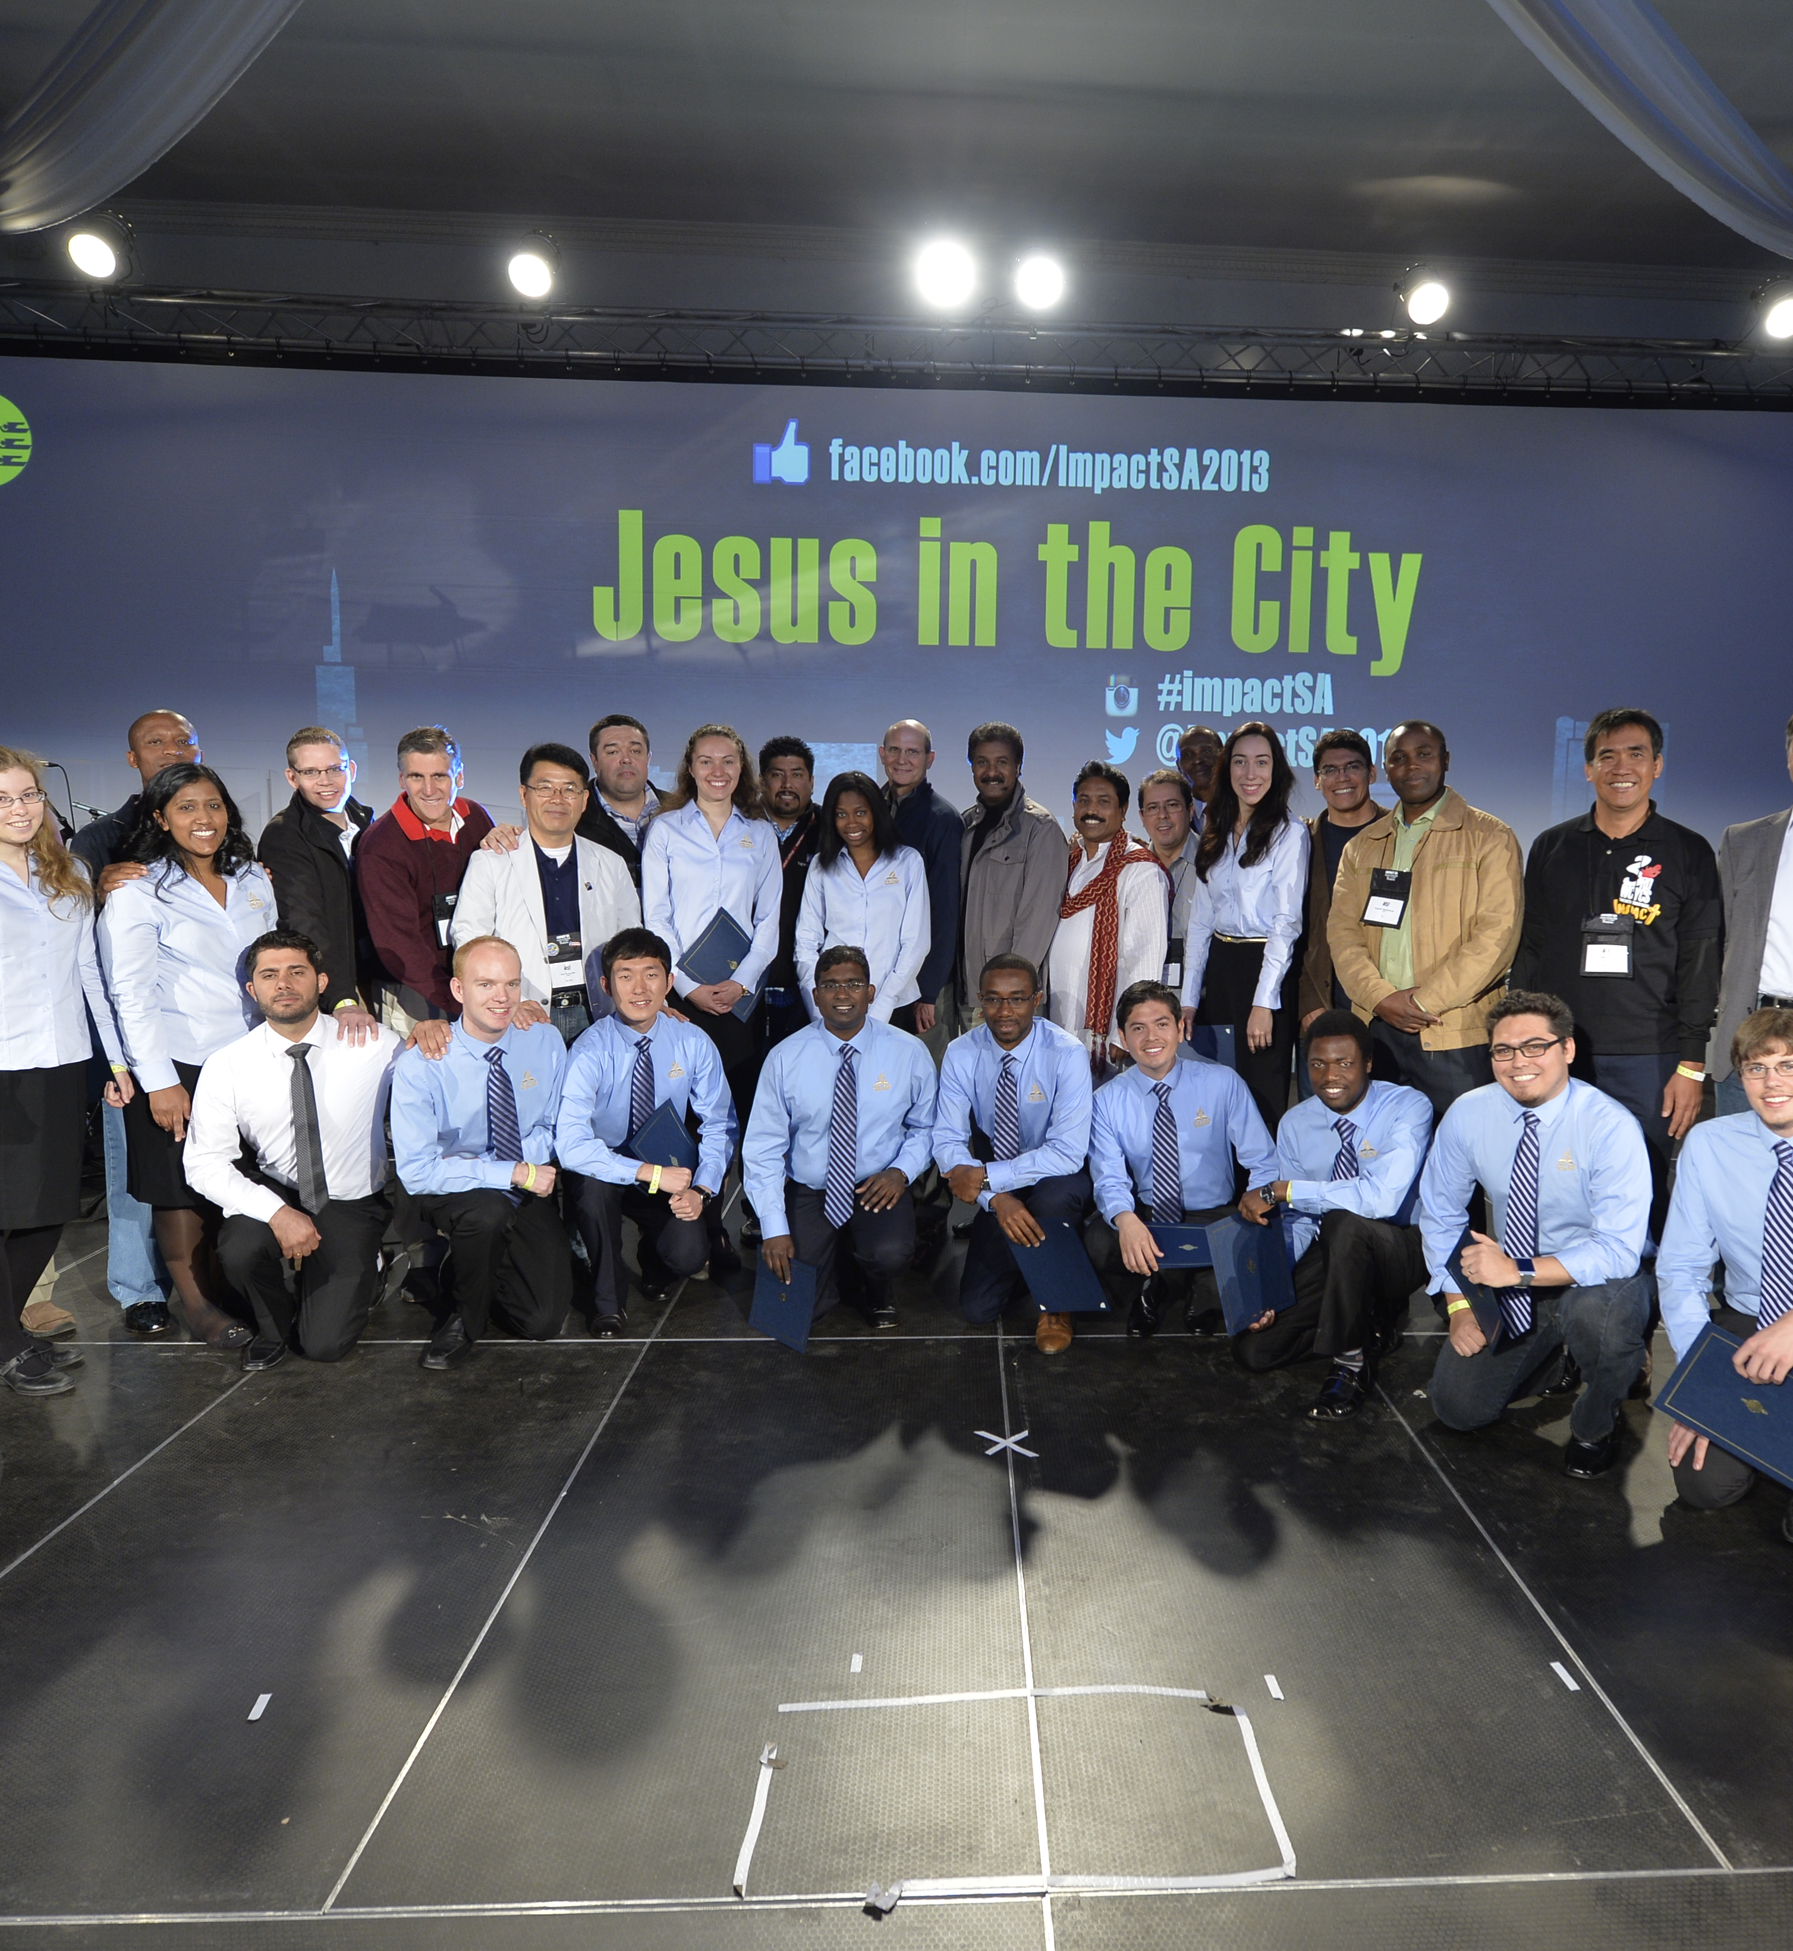
Step 2: (July-January 2019) The Division Youth Director should form an OYiM Strategic Team made up of your Union Youth Directors who catch the vision and want to move forward. Each Union Youth Director should then work with their conference youth directors to:
Identify a city,
Acquire a center of influence,
Recruit two OYiM leaders, and
Begin mass recruiting in their Union.

Slide 13
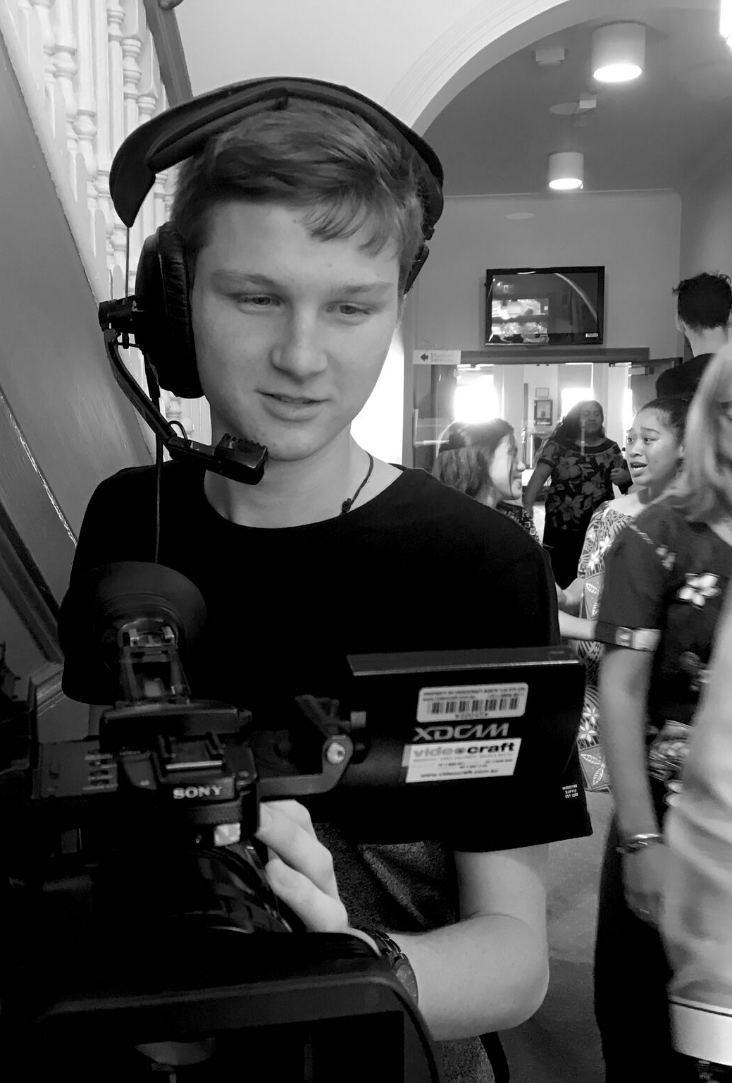
Step 3: (2019-2020) following a Union-wide dedication service each Union should launch an OYiM in 2019. These OYiMs should ideally end before the 2020 General Conference Session. At that time, each division should send their report regarding the success of OYiM to the General Conference Youth Ministries Department. The reports should be done by video and/or live stream.

Slide 14
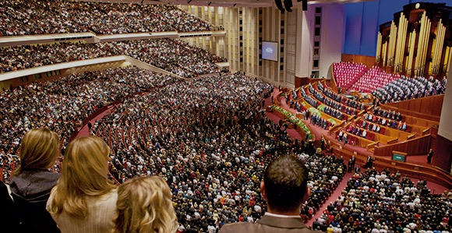
VISION: Following the 2020 General Conference Session we would like to challenge every conference to lead a OYiM! Imagine the impact that would leave.

Slide 15
Who should lead the OYiM initiative?
Of course, the initiative should be carefully and prayerfully overseen by the Union Youth Director but the day-to-day operations and leadership should be done by two trusted, tested, and mature OYiM leaders (35+). They need to have the skills to lead a team of between 15-30 young adults. If the OYiM team consist of male and female, the leaders would be of both genders. Youthful Pastors who are able to focus on the OYiM initiative would be ideal for this role.

Slide 16
How will OYiM Leaders be trained?
An online 10-day (4-8 hours daily) training school will be available January 22-Feb 2, 2019. This is a tentative date, we will confirm later.
Both OYiM leaders from each Union should join the event from their Union office.
The Union Youth Director should be present for the training.
The participating Conference Youth Directors should be present for the training.

Slide 17
Why online—not face to face?
Four reasons:
Cost: less money spent for travel means more resources for the OYiM missions.
Culture: all training can be more easily contextualized.
Connection: this gives the OYiM directors a chance to connect with their Conference/Union directors face to face.
Continuing Education: create an OYiM training hub at youth.adventist.org.

Slide 18
Where will OYiM missionaries stay and minister?
Missionaries serve and sometimes live at the “center of influence” a term coined by Ellen White. These places can be rented or purchased facilities, churches, schools or homes. If at all possible, the missionary’s living and serving locations should be at different places. “Centers of influence” are places where our OYiM missionaries can give Bible Studies, hold workshops, have church and conduct evangelistic seminars, etc.

Slide 19
How much does it cost our OYiM young adults?
The cost is up to the overseeing Union and Division. Some may cover all housing, food, and transportation, while travel to and from the mission, as well as basic necessities are left up to the individual missionaries. Please note that the OYiM Missionaries should carry at least some of the financial burden themselves.

Slide 20
How will the Union fund OYiM?
We are promised that “As we do this work, we shall find that means will flow into our treasuries…” (Evangelism p. 62). However, there are at least three potential streams of financial support.
The local Division/Union/Conference evangelism, youth and church planting budget.
The GC Youth Department will invest $40,000 in every Division that garners a minimum of 3 Union support (this money could be used as a matching fund). There is also $5,000 for each additional participating union after the first three.

Slide 21
Mission to the Cities offer up to 150K per city once your application with them is approved. Visit their website urbancenters.org for information on applying for a grant.
Again, we must never forget that the same God who fed 5,000 with 5 loaves and 2 fish, is the same God who “shall supply all of your [our] needs according to His riches in glory by Christ Jesus” (Phil. 4:19).
If we pray, plan and implement God will provide!

Slide 22
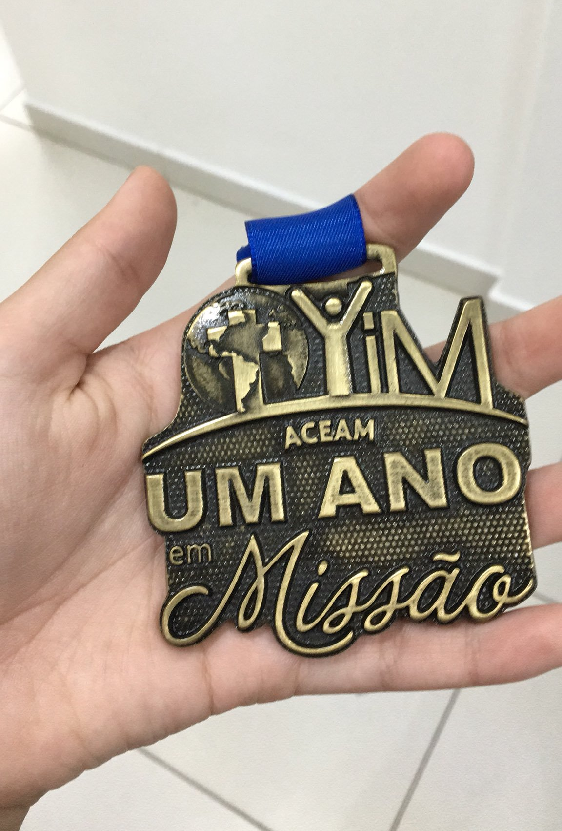
What if we want to call our initiative by a different name?
No problem! Just be sure that your initiative is in harmony with the strategy outlined above.
All major variations must get prior approval from the OYiM Steering Committee.
Please keep in mind that even if you choose a different name to use locally, to avoid any confusion your OYiM initiative will still be referred to as OYiM.

Slide 23
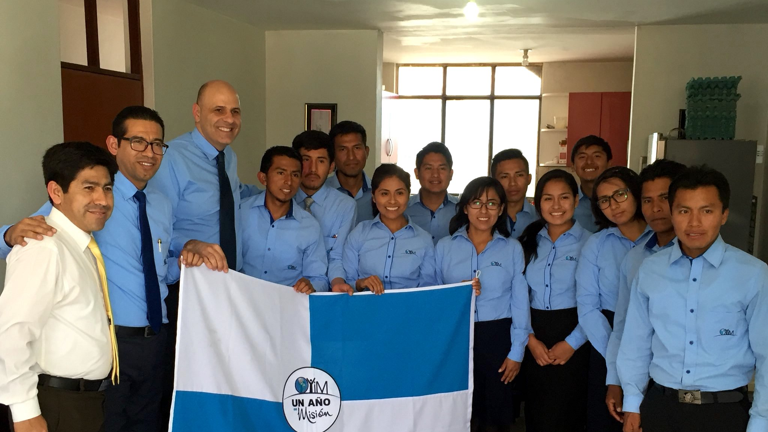
What about our Division OYiM coordinators?
Yes, each Division should already have a coordinator in place. Please make sure this is a reality in your Division. Also, make sure your OYiM coordinator is on high alert and knows the strategy outlined in this document. We are praying that hundreds of young people will be rallying to join OYiMs around the world and these coordinators have to be well informed, positive and helpful. To assure this each Division Coordinator should be a member of the OYiM Strategic Team.

Slide 24
Why such an emphasis on this initiative now?
We are fast approaching one of the most important gatherings in the history of the SDA church, the 2018 Global Youth Leaders Congress (July 31-August 4). This congress will provide the perfect setting to motivate and direct our youth and young adult leaders around the world. Now is the time TO GO BIG SO WE CAN GO HOME!

Slide 25
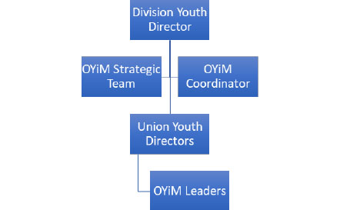
What would the infrastructue for OYiM look like?

Slide 26
Division Youth Director:
Casts vision, motivates and oversees the Union Youth Directors.
Chairs the OYiM strategic team that is made up of Union Youth Directors and the OYiM division coordinator.

Slide 27
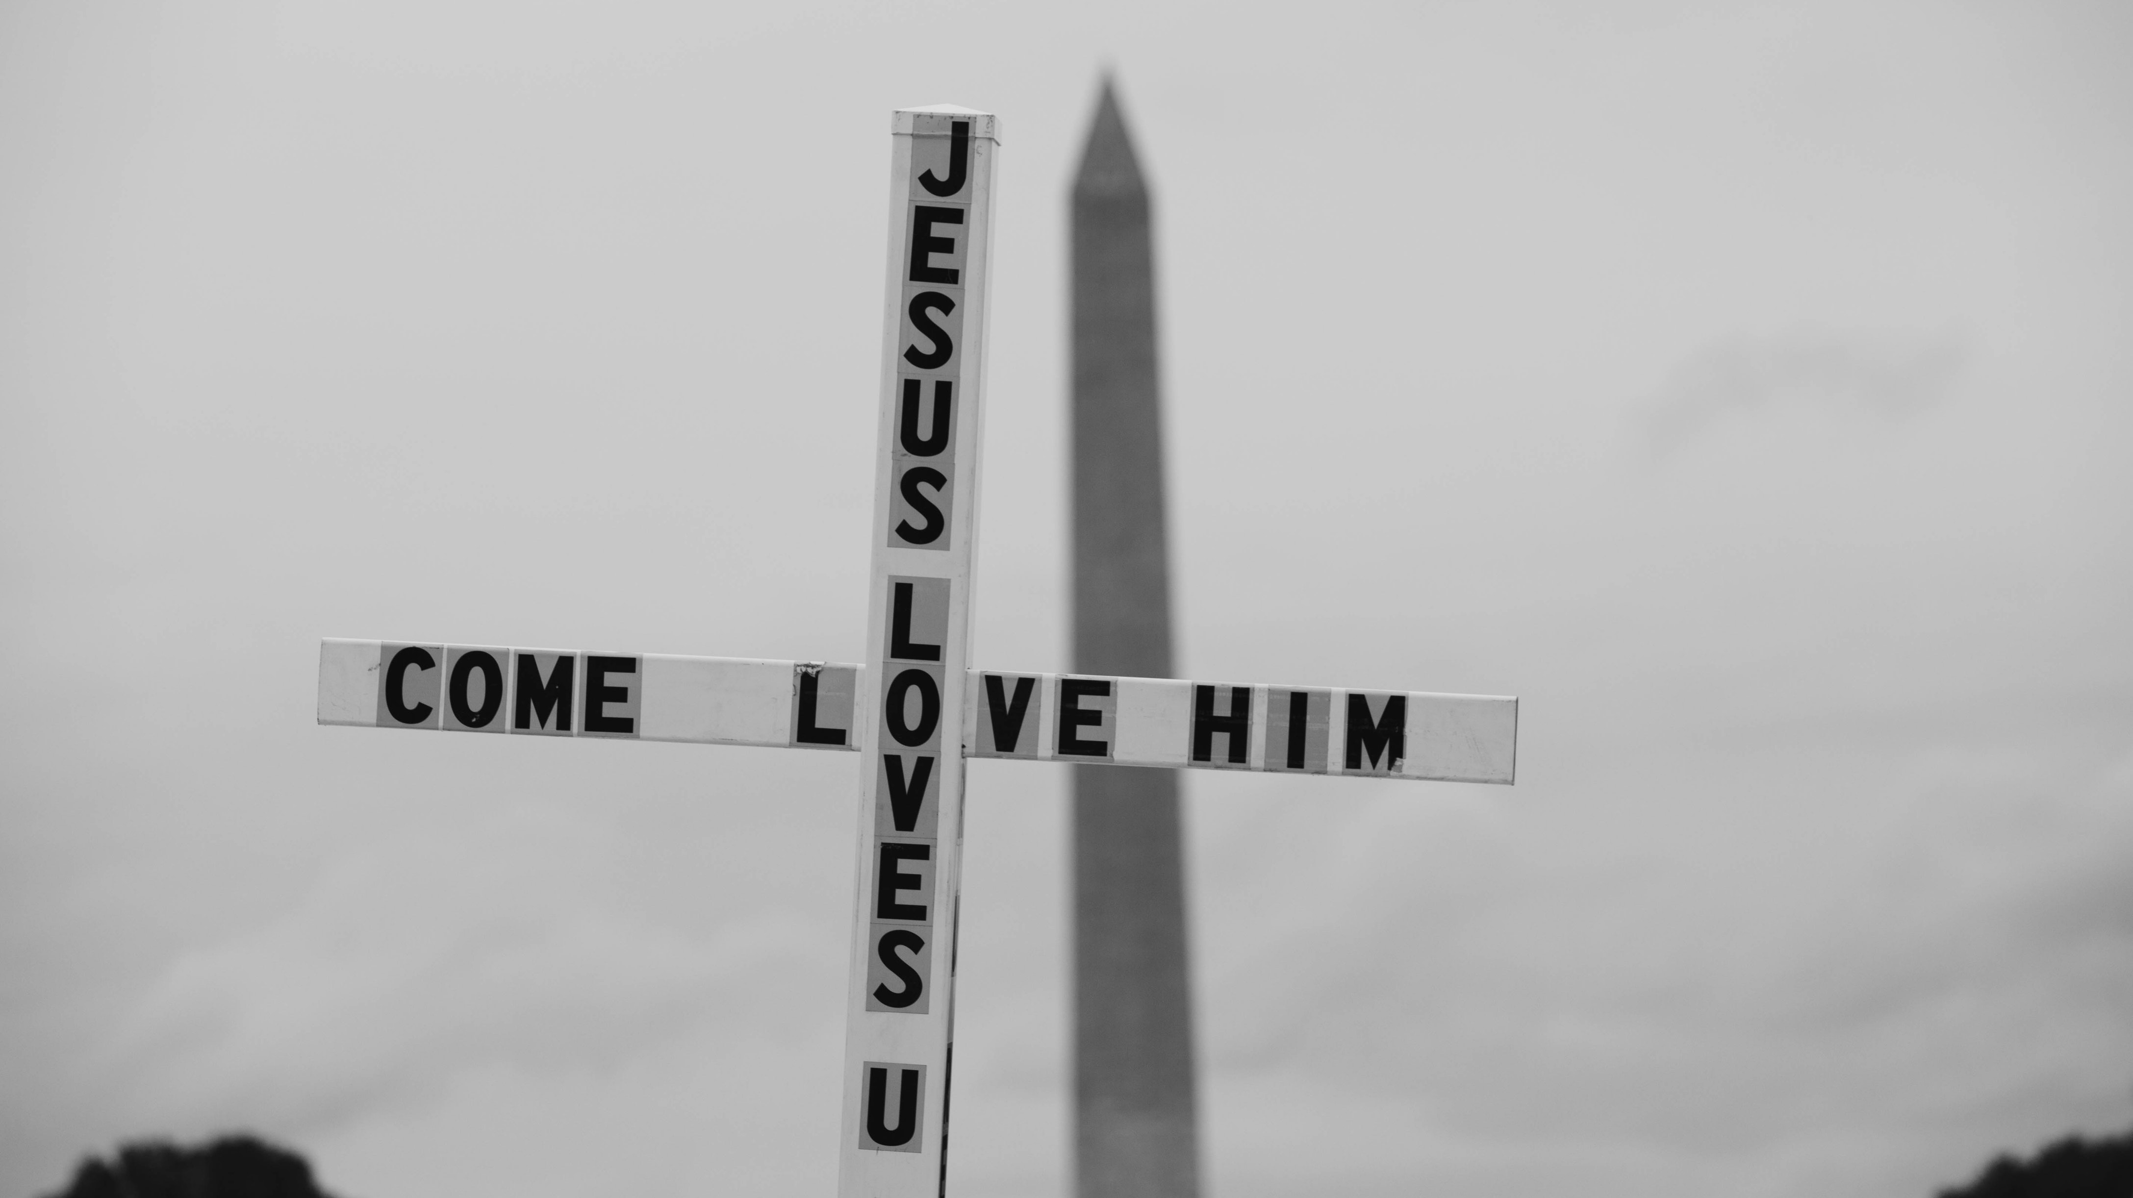
OYiM Strategic Team: This team is made up of Union Youth Directors who want to see the OYiM mission succeed in their Unions.

Slide 28
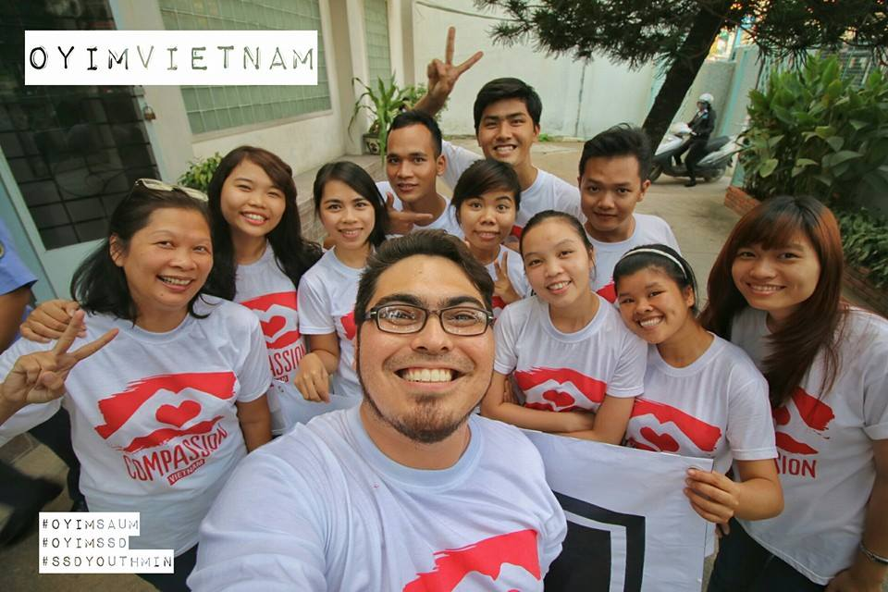
OYiM Coordinator: (It is recommended that these individuals be stipend or paid employees in the Division youth department.) They:
Take calls from young people in their division interested in OYiM and answer questions they may have.
Connect young people with the two OYiM leaders (male and female) for their specific Unions.
Follow-up with the young people to make sure that all connections are made.
Send a list of interested young people to their respective Union Youth Directors.

Slide 29
Union Youth Director
Casts vision, motivates, and oversees the success of the OYiM initiative in his/her union.
Work with the local conferences to appoint two OYiM leaders and initiate mass recruiting.

Slide 30
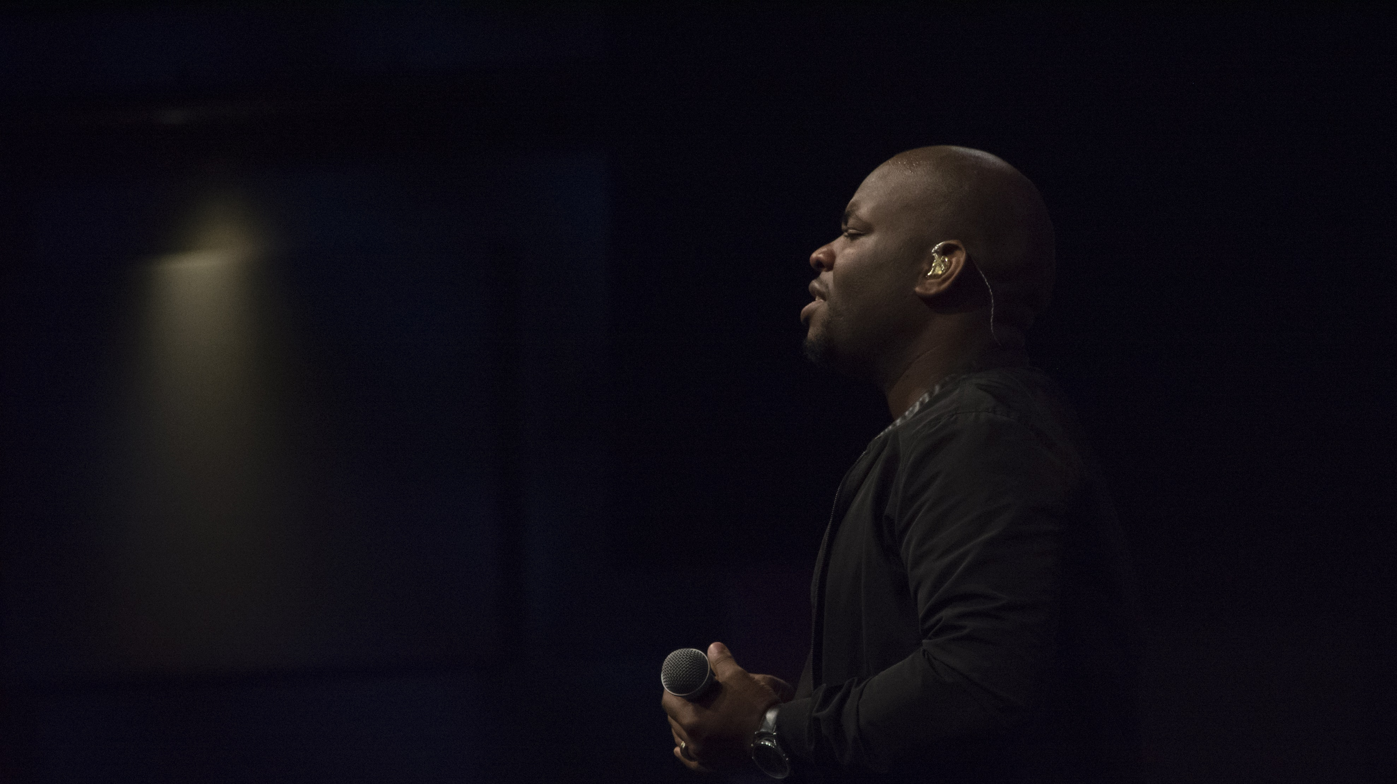
OYiM Leaders: The success of the operation is almost entirely dependent on these gifted and called leaders. It is recommended that these directors could receive a stipend or even be paid pastors or church planters provided they can focus on OYiM and not be tasked with local church leadership.
Oversee the day-to-day operations of the OYiM team.
Responsible for the mission strategy, training, spiritual growth and overall safety of the missionaries.
They are directly responsible to the Union Youth Director.

Slide 31
Suggested books to read available for sale at the adventistbookcenter.com
“Passport to Missions” by W. Guy Henderson “Ministry to the Cities” by Ellen G. White
“The Blueprint” by Rico Hill and Jared Thurmon “Evangelism” by Ellen G. White

