Slide 1


Adventist Youth Ministries

Slide 2

Module 1
A Christ-Centered
Discipleship Plan
Busi Khumalo (SID)
Adventist Youth Ministries

Slide 3

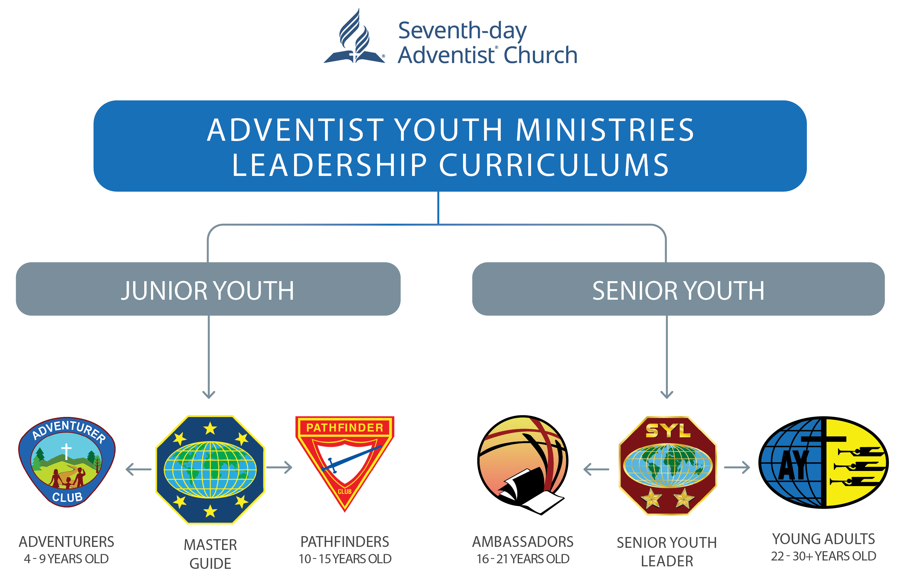
The Ambassador club is under the Senior Youth bracket.
The age group for this club is 16-21.
“A Christ-Centered Discipleship Plan” is the first of the seven modules.

Slide 4

Introduction
An ambassador is someone who represents another person or organization (heaven)
In each module, the participant is expected to have a partner (of the same gender) who will support them along the journey; develop an Individual Discipleship Plan (IDP); engage in a project for service to put into practice the module concepts
The duration of this module is 90 minutes (p. 11)
Each module has the leader’s guide and participant’s guide (workbook)

Slide 5
About this Module
                This module has 9 Sessions:
                I am called to be an ambassador for another world
                I am on an eternal journey to reflect Jesus
                An ambassador is designed to grow in community
                An ambassador’s role is to honor Jesus
                Openness
                Faith
                Dying to Self
                Baptism of the Holy Spirit
                Reflecting Jesus

Slide 6


I am Called to be an Ambassador
for Another World
This module
sets the
tone
for the
Ambassador Curriculum
                Materials
                for the Participant
                Each session requires these materials
                Handouts for each participant
                Pen and marker for each participant
                Blank sheets of paper for group work and signs
                Lesson
                Overview

Slide 7
I am Called to be an
Ambassador for Another World
                Learning Outcomes:
The outcomes cover three areas: Head, Hand and Heart and Evidence of learning
Head/Knowledge
Definition of an ambassador (Bible and dictionary), group discussion
Called as a lifelong ambassador for Jesus, group discussion
Revealing God’s character through one’s life, written report
A definition of character, written report

Slide 8
I am Called to be an
Ambassador for Another World
Hands/Doing
Participants should identify influences that shape their lives (heavenly or worldly), written report and discussion
Heart/Decision
Participants should choose to be an ambassador for Jesus and His kingdom, written or discussion
The Teaching Plan (actual lesson) for the leader follows the lesson overview

Slide 9
I am on an Eternal Journey to Reflect Jesus
Lesson Overview
                Notes for the Leader:
                This lesson challenges Ambassadors to make it their personal effort to follow Jesus consistently into eternity
                Learning Outcomes:
The outcomes cover three areas: Head, Hand and Heart and Evidence of learning
Head/Knowledge
Understand the concept of spiritual journey, discussion
Know the objective of embarking on a spiritual journey, discussion
Understand that this journey continues into eternity, discussion

Slide 10
I am on an Eternal Journey to Reflect Jesus
Hands/Doing
Create their own individual discipleship plan, discussion and written report
Heart/Decision
Desire to make reflecting Jesus their highest priority, prayer
The Teaching plan (actual lesson) for the leader follows after the lesson overview

Slide 11
An Ambassador is Designed to Grow in Community
Lesson Overview
                Notes for the Leader:
                One becomes a true ambassador in the context of the community
                Learning Outcomes:
The outcomes cover three areas: Head, Hand and Heart and Evidence of learning
Head/Knowledge
Know the biblical basis of growing into the fullness of God in community, written report and discussions

Slide 12
An Ambassador is Designed to Grow in Community
Hands/Doing
Learn how to encourage someone as a spiritual companion, discussion
Heart/Decision
Desire to grow in community, discussion
The Teaching plan (actual lesson) for the leader follows the lesson overview

Slide 13
An Ambassador’s Role is to Honor Jesus
Lesson Overview
                Notes for the Leader:
This lesson focuses on the idea that Jesus is honored as ambassadors dedicate their lives to revealing the character of Jesus to others and establishing communities dedicated to restoring broken people back into the image of God
                Learning Outcomes:
The outcomes cover three areas: Head, Hand and Heart and Evidence of learning
Head/Knowledge
Understand what is at the foundation of the call to come out of Babylon, discussion
Know the primary purposes of God and Paul, discussion
Memorize the seven main components of the bible story and explain how they relate to the ambassador’s task of reflecting Jesus, activity

Slide 14
An Ambassador’s Role is to Honor Jesus
Hands/Doing
Memorize the seven main components of the Bible story and explain how they relate to the ambassador’s task of reflecting Jesus, activity
Heart/Decision
Desire to honor Christ by revealing who He is to others, written report and discussion
The Teaching plan (actual lesson) for the leader follows the lesson overview

Slide 15
Openness
Lesson Overview
                Notes for the Leader:
                Ambassadors will learn the importance of openness to God and how it induces spiritual growth
                Learning Outcomes:
The outcomes cover three areas: Head, Hand and Heart and Evidence of learning
Head/Knowledge
Gain knowledge on spiritual maturity, discussion
Understand the biblical idea of being closed and open, written report and discussion

Slide 16
Openness
Hands/Doing
Identify the areas in which they are closed to God
Heart/Decision
Desire to grow in openness to God, written report
The Teaching plan (actual lesson) for the leader follows the lesson overview

Slide 17
Faith
Lesson Overview
                Notes for the Leader:
                This lesson explores the importance of faith and how it can grow
                Learning Outcomes:
The outcomes cover three areas: Head, Hand and Heart and Evidence of learning
Head/Knowledge
Understand the importance of faith in the process of spiritual transformation, written report and discussions

Slide 18
Faith
Hands/Doing
Identify biblical promises that speak most to their present need, discussion and prayer
Heart/Decision
Desire to apply God’s words to their own lives, written report
The Teaching plan (actual lesson) for the leader follows the lesson overview

Slide 19
Dying to Self
Lesson Overview
                Notes for the Leader:
                The lesson explores the concept of dying to self
                Learning Outcomes:
The outcomes cover three areas: Head, Hand and Heart and Evidence of learning
Head/Knowledge
Understand the problem of having a sinful nature, discussion and written report
Understand the difference between sins and sin, discussion and written report
Understand the importance of sacrifice, discussion and written report

Slide 20
Dying to Self
Hands/Doing
Become familiar with Ellen White’s understanding of dying to self, presentation
Heart/Decision
Desire to apply the concept of sacrifice in their lives, written report
The Teaching plan (actual lesson) for the leader follows the lesson overview

Slide 21
Baptism of the Holy Spirit
Lesson Overview
                Notes for the Leader:
                Explores the biblical teaching of baptism of the Holy Spirit
                Learning Outcomes:
The outcomes cover three areas: Head, Hand and Heart and Evidence of learning
Head/Knowledge
Understand that the baptism of the Holy Spirit is a consequence of dying to self, written report and discussions
Ambassadors need to live with divine power and not their own efforts, verbal report

Slide 22
Baptism of the Holy Spirit
Hands/Doing
Identify important insights on the baptism of the Holy Spirit, verbal report
Heart/Decision
Desire to be filled with the Holy Spirit everyday, written report
The Teaching plan (actual lesson) for the leader follows the lesson overview

Slide 23
Reflecting Jesus
Lesson Overview
                Notes for the Leader:
                Ministry to others is a consequence of dying to self and baptism of the Holy Spirit, this lesson summarises the last three lessons and the sanctuary doctrine
                Learning Outcomes:
The outcomes cover three areas: Head, Hand and Heart and Evidence of learning
Head/Knowledge
Our connection with Jesus inspires us to serve others, written report and discussions
Understand the three priorities of mission, written report and discussions

Slide 24
Reflecting Jesus
Hands/Doing
Identify how their lives can be shaped by the three priorities for mission, discussion and prayer
Know what to do when someone is spiritually stuck, discussion and prayer
Heart/Decision
Desire to apply God’s words to their own lives, discussion
The Teaching plan (actual lesson) for the leader follows the lesson overview

Slide 25
Adventist Youth Ministries

