Slide 1
Notes:
New Beginnings

Slide 2
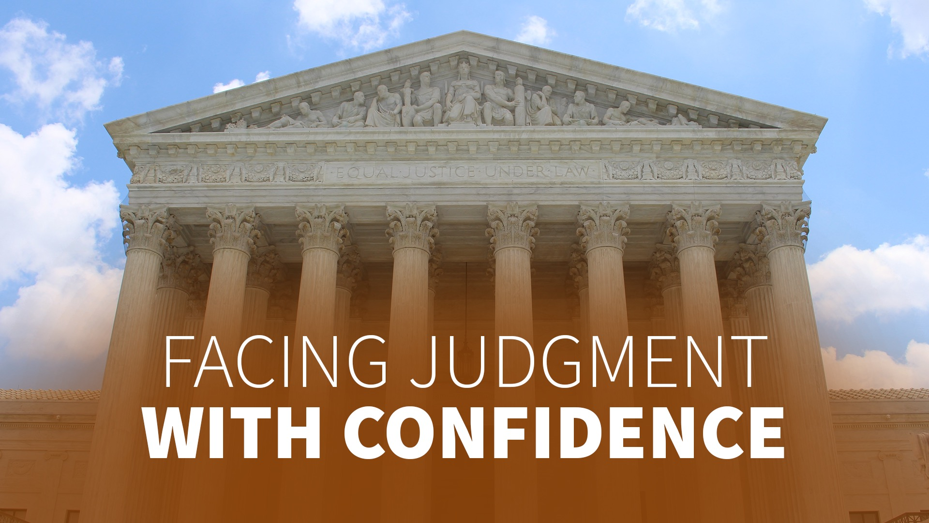
Notes:
The Judge Is On Your Side

Slide 3
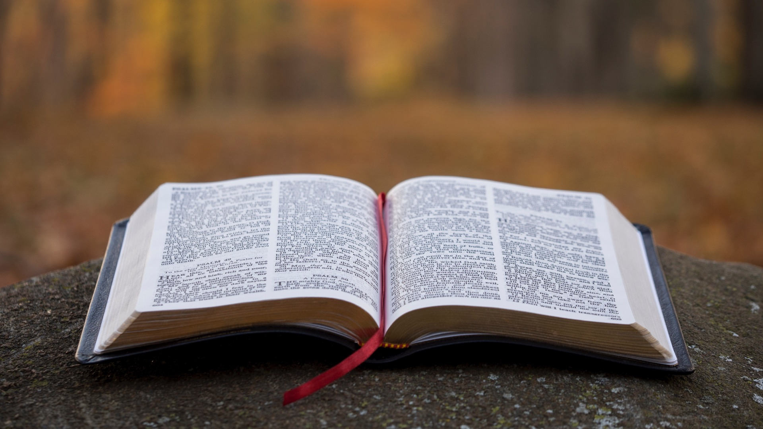
Notes:
James I, one of England’s kings, is said to have tried his hand as a judge. He carefully listened to one side of the case. He was just about ready to make up his mind when he listened to the other side of the case.
Then totally perplexed, he didn’t know what to do.
The people he first thought innocent now appeared guilty. The people who first appeared guilty now appeared innocent. He eventually abandoned his position as a judge in despair.
King James I put it this way, “I could get on very well hearing one side only, but when both sides have been heard by my soul, I know not which is right.”
I don’t think I’d want to have him as my judge!
In general, being in court is not something to which we look forward.
But as we read the Bible we find that the Bible writers spoke very positively of judgment – even as if it was something to look forward to and to anticipate!
The Psalmist wrote:

Slide 4
Notes:
(Text 4 slides: Psalm 96:11-13)
“Let the heavens rejoice, and let the earth be glad; Let the sea roar, and all its fullness;

Slide 5
Notes:
Let the field be joyful, and all that is in it. Then all the trees of the woods will rejoice….

Slide 6
Notes:
For He is coming, for He is coming to judge the earth. He shall judge the world with
righteousness, and the peoples with His truth.”
David looked forward to God making all things right. The apostle Paul also knew there was a day appointed for judgment:

Slide 7
Notes:
(Text: Acts 17:31)
“...He has appointed a day on which He will judge the world.” Acts 17:31.
And who is going to be involved in this great judgment?
The Bible clearly states that we will all be judged:

Slide 8
Notes:
(Text: 2 Corinthians 5:10)
“For we must all appear before the judgment seat of Christ. . .”
2 Corinthians 5:10.

Slide 9
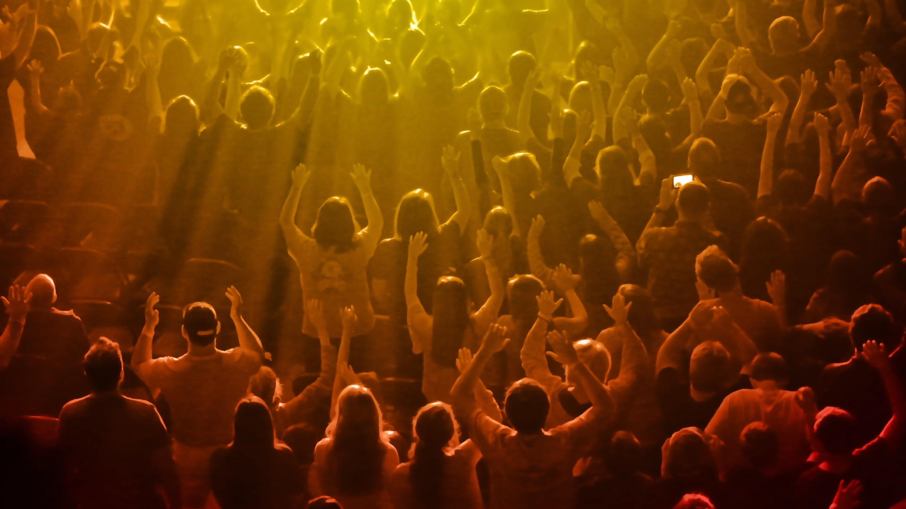
Notes:
Whether we believe it or not,
Whether we like it or not,
Whether we profess to be Christians or not,
Whoever we are – we all are to be held accountable for the decisions of our lives. The Bible says:

Slide 10
Notes:
(Text: Romans 14:12)
“So then each of us shall give account of himself to God.”
Romans 14:12.
Not only does the Bible reveal the truth that we will all be judged, it gives us great insights into how and when this judgment will take place.
The prophet Daniel wrote:

Slide 11
Notes:
(Text: Daniel 7:9, 10)
“I watched till thrones were put in place, And the Ancient of Days was seated;
His garment was white as snow, and the hair of His head was like pure wool.

Slide 12
Notes:
His throne was a fiery flame, Its wheels a burning fire;

Slide 13
Notes:
a fiery stream issued and came forth from before Him.
A thousand thousands ministered to Him;
ten thousand times ten thousand stood before Him. The court was seated, and the books were opened.”
Daniel 7:9, 10.
Here Daniel pictures God, the Father, or the Ancient of Days, seated upon His eternal throne, and surrounded by countless angels.
Now notice what Daniel saw next in his vision:

Slide 14
Notes:
(Text: Daniel 7:13)
“I was watching in the night visions, and behold,
one like the Son of Man, coming with the clouds of heaven!
He came to the Ancient of Days, and they brought Him near before Him.”
Daniel 7:13.

Slide 15
Notes:
Here the Son of God is pictured standing before the Ancient of Days.
How very much like a courtroom scene on Earth!
Presiding is the Ancient of Days, or God the Father.
There are witnesses, the holy angels who have seen and recorded everything.
And standing before the throne is Jesus – man’s Advocate, for John wrote:
(Text: 1 John 2:1 )
“We have an advocate with the Father, Jesus Christ the righteous...”
1 John 2:1.

Slide 16
Notes:
“Well,” you say, “everyone seems to be there but the one who is to be tried!”
In essence that is true, but let us notice what the Bible says:
(Text: Daniel 7:10)
“The court was seated, and the books were opened.”
Daniel 7:10.
Evidently these books contain the records of the deeds of those who stand trial, for Solomon wrote:

Slide 17
Notes:
(Text: Ecclesiastes 11:9)
“Rejoice, O young man, in your youth, and let your heart cheer you in the days of your youth;

Slide 18
Notes:
walk in the ways of your heart, and in the sight of your eyes;
but know that for all these God will bring you into judgment.”
Ecclesiastes 11:9.
And in the next chapter he writes:

Slide 19
Notes:
(Text: Ecclesiastes 12:14)
“For God will bring every work into judgment, including every secret thing, whether good or evil.” Ecclesiastes 12:14.
Even the words we speak are recorded and will be considered:

Slide 20
Notes:
(Text: Matthew 12:36, 37)
Matthew wrote: “For every idle word men may speak, they will give account of it in the day of judgment.

Slide 21
Notes:
For by your words you will be justified, and by your words you will be condemned.”
Matthew 12:36, 37.

Slide 22
Notes:
(Text: Malachi 3:16)
Malachi described these records this way: “Then those who feared the Lord spoke to one another, And the Lord listened and heard them;

Slide 23
Notes:
So a book of remembrance was written before Him for those who fear the Lord and who meditate on His name.”
Malachi 3:16.
God notices every time our hearts are drawn to Him. He marks down every word of encouragement that we give to somebody else and every deed of kindness.
King David was also confident in God’s record-keeping, for he said:

Slide 24
Notes:
(Text: Psalm 56:8)
“Put my tears into Your bottle; are they not in Your book?” Psalm 56:8.
God knows about the deepest sorrows of your life, too. He understands what we go through. The books of heaven are incredibly detailed!
God keeps such records not for His benefit, but for the benefit of the universe. There must be clear evidence of God’s love and justice in every case.
With God there are no secrets. Everything is transparent. And that’s the way He conducts the judgment as well.

Slide 25
Notes:
(Text: 1 Corinthians 4:5)
“...He will bring to light what is hidden in darkness and will expose the motives of men’s hearts...”
1 Corinthians 4:5.

Slide 26
Notes:
There will be no erasures, no cover-ups in that day!
Men may be able to fool their friends and even their families, but no one can fool God.
He reads the secrets of the heart!
You see, when our judgment day comes, we will find ourselves in one of two positions: either our entire record of past failures will have been covered by the blood of Jesus, or our record will stand to condemn us.
Our obedience is not the basis of our salvation, God’s grace is. But our good works do reveal that our hearts are committed to God.

Slide 27
Notes:
(Text: Matthew 16:27)
We are told that when Jesus comes, “...He will reward each according to his works.” Matthew 16:27.
How can the lives we live be the subject of the judgment when we are saved by grace?
Because living in harmony with God’s will is the spontaneous result of a heart full of love for God and man.
It is a love relationship with Jesus that motivates His followers to do good works.
Summing up in the Book of Ecclesiastes, Solomon said:

Slide 28
Notes:
(Text: Ecclesiastes 12:13, 14)
“Let us hear the conclusion of the whole matter:
Fear God and keep His commandments: for this is the whole duty of man.

Slide 29
Notes:
For God shall bring every work into judgment.”
Ecclesiastes 12:13, 14.
Since man’s relationship to Christ is to be judged by his conduct, there must be some clear standard by which to measure that conduct.

Slide 30
Notes:
Our judicial procedures here on earth are based on law. The purpose of a trial is to determine if a law has been broken.
The court compares the conduct of the person with the acceptable standard of conduct as defined by the law.
In God’s judgment there is a law or standard, and James makes it clear which law will be upheld.

Slide 31
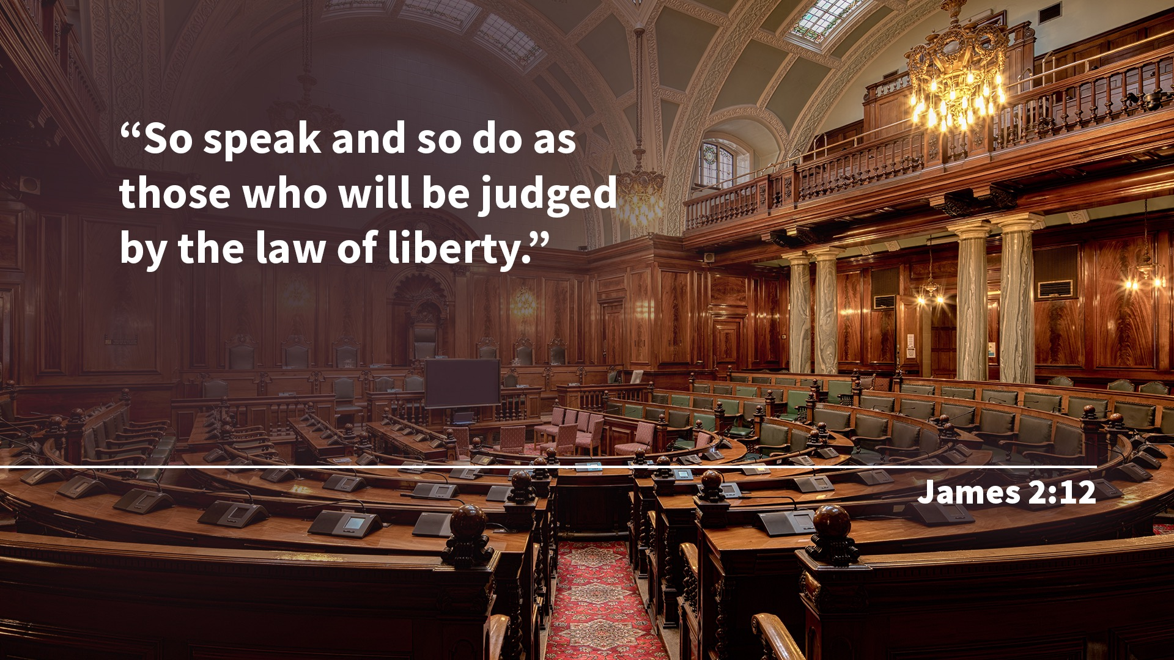
Notes:
(Text: James 2:12)
“So speak and so do as those who will be judged by the law of liberty.”
James 2:12.

Slide 32
Notes:
(Text: James 2:11)
In the previous verse, James mentions two of the commandments, “Do not commit adultery,” and “Do not kill.”
So obviously, God’s Ten Commandment law is called the “Law of Liberty” by which the lives of men will be judged.

Slide 33
Notes:
The judgment will simply determine on which side we stand in the great conflict between Christ and Satan.
Are we with Christ?
Have we let Him live out His life in us?

Slide 34
Notes:
Have we had a supreme love for Him and His will, as expressed in the Ten Commandments?
Is it our desire to follow His will by His strength?
Has He written His law in our hearts?
It is not enough to be declared righteous now; we must remain faithful to Him until He comes.
It is not enough to profess that we are followers of Christ; we must allow Jesus’ perfect life of obedience and faithfulness to be lived out in us.

Slide 35
Notes:
(Text: Matthew 7:21)
Jesus said, “Not everyone who says to Me, ‘Lord, Lord,’ shall enter the kingdom of heaven,
but he who does the will of My Father in heaven.”
Matthew 7:21.
The whole controversy between good and evil, between Christ and Satan, is about God’s character of love.

Slide 36
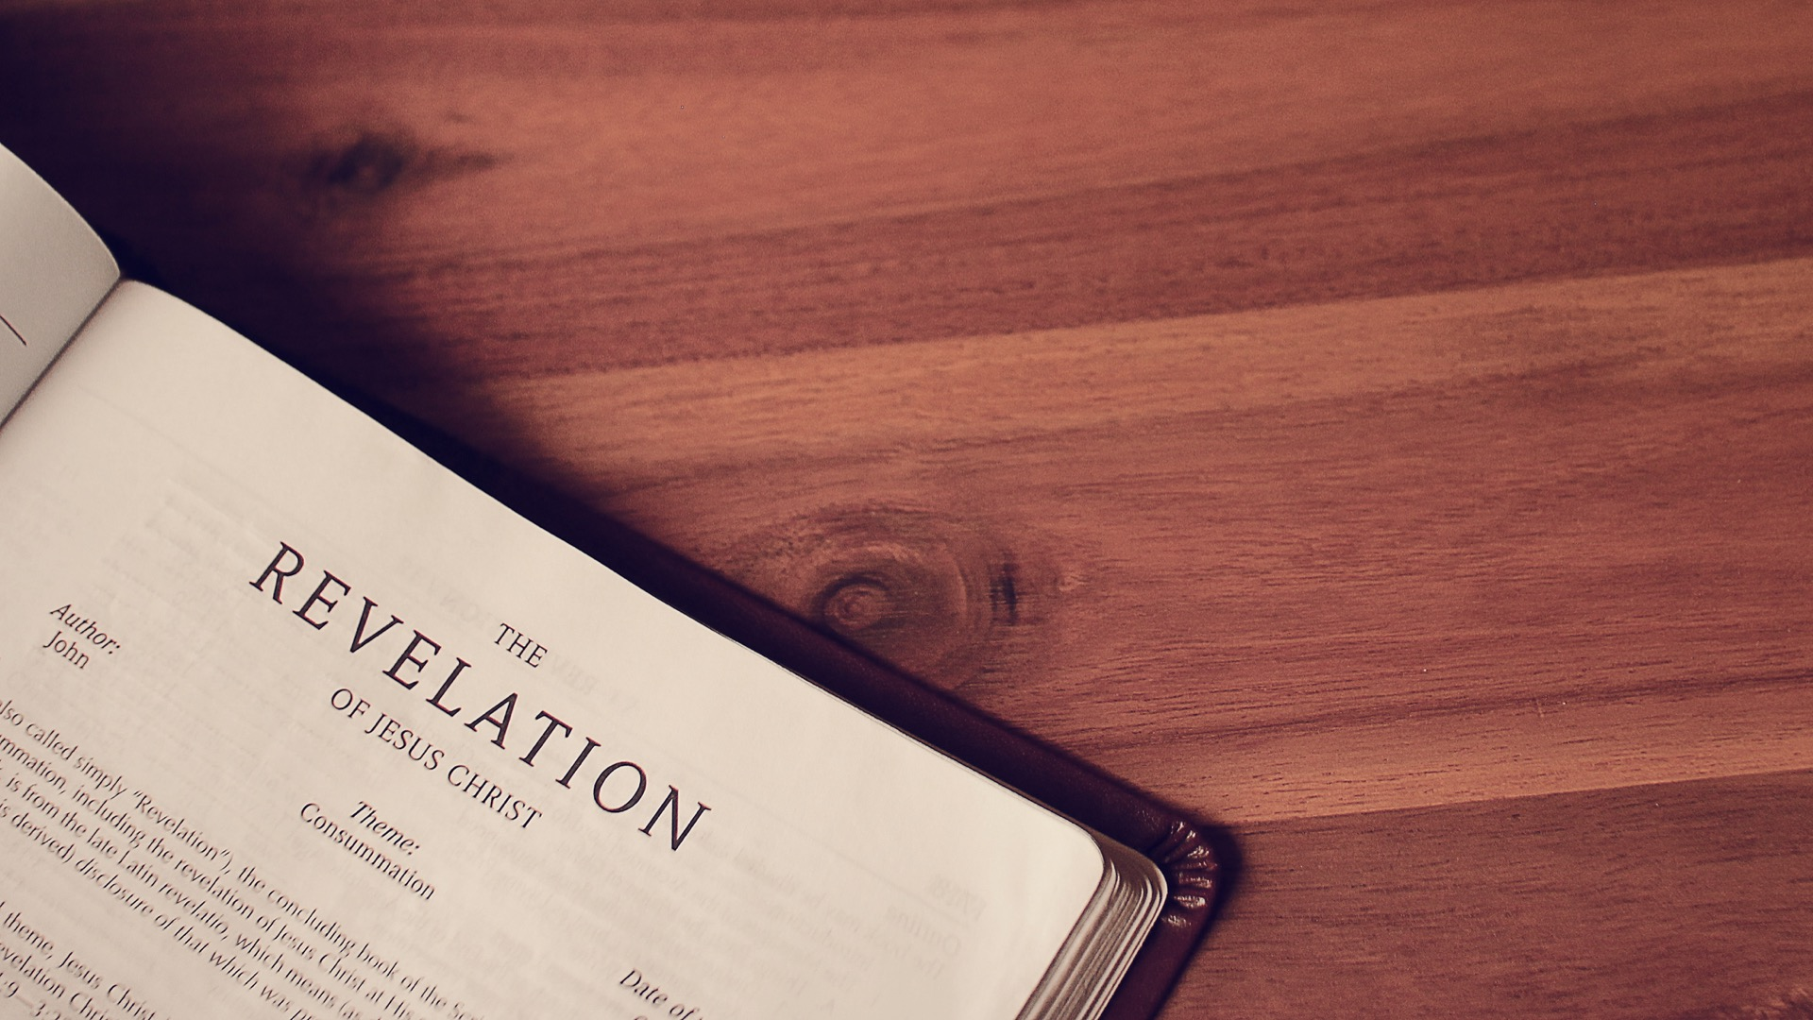
Notes:
And the law is a written expression of that love.
No wonder it is the standard used in the final judgment!
But even more exciting is the Bible’s teaching that the judgment is already in session now!
That is why, in the closing chapters of the Book of Revelation, John outlines the world’s last warning and invitation in these words:

Slide 37
Notes:
(Text: Revelation 14:6, 7)
“Then I saw another angel flying in the midst of heaven,

Slide 38
Notes:
having the everlasting gospel to preach to those who dwell on the earth—
to every nation, tribe, tongue, and people—

Slide 39
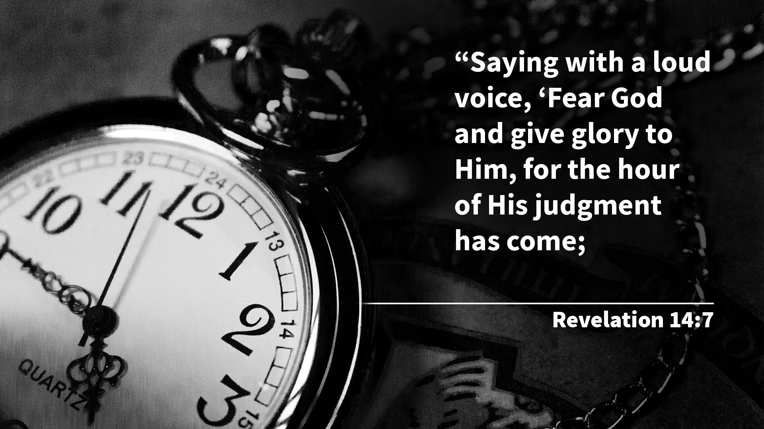
Notes:
saying with a loud voice, ‘Fear God and give glory to Him, for the hour of His judgment has come;

Slide 40
Notes:
and worship Him who made heaven and earth, the sea and springs of water’.”
Revelation 14:6, 7.

Slide 41
Notes:
You will notice that this message does not say, “the judgment will come,” it says “the hour of his judgment has come.”
We will be looking more at these Three Angels’ Messages in coming studies. But notice what happens after they are given!

Slide 42
Notes:
(Text: Revelation 14:14, 15)
“Then I looked, and behold, a white cloud, and on the cloud sat One like the Son of Man,
having on His head a golden crown, and in His hand a sharp sickle.

Slide 43
Notes:
And another angel came out of the temple, crying with a loud voice to Him who sat on the cloud,

Slide 44
Notes:
‘Thrust in Your sickle and reap, for the time has come for You to reap,
for the harvest of the earth is ripe.’”
Revelation 14:14, 15.

Slide 45
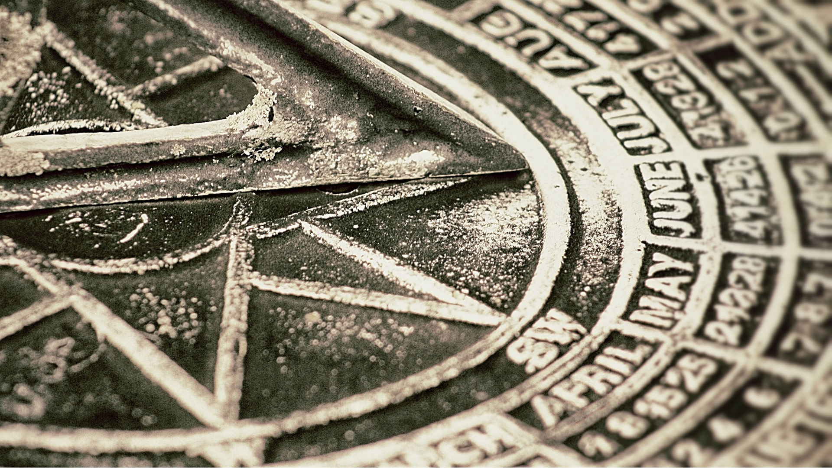
Notes:
What is the harvest of the earth? It is the end of the world. It is the second coming of Christ. What occurs before the second coming of Jesus? God’s judgment.
His judgment reveals who is ready for His return. But we must pause to investigate this subject in greater depth. Maybe you are wondering when this judgment began?

Slide 46
Notes:
The key is found in a most remarkable prophecy in the Book of Daniel!
(Text: Daniel 8:14)
“Unto two thousand and three hundred days; then shall the sanctuary be cleansed.”
Daniel 8:14, KJV. This is a fascinating verse. It marks the end of the vision here in Daniel 8, for immediately following this prediction the angel Gabriel begins explaining the interpretation of the vision.
In Gabriel’s explanation we see that this vision is a parallel to the one we read about in Daniel 7 that revealed the judgment scene just before the end of the world. Notice what he said about this time prophecy:

Slide 47
Notes:
(Text: Daniel 8:26)
“And the vision of the evenings and mornings which was told is true;
(Text: Daniel 8:26)
Therefore seal up the vision, for it refers to many days in the future.”
This announcement was so shocking to Daniel that the Bible then records:

Slide 48
Notes:
(Text: Daniel 8:27)
“And I, Daniel, fainted and was sick for days…. I was astonished by the vision, but no one understood it.”
Why would Daniel be so dramatically affected by the vision? Why did he not understand it even after Gabriel had explained it to him? The evidence is overwhelming that it was this last portion of the prophecy that really bothered him and that he just couldn’t understand.
We must remember that Daniel and his people had been carried into Babylonian captivity. The temple in Jerusalem, along with the rest of the city, lay in ruins. But Daniel found hope in the prophecy of Jeremiah, which predicted that this exile would last seventy years (Jeremiah 25:11). And he knew that these seventy years were just about finished! He was looking forward to Jerusalem’s restoration! But could this prophecy mean that it would still be many more years before the temple and the city would be restored?
In Daniel chapter nine we find the prophet studying again the prophecy of Jeremiah, and then praying earnestly, repentantly for God’s mercy upon His people.

Slide 49
Notes:
(Text: Daniel 9:19)
“O Lord, hear! O Lord, forgive! O Lord, listen and act! Do not delay for Your own sake,
my God, for Your city and Your people are called by Your name.”
In response to this prayer of Daniel the angel Gabriel was again sent to finish explaining the vision. He tells Daniel to “consider the vision” and begins right where Daniel had previously fainted, with an explanation of the 2300-day prophecy. Let’s listen to what he had to say.

Slide 50
Notes:
(Text: Daniel 9:24)
“Seventy weeks are determined for your people and for your holy city, to finish the transgression, to make

Slide 51
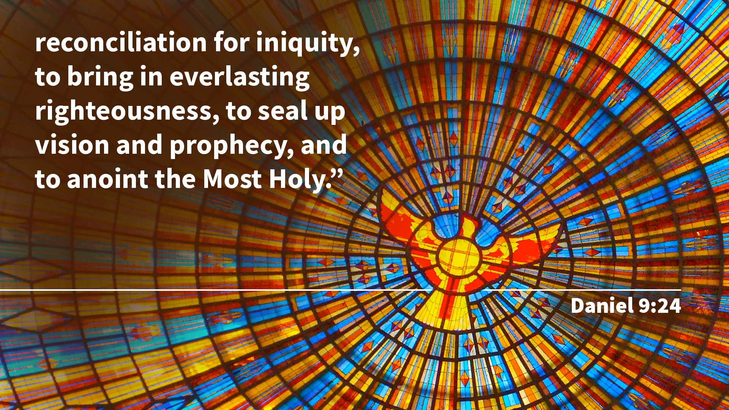
Notes:
an end of sins, to make reconciliation for iniquity, to bring in everlasting righteousness, to seal up vision and
prophecy, and to anoint the Most Holy.”

Slide 52
Notes:
(Text: Ezekiel 4:6)
In symbolic prophecy we note that a day represents a year. “I have appointed thee each day for a year.” Ezekiel 4:6. So 2300 days represents 2300 years. Seventy weeks (or 490 days) represents 490 years.

Slide 53
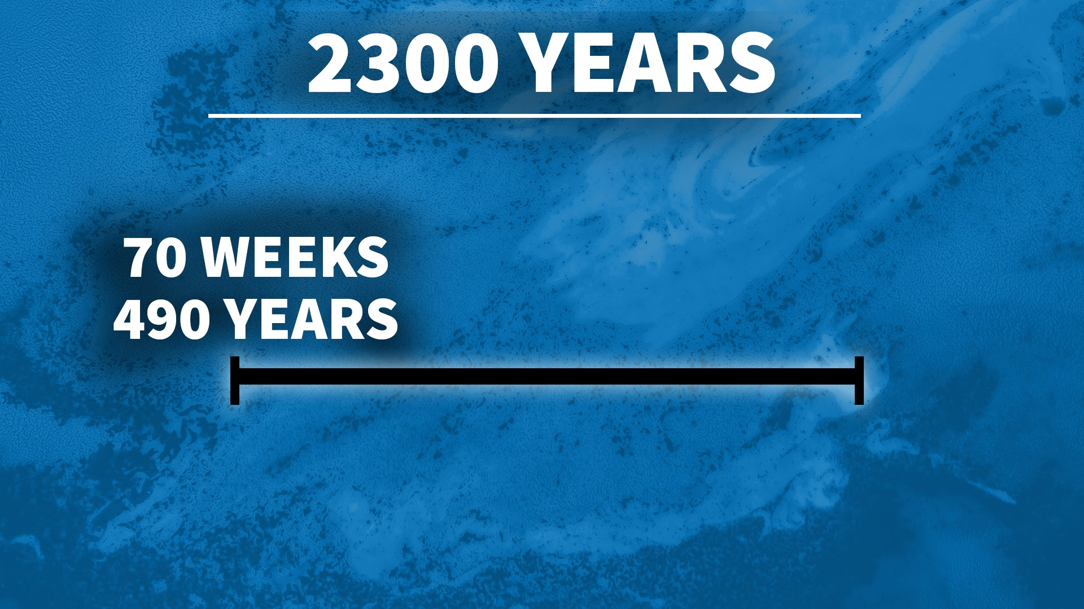
Notes:
Daniel is being told that the first seventy weeks, or 490 days, of the 2300-day prophecy are set aside for Daniel and his people.
But when would this time prophecy begin? Daniel 8:14 only revealed what would happen at the end, but not what would mark the beginning. Now, finally Daniel is about to get his explanation.

Slide 54
Notes:
(Text: Daniel 9:25)
“Know therefore and understand, that from the going forth of the command to restore and build Jerusalem until Messiah

Slide 55
Notes:
the prince there shall be seven weeks and sixty-two weeks; the street shall be built again,
and the wall, even in troublesome times.”
Daniel must have been extremely relieved when he understood that the restoration of Jerusalem would mark the beginning of the 2300-day prophecy, not the end! But what about these time predictions?
This phenomenal prophecy predicted the timing of the rebuilding of Jerusalem, the advent of the Messiah, His death in our behalf, and the gospel message being entrusted to the Gentiles!

Slide 56
Notes:
History records that the decree by the Persian King Artaxerxes to restore and rebuild Jerusalem was made in the year 457 B.C. Sixty-nine weeks, or 483 years, brings us down to the year 27 A.D. – the year Jesus was baptized by John the Baptist in the Jordan River. This began the last week of opportunity for the Jews, as a nation, to turn from their rebellious ways.

Slide 57
Notes:
At His baptism, in 27 A.D., Jesus was anointed by the Holy Spirit, and for the next three and a half years worked to save the Jews from their own stubborn rebellion and sin. But after three and a half years, in the middle of that last prophetic week as the prophecy predicted, He was crucified, in the Spring of 31 A.D. Three and half years later, after the stoning of Stephen in 34 A.D., the gospel was given to the Gentiles.

Slide 58
Notes:
Since history has demonstrated the accuracy of this prophecy for the first 490 years, we can have confidence in the rest of the prophecy as well. Adding the remainder of the 2300 years to the end of the 490 brings us to the year 1844, when Daniel was told the sanctuary would be cleansed!

Slide 59
Notes:
You might ask, “How does the judgment relate to this cleansing of the sanctuary Daniel foretold would occur at the end of the 2300 days?”
First we have to understand a little bit about the sanctuary symbolism found in the Bible. The Bible describes two sanctuaries – one on earth, the other in heaven.

Slide 60
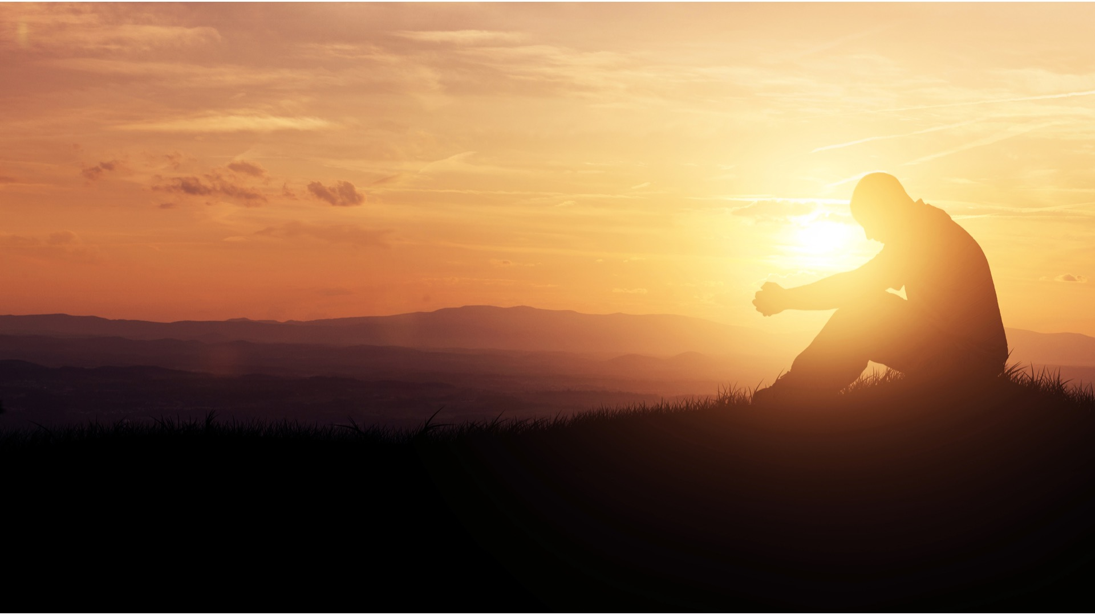
Notes:
Today, if we sin, we ask God to forgive our sins because Jesus died in our place to pay the sin debt.
However, before Calvary, the people had no sacrifice to look back to, so by faith they looked forward instead, to the time when the “Lamb” of God would die for them.
By the act of sacrificing an innocent animal, they acknowledged their belief in a Savior who would come and die to make it possible for them to have forgiveness.
In ancient Israel, the people daily brought their sacrifices to the sanctuary.
There they confessed their sins and took the life of a lamb to show their faith in the future death of Jesus, the Son of God.
Then their sins were symbolically transferred to the sanctuary by the priest sprinkling the blood from the animal before the veil of the Most Holy Place in the sanctuary.

Slide 61
Notes:
Once a year the children of Israel held a most solemn and sacred service, called the Day of Atonement. This was the day of the cleansing of the sanctuary. For the people of Israel, it was also understood as a day of judgment.
Ten days before the Day of Atonement, the trumpets were blown, reminding the Israelites that it was time for them to take inventory of their lives—to repent and confess their sins.
All who failed to do so were banished from the camp.

Slide 62
Notes:
“For on that day the priest shall make atonement for you, to cleanse you,
that you may be clean from all your sins before the Lord.”
Leviticus 16:30.

Slide 63
Notes:
Now, the Book of Hebrews makes it plain that the earthly sanctuary and its service was an illustration of the sanctuary in heaven where Christ our High Priest forgives our sins.
(Text: Hebrews 8:1, 2)
Paul says, “We have such a High Priest, who is seated at the right hand of the throne of the Majesty in the heavens,

Slide 64
Notes:
a Minister of the sanctuary and of the true tabernacle which the Lord erected, and not man.”
Hebrews 8:1, 2.

Slide 65
Notes:
(Text: Hebrews 9:11, 12, 24)
Again: “But Christ being come an High Priest...

Slide 66
Notes:
by His own blood he entered in once into the Holy Place,
having obtained eternal redemption for us...

Slide 67
Notes:
for Christ is not entered into the holy places made with hands,

Slide 68
Notes:
which are the figures of the true; but into heaven itself,
now to appear in the presence of God for us:...”
Hebrews 9:11, 12, 24.
Christ’s death on Calvary provided a complete sacrificial atonement for our sins.

Slide 69
Notes:
(Text: Hebrews 7:25)
“...He is also able to save to the uttermost those who come to God through Him,
since He always lives to make intercession for them.”
Hebrews 7:25.
The true tabernacle or sanctuary is in heaven. Everything which happens on earth is only a pattern of what happens in the plan of salvation.
Jesus is the Lamb who dies. Jesus is the priest who lives. And just as Israel’s high priest entered the Most Holy Place once a year, so Jesus at the end of time entered the Most Holy Place to perform His work of judgment.

Slide 70
Notes:
(Text: Matthew 10:32, 33)
In the judgment, it is our relationship and attitude toward Christ which determines our eternal destiny.
Christ longs to save us.
He is doing everything He can to save us. He says, “Therefore, whoever confesses me before men,
him I will also confess before My Father who is in heaven.

Slide 71
Notes:
But whoever denies Me before men, him I will also deny before My Father who is in heaven.”
Matthew 10:32, 33.

Slide 72
Notes:
You see, you don’t have to stand alone in the judgment!
If we have confessed Christ, He will confess us before His Father.
If we are Christ’s, He is our Advocate. Through Jesus we will stand before God as if we had never sinned.
Our records will show only the lovely life of our Savior, and we get credit for His perfect life.
So, friend, there is nothing to fear about the time of judgment. It is a time of soul searching, yes. But it is a time when Jesus longs to cleanse our hearts from sin by the power of His blood, the power of His grace. It is a time for Him to stand in our behalf, to affirm before the watching universe our decision to follow Him with all our heart and soul.

Slide 73
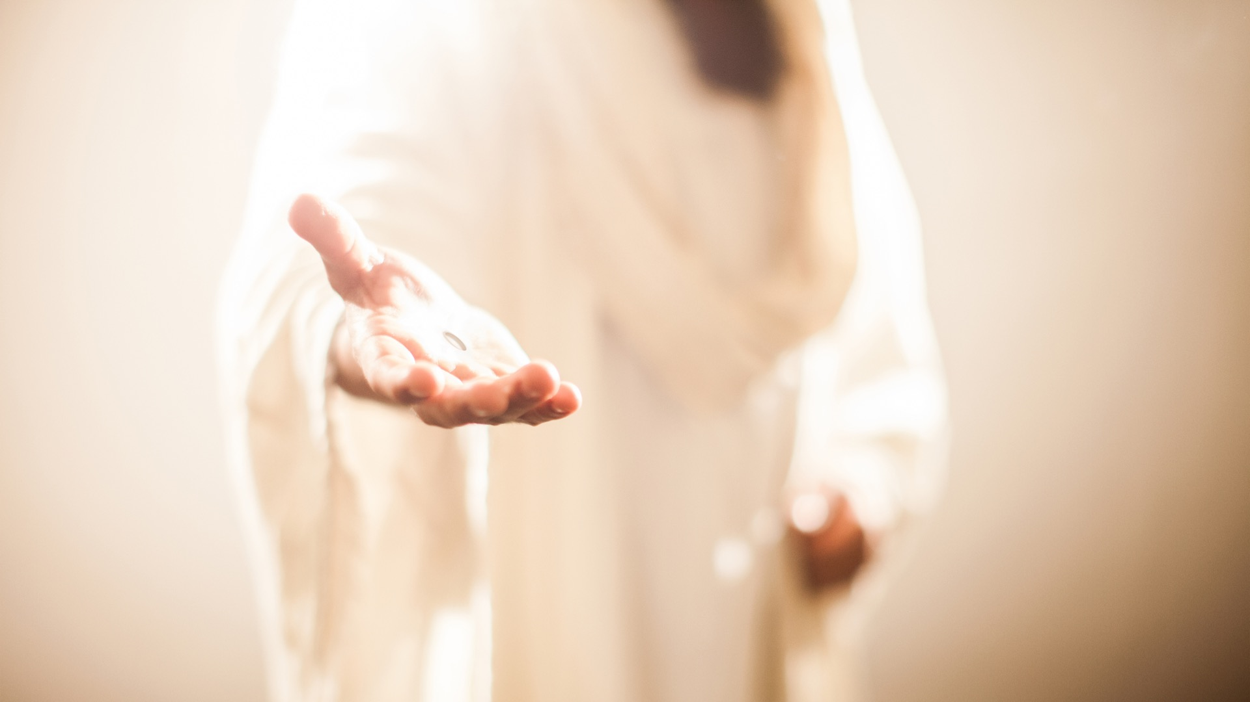
Notes:
Friend, Jesus longs to affirm your eternal salvation before the watching universe!
He longs for you to accept His sacrifice on Calvary.
He longs for you to confess your sins to Him so He can blot them out.
He longs to have your name written in the Book of Life.
Would you like to open your heart to Jesus right now? Would you like to ask Him to take out of your life anything which would keep you from being in His kingdom?
Would you like your sins covered – covered with the blood of Jesus? Would you like Christ to step forth and say, “Yes, this man, this woman, is one of mine.
I have forgiven their sins. I have canceled their debt. I have pardoned their guilt. Their sins are covered with my blood. Blot them out of the records forever.”
Is this your desire? Do you want to say, “Yes, Lord, take my life, I want to be yours?”
Why not lift your hand to heaven right now as we pray?
[Suggested Prayer Next Slide]

Slide 74
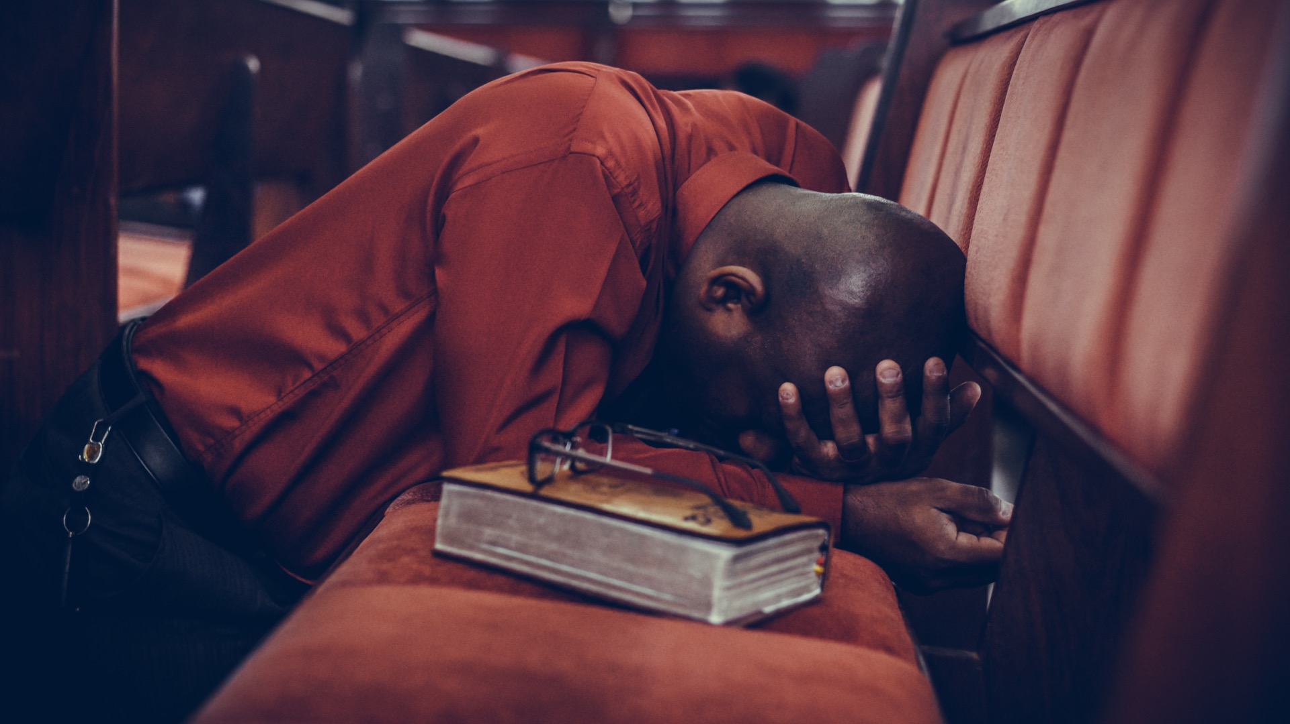
Notes:
[Suggested Prayer]
“Dear Jesus, Thank you for shedding your blood in our behalf. Thank you for inviting us to exchange our guilt, our sins, our stained characters for your perfect righteousness. And thank you for this message of the judgment. Thank you for doing a work in our hearts as we cooperate with you, to cleanse us from sin and write your law within us. Thank you for the promise that through your plan of salvation, including the judgment, you are restoring this world and your people to your perfect plan. Thank you for the promise of a new heavens and a new earth, where righteousness dwells. Lord, we long to be a part of that perfect world. We long to be reunited with you, to see you face-to-face. As we give our hearts and lives to you tonight, we ask that we will always choose our relationship with you over the things of this world. Write our names in the Book of Life, we pray, and by your grace and through your power may they always remain. We ask and pray these things in Jesus’ name, Amen.”

